Slide 1
Neu

Slide 2
Multiple testing problem:
https://www.ncbi.nlm.nih.gov/pmc/articles/PMC117123/

Slide 3
Normalisiert mit 12 stabilsten miRNAs
miR-23a-3p
miR-23b-3p
miR-24-3p
mIR-26a-3p
miR-30b-3p
miR-22-3p
miR-16-5p
miR-221-3p
miR-15a-3p
miR-29a-3p
Let-7f-5p
miR-29c-3p

Slide 4
Status 08.06.2020
12 miRNAs zu niedrig exprimiert (median < 2.5)
hsa-mir-9-5p
hsa-mir-125b-5p
hsa-mir-181a-3p
hsa-mir-296-5p
hsa-miR- 101-3p
hsa-miR- 378g
hsa-miR- 382-5p
hsa-miR- 1246
hsa-miR- 4454
miR-378i

Slide 5
Differential expression between cell lines

Slide 6
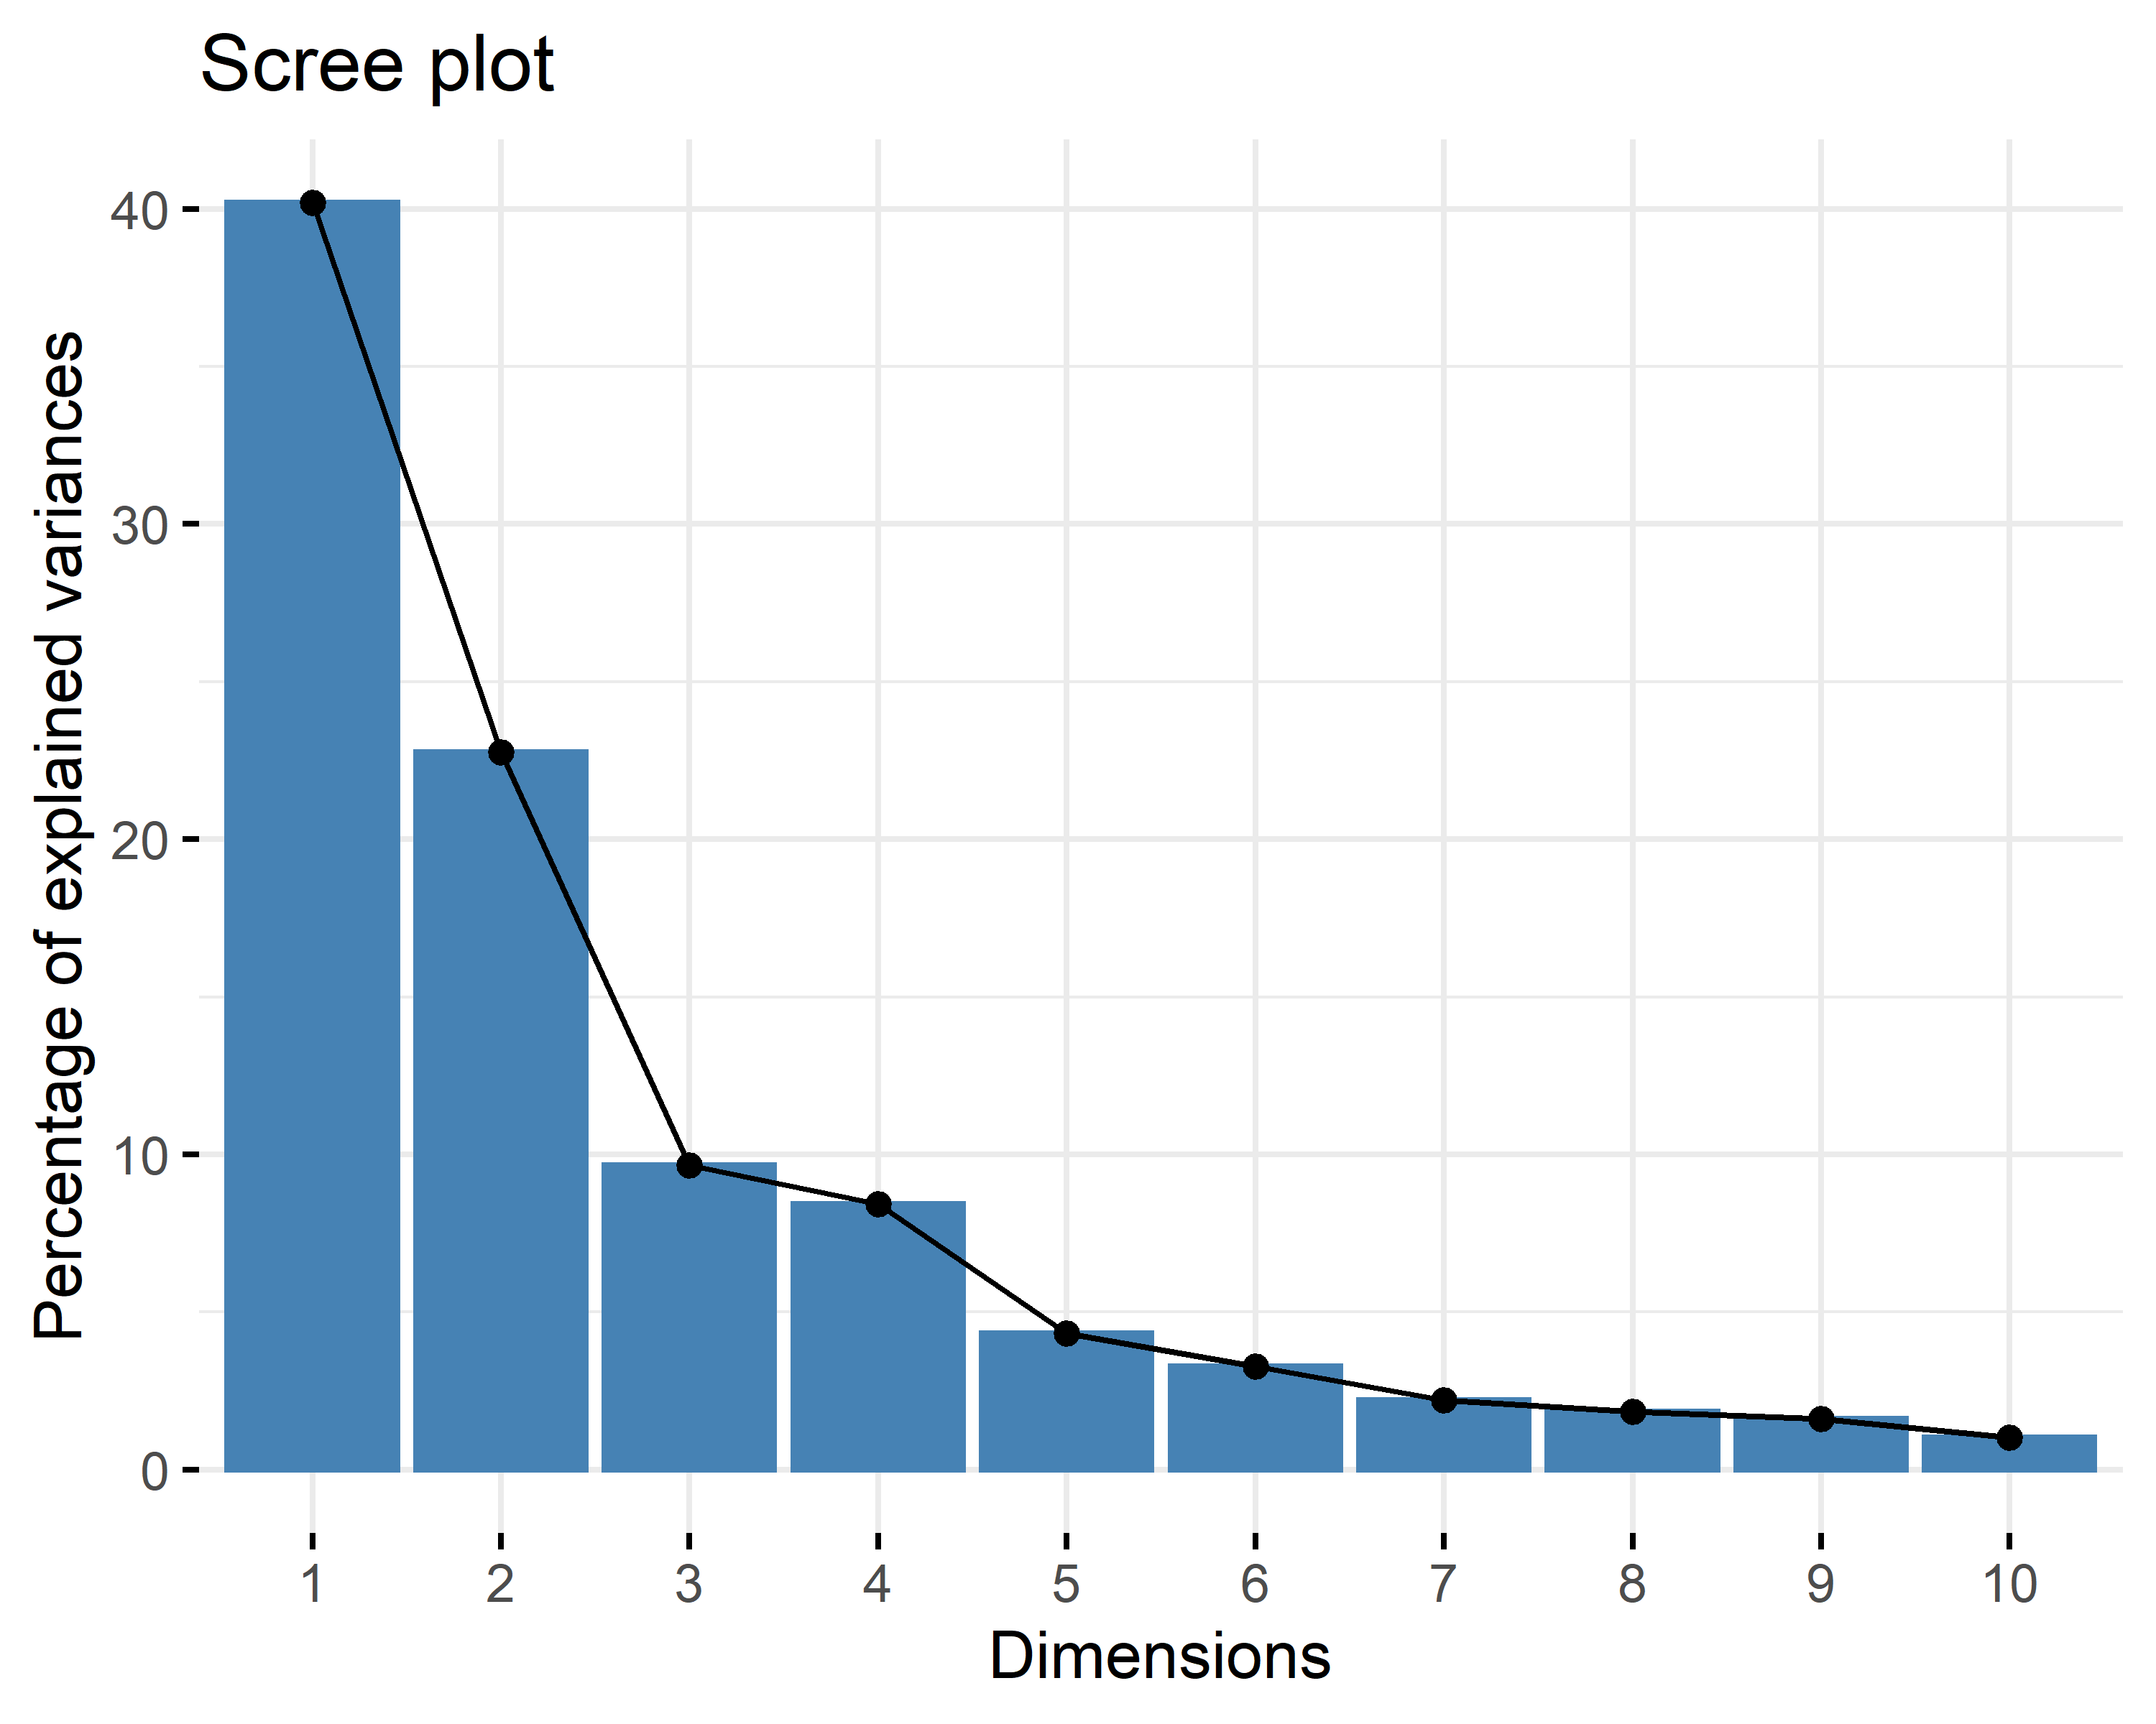
PCA
3 PCs account for 72 % variance explained → as data only used for descriptive purposes, cut-off sufficient (PC4 adds just 8.7% var explained and. This added value is negated by the loss in interpretability as 3 dimensional data still can be shown in a plot)
Scree plot showing the var explained

Slide 7
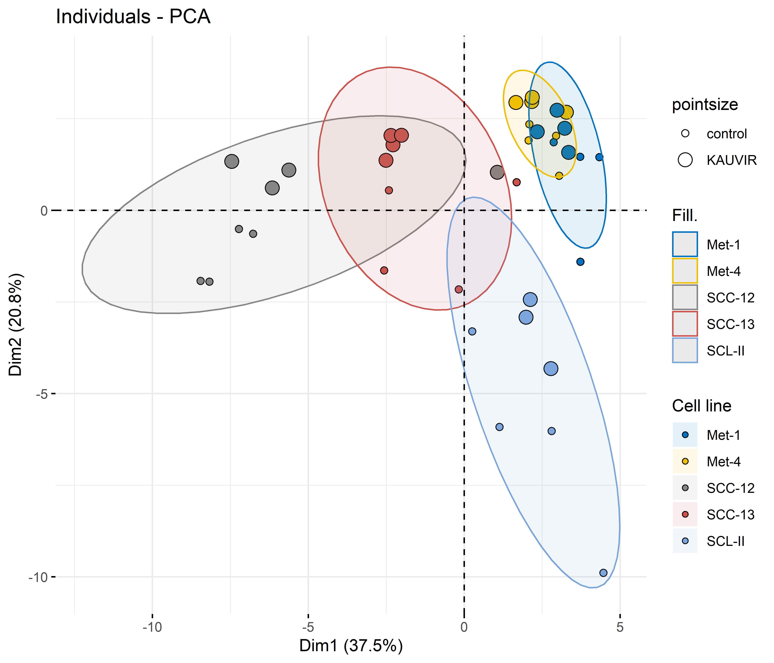
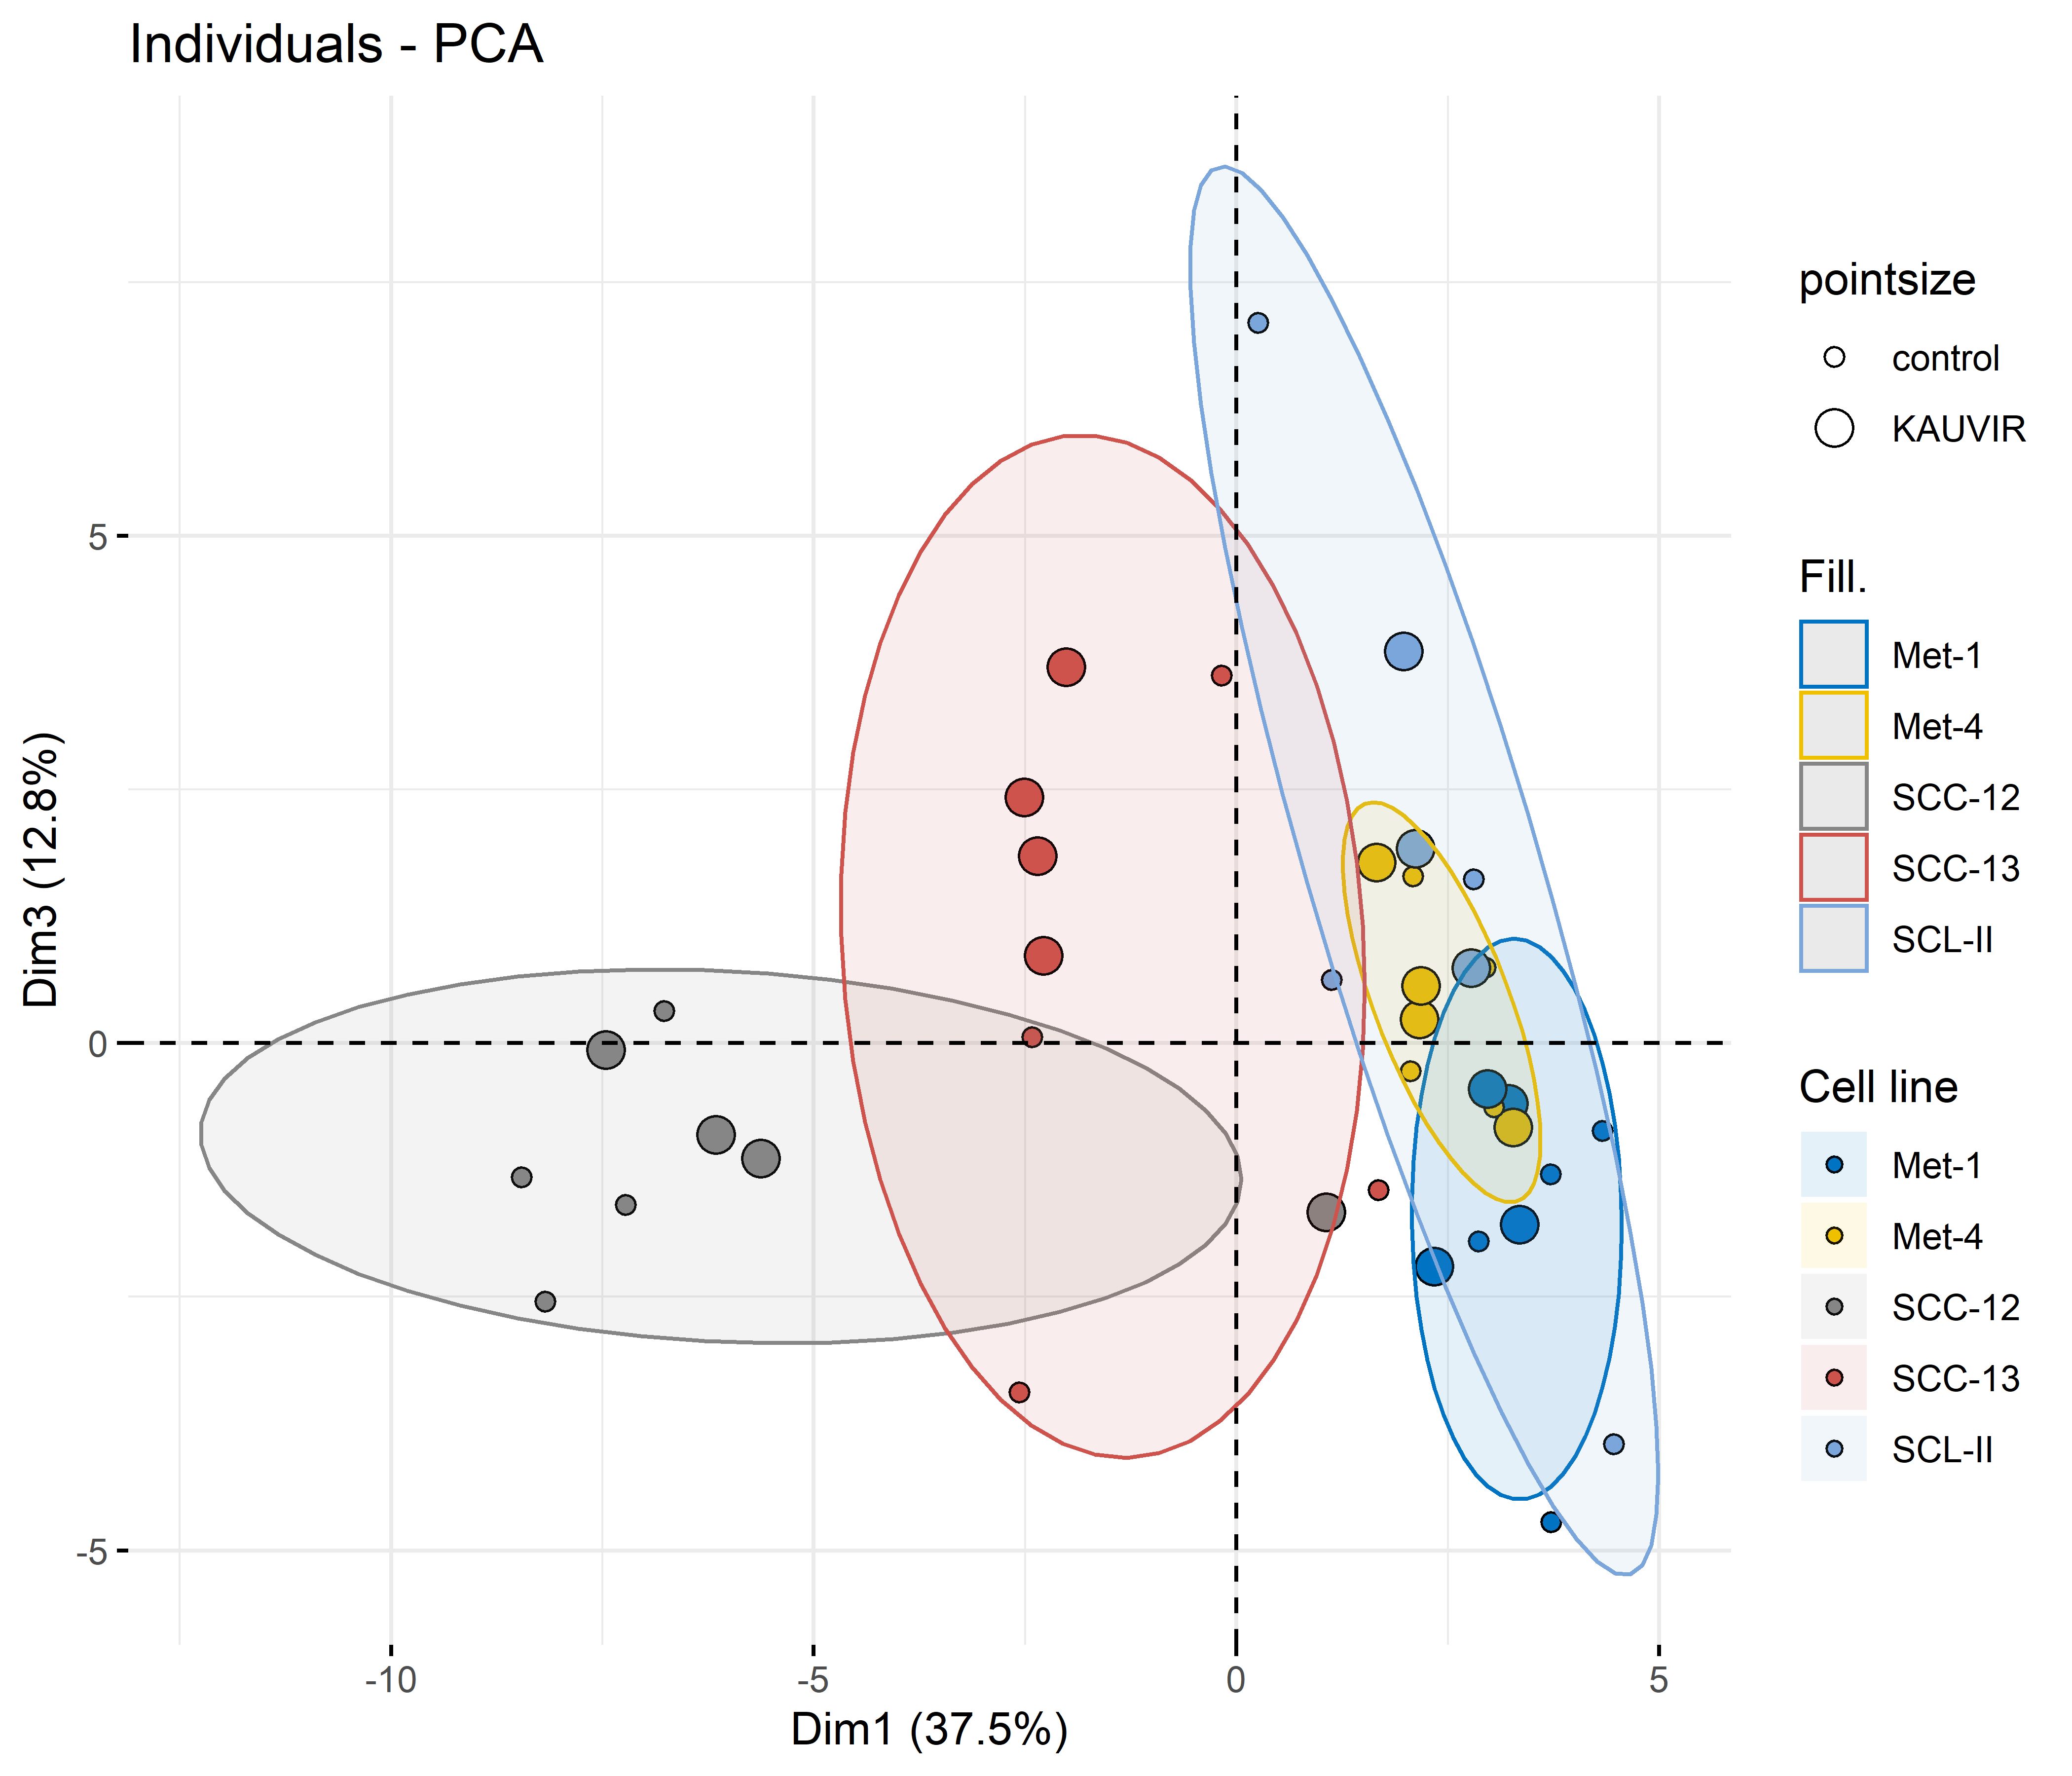
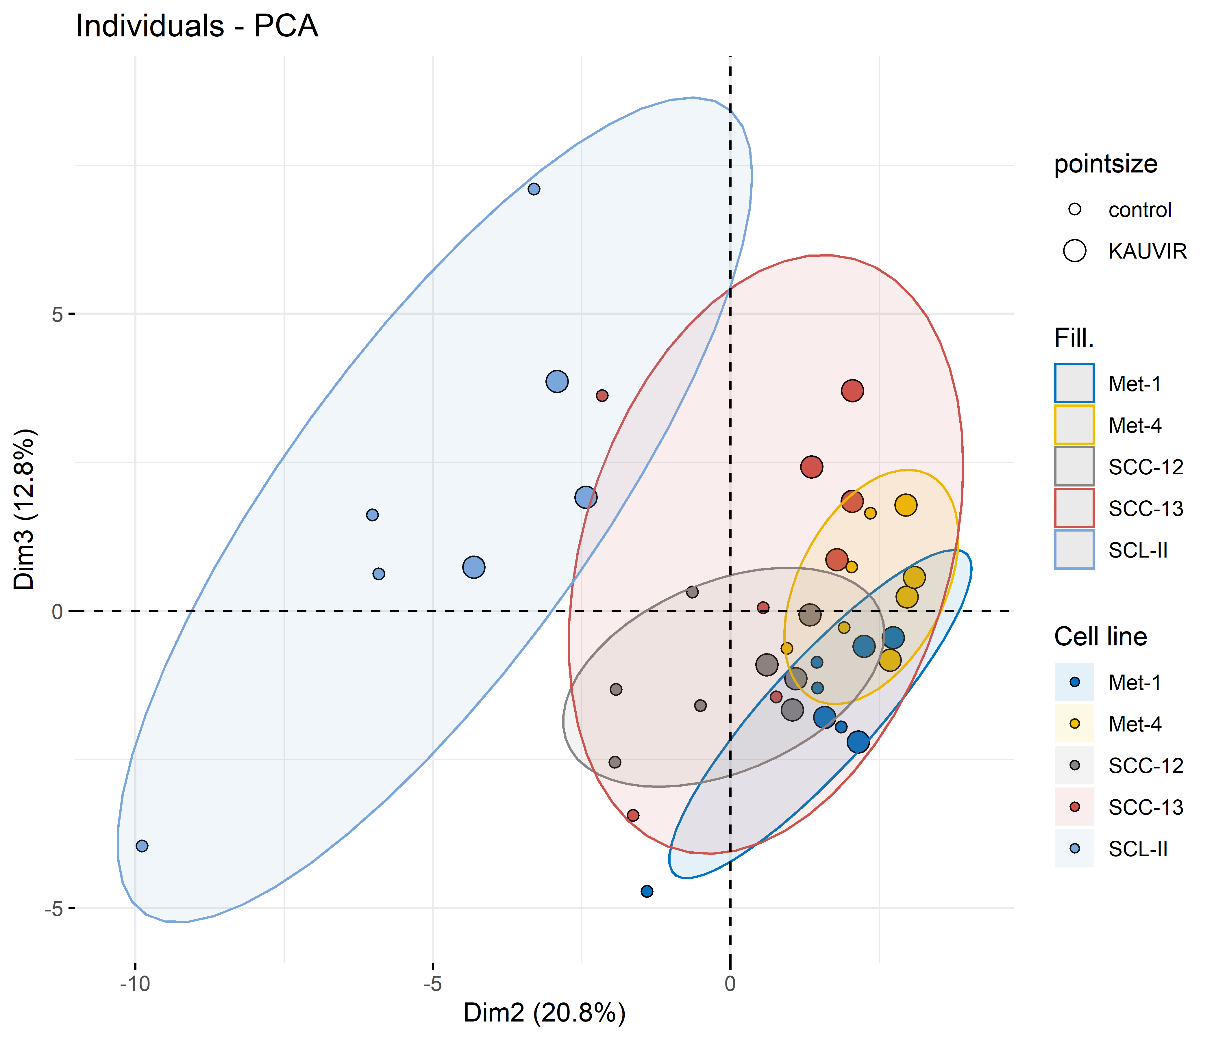
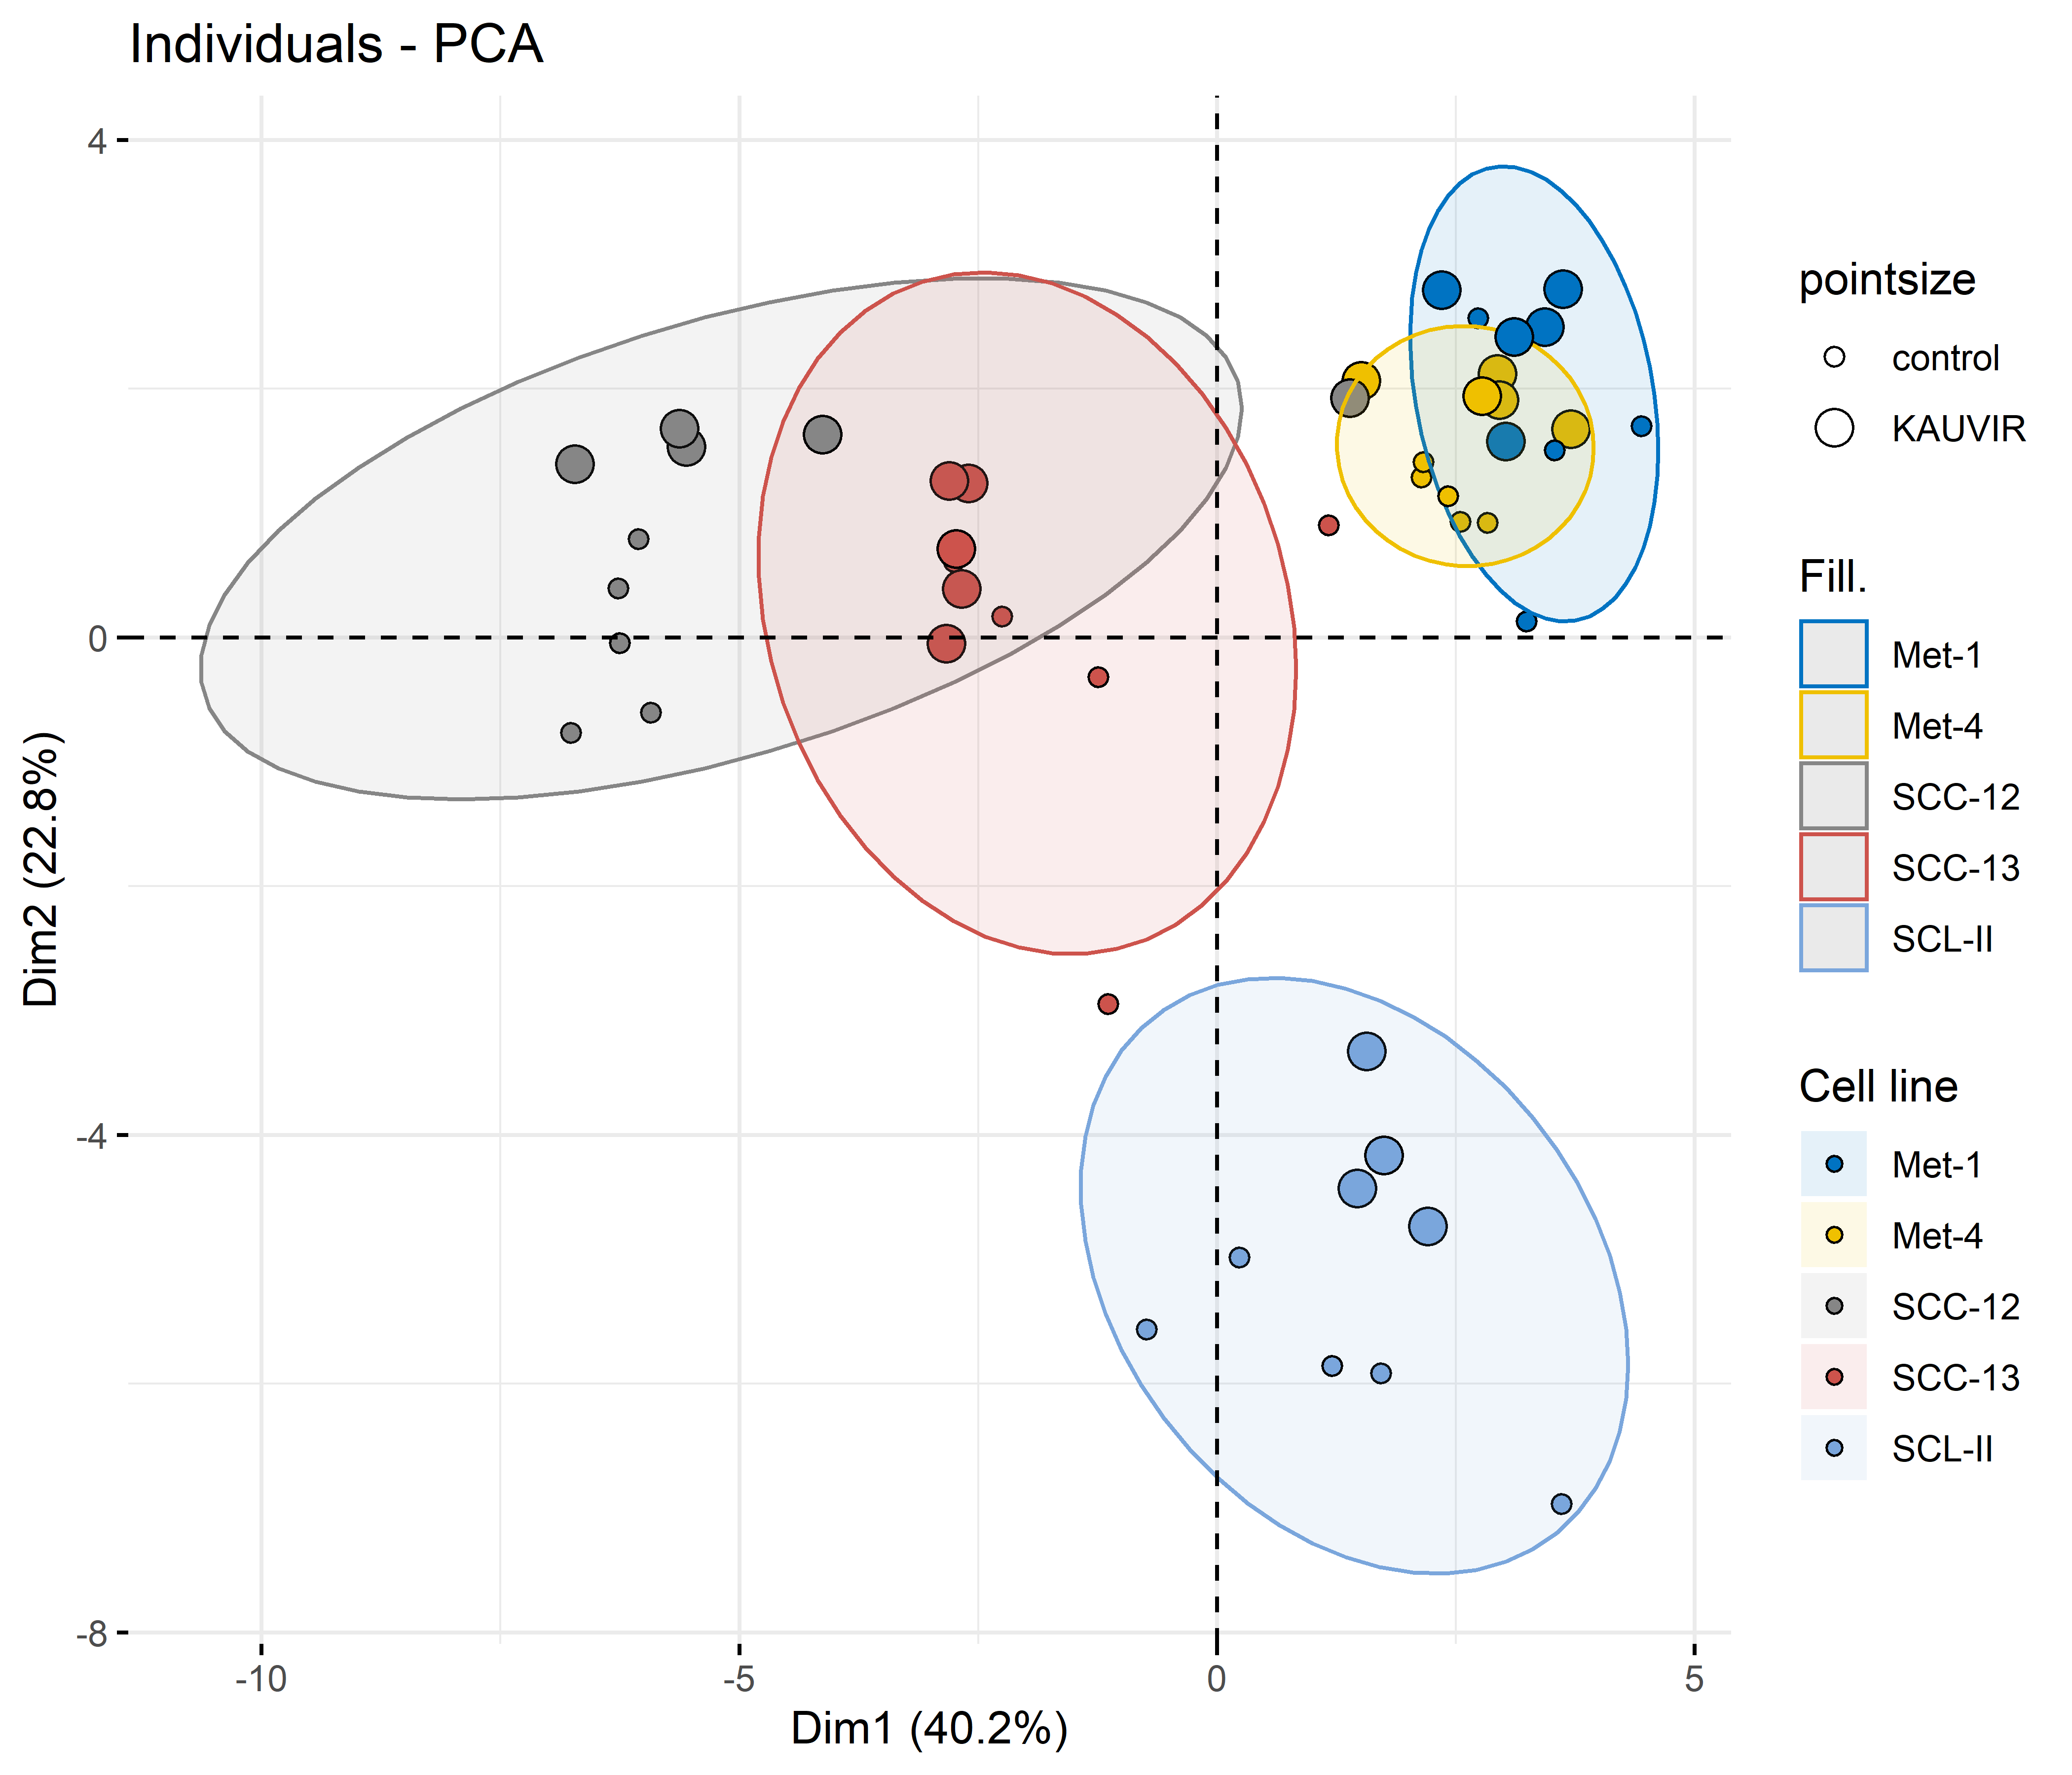
A
B
C
Irradiation
PC1 separates SCC12/13 from Met1/Met4
PC2 separates SCL-II from the other cell lines
PC3 separates Met-1 from Met-4 and also SCC12 from SCC-13 (slightly)
→ SCC12 and SCC13, as well as Met-1 and Met-4 share similar expression patterns, SCL-II shows very different miRNA expression
Within the clusters, irradiated cells form subcluster in the PC1 vs PC2 plot for all cell lines, for Met-4, SCC-13 and SCL-II in the PC1 vs PC3 plot and for all cell lines in the PC2 vs PC3 although not as pronounced as the cell line effects
Notes:
PCA
Hauptsächlich Zelllinieneffekte
Aber innerhalb der Zelllinien subcluster based on irradiation
Met-1 und Met-4 clustern sehr nah zusammen, interindividuelle Varianz scheint einen größeren Einfluss zu haben (sobald Zellen anderen Ursprungs, clustern sie nicht mehr, und Met-1 und Met-4 obwohl Primärtumor und Metastase, clustern sehr nah zusammen)
SCC-12 und SCC-13 clustern ebenfalls, wahrscheinlich, da beides hoch differenzierte Zelllinien sind
SCL-II bildet ein einzelnes Cluster als undifferenzierte Zelllinie
Unterschiedliche Eigenschaften zeigen sich auch in UV-sensitivity (schwanken stark zelllinienabhängig, p53 Wt niedrigere UV-Sensitivität als p53 defiziente Zelllinien → Korrelation oder Kausal?)

Slide 8
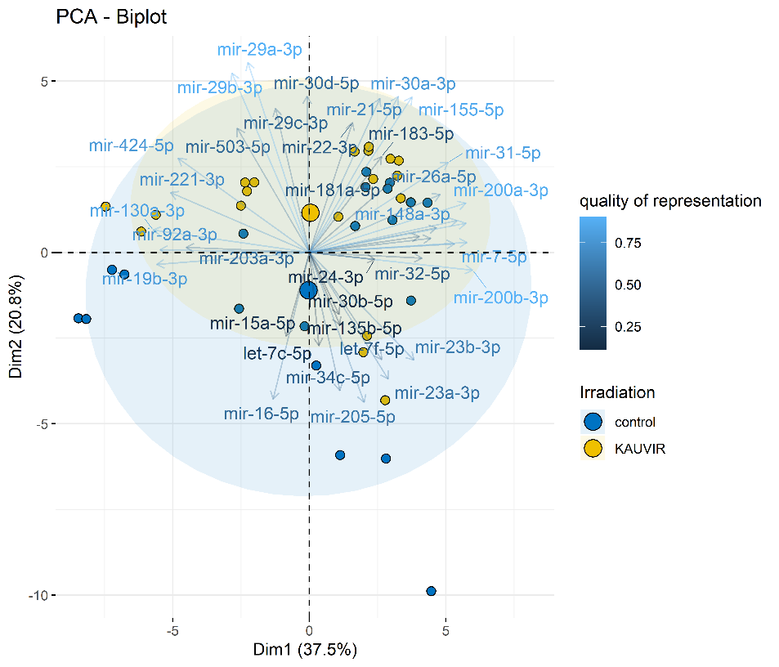
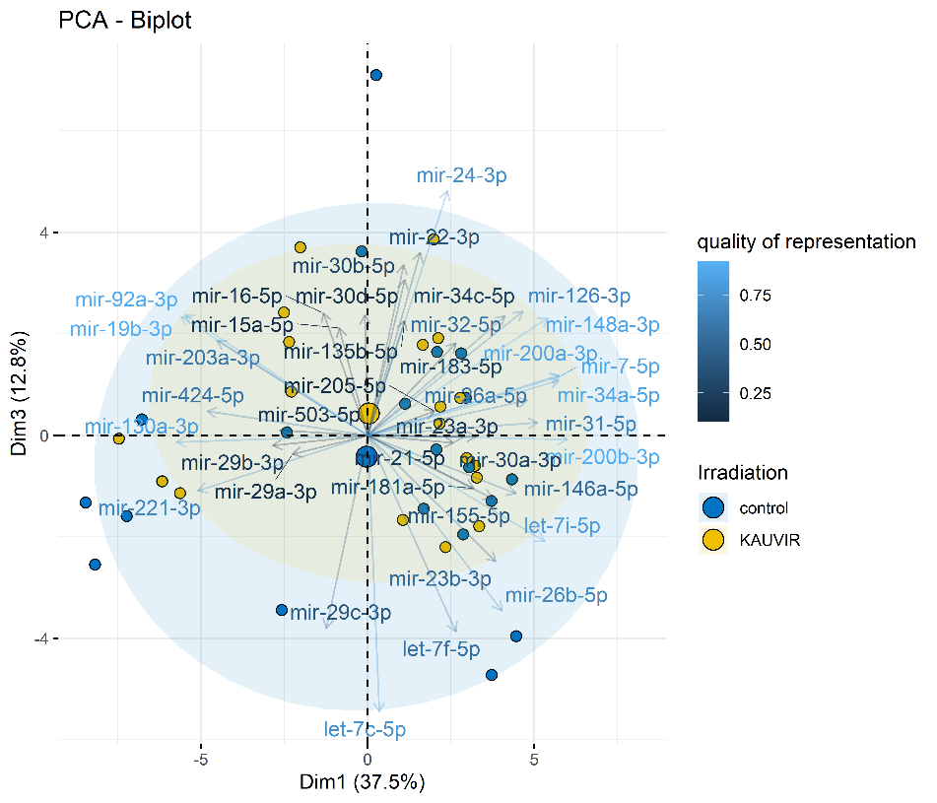
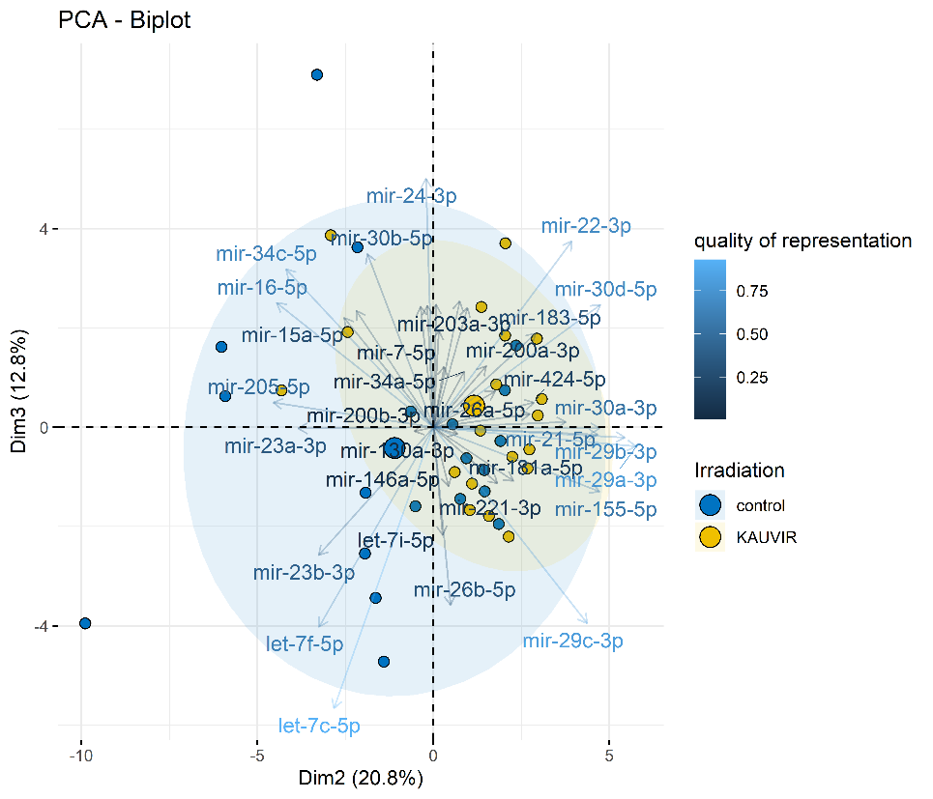
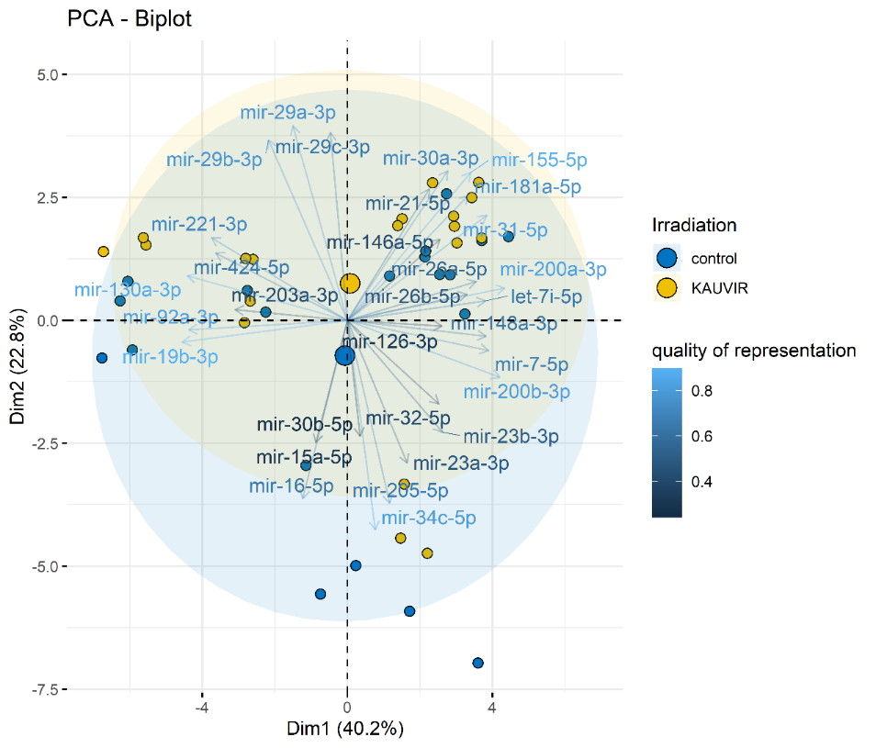
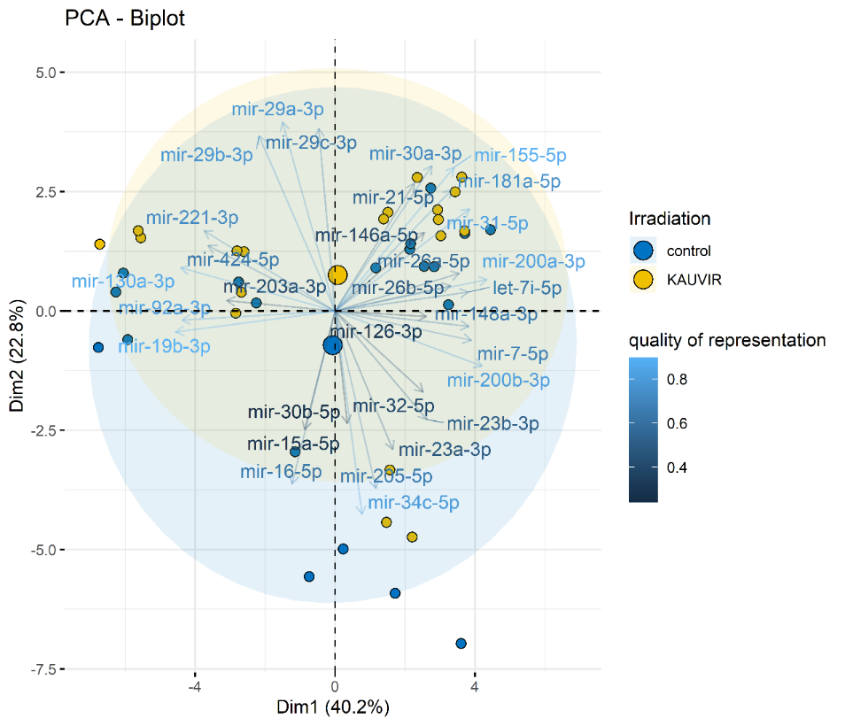
A
B
C
Big points represent mean of all samples within each group
Best separation of irradiated and control samples achieved PC2 vs PC3 showing that high values in PC2 and PC3 are correlated with irradiated samples and low values in PC2 and PC3 are correlated with control samples
Arrows show the correlation of each miRNA with the respective principal component
miRNAs that share a similar anlge (i.e. point into the same direction) are positively correlated, miRNAs with an angle of 90° are uncorrelated and miRNAs with an angle of 180° are negativel correlated
Notes:
Quality of representation calculated by cos²
Zunächst Zelllinieneffekt genauer untersucht → differentiell exprimierte miRNAs
→ Nur Kontroll samples genommen und hierarchical clustering → Heatmap Analyse um etwas detailliertere Aussage treffen zu können

Slide 9
Examination of controls only

Slide 10
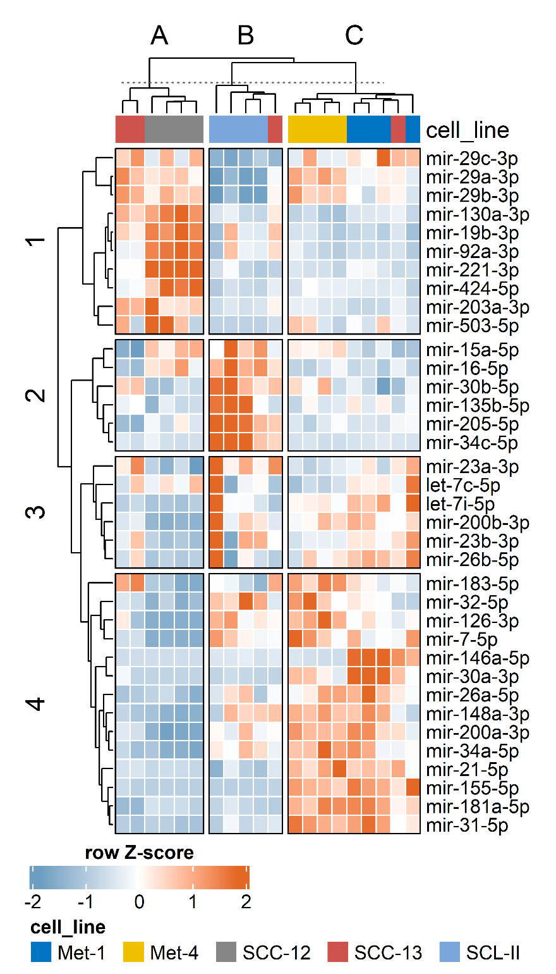
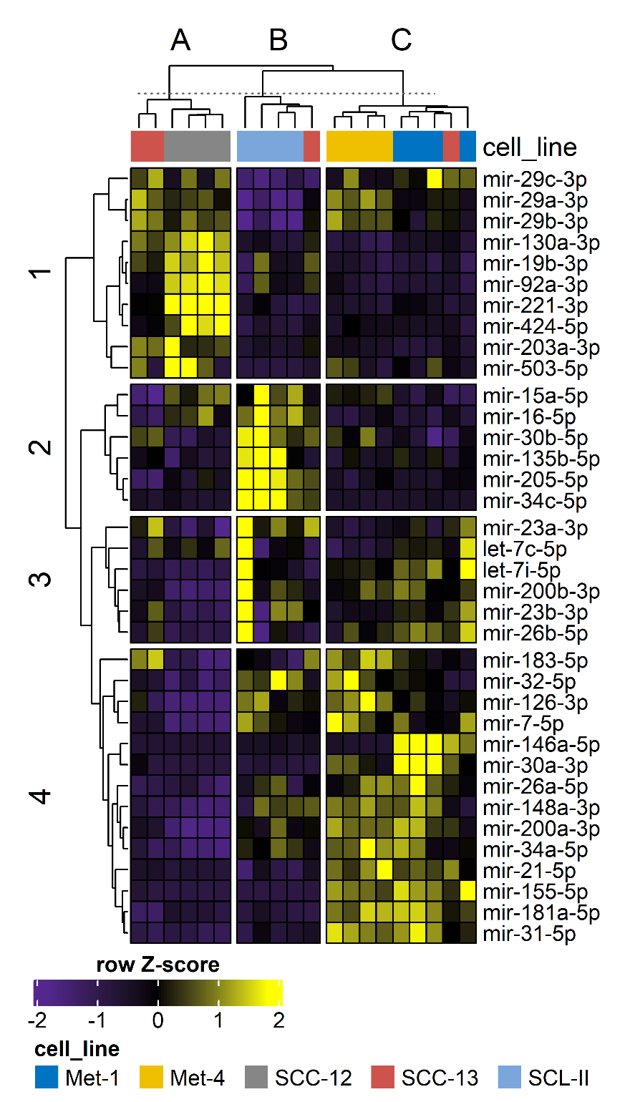
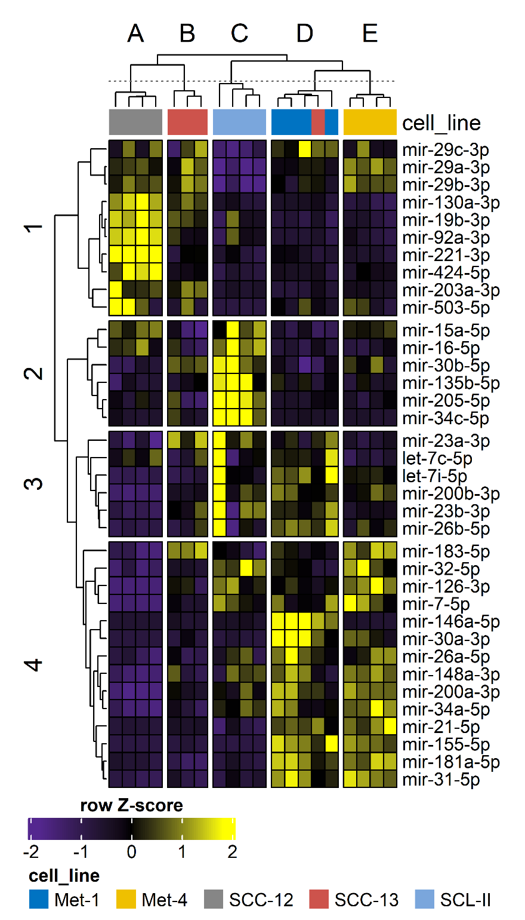
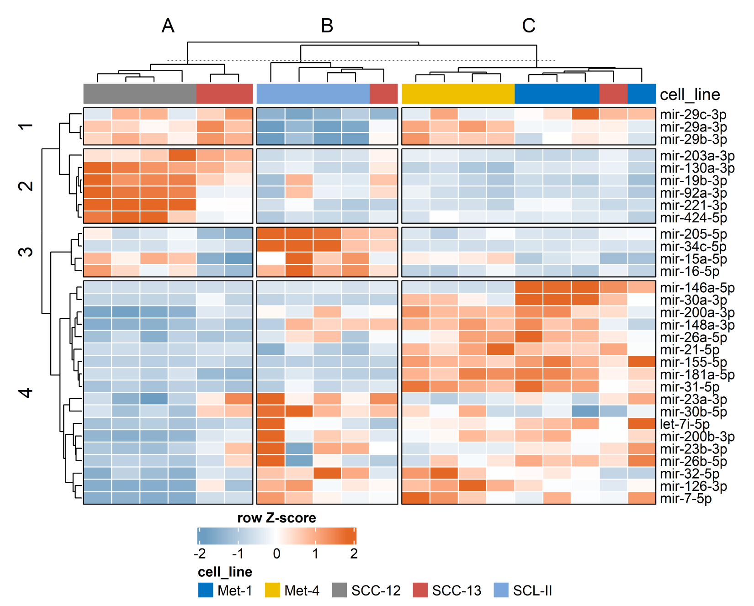
Zelllinien detaillierter Vergleich differentiell exprimierte miRNAs
cell line
Notes:
Cluster der PCA analyse genommen und für supervised kmeans clustering bei Heatmap Analyse genutzt, um quantitative Unterschiede der miRNAs zu erfassen (k = 3).
miRNAs mit geringer Expression (median <2.5 in einer der zu vergleichenden Gruppen) herausgefiltert → differentielle Expression ermittelt → ANOVA mit mit hccm fdr-correction → post-hoc-pairwise t-test with unequal variances →
31 differentiell exprimierte miRNAs vorhanden (p-values in Tabelle weiter unten)
Einzelne subcluster auf Funktionalität untersuchen und mit Differenzierungs-, p53- Status, Chromosomal gain/loss usw. assoziieren
Cluster A: SCC-Cluster
Cluster B: SCL-II Cluster
Cluster C: Met-Cluster
Cluster 1: miR-29 Familie
Cluster 2: (545 Gene, weak und strong evidence)
KEGG: p53 signaling (q=1.16*10^-6), Cell Cycle (q=2.07*10^-5), FoxO signaling (q=2.51*10^-5)
GO_biological process: negative regulation of translation (q=4.62*10^-4) and protein stability (q= 4.34*10^-4), gene silencing by miRNA(q=0.0011), miR loading onto RISC (q=0.0011)
die getargeten Proteine sind involved in verringerter miRNA Regulation
durch hohe miRNA Expression in SCC-12/13, ist die Proteinexpression dieser Regulatoren verringert
Feedbackloop?
Außerdem kutaner Differenzierungsmarker in SCC-12/13 stark erhöht (spiegelt Differenzierungsstatus wieder, Met-1/Met-4 wenig differenziert, SCL-II undifferenziert)

Slide 11
Pathway Analysis

Slide 12
KEGG
Controls
10 miRNAs randomly sampled from miRBase List
FC and pvalues pairs from original data assigned randomly
Pathway analysis run
Process repeated 50 times
Randomly enriched pathways (%) calculated by division of times the pathways were enriched in these 50 iterations by the number of iterations (50)
Pathways that were enriched in more than 10% of controls were omitted from the analysis

Slide 13
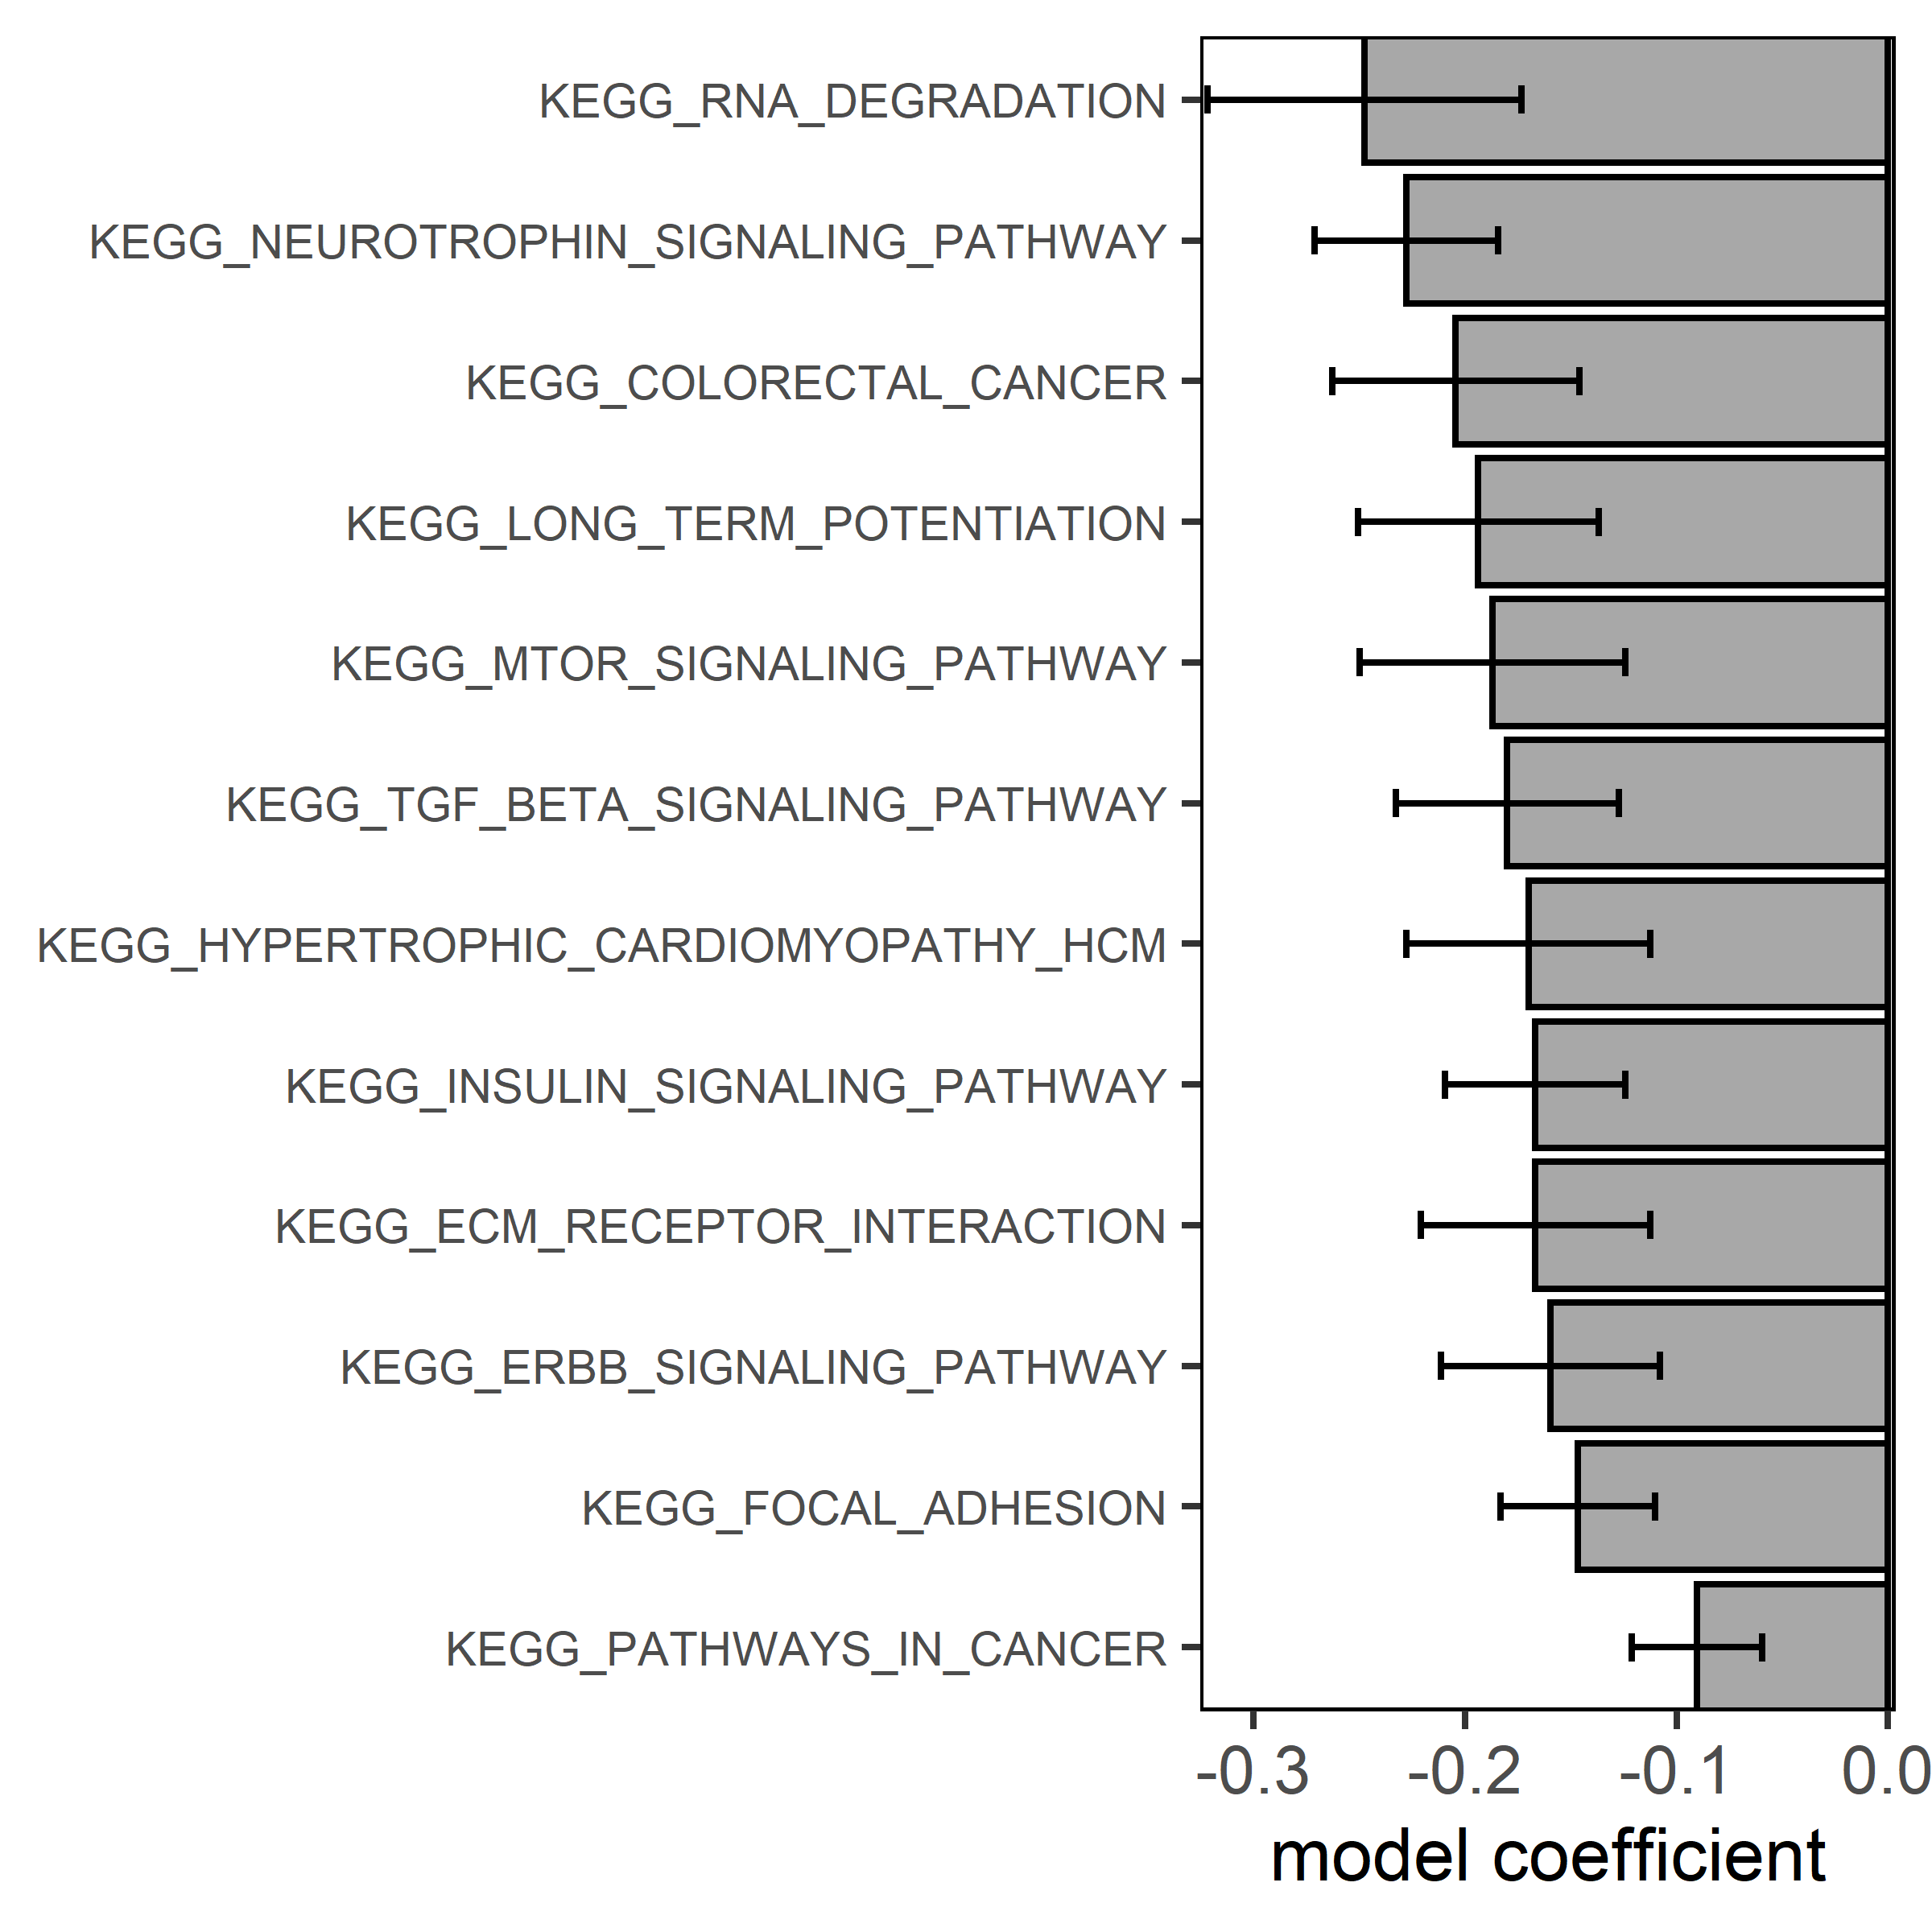
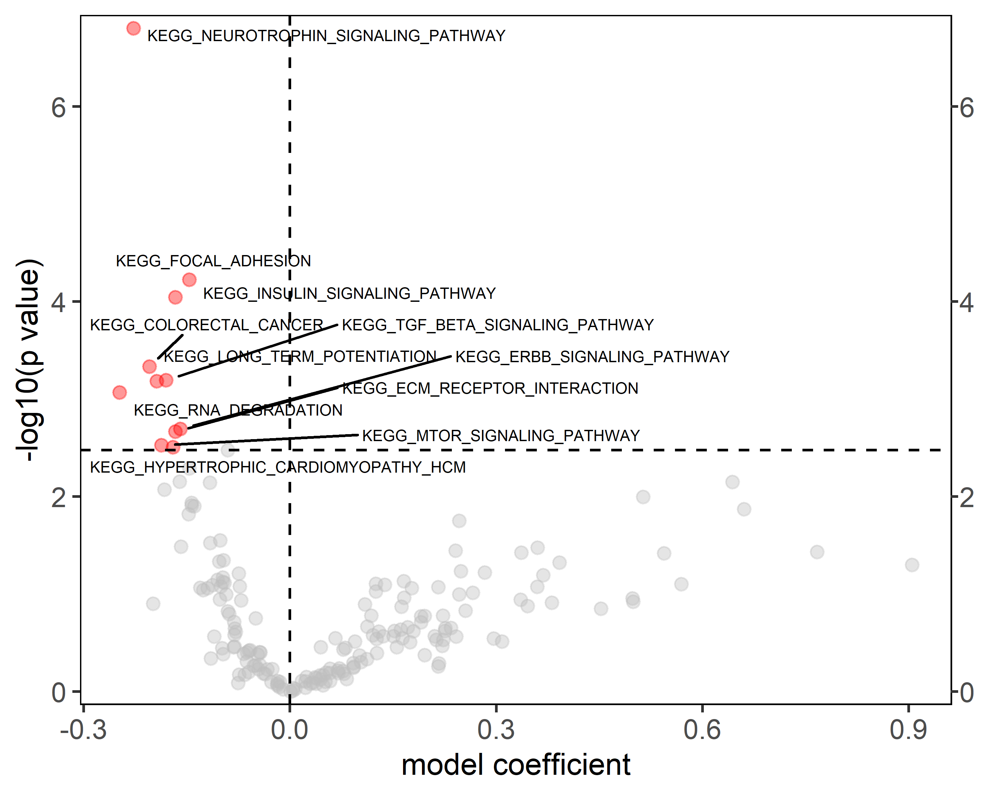
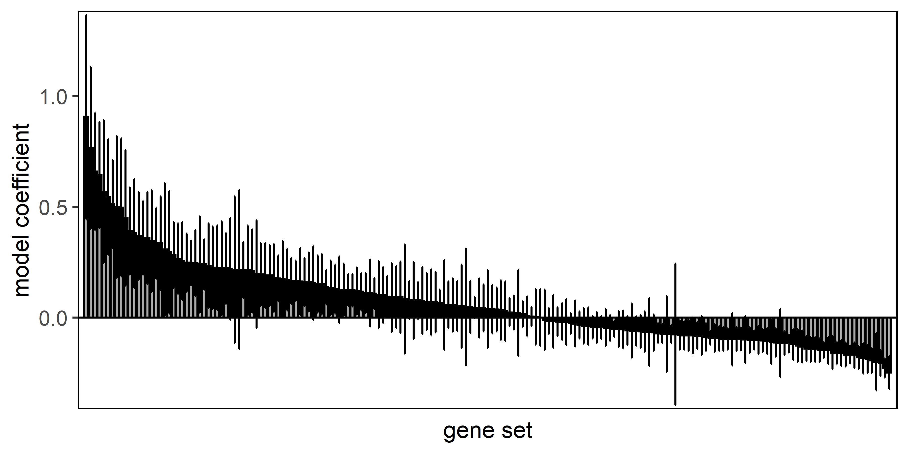
KEGG – cluster 1A (+1B)

Slide 14
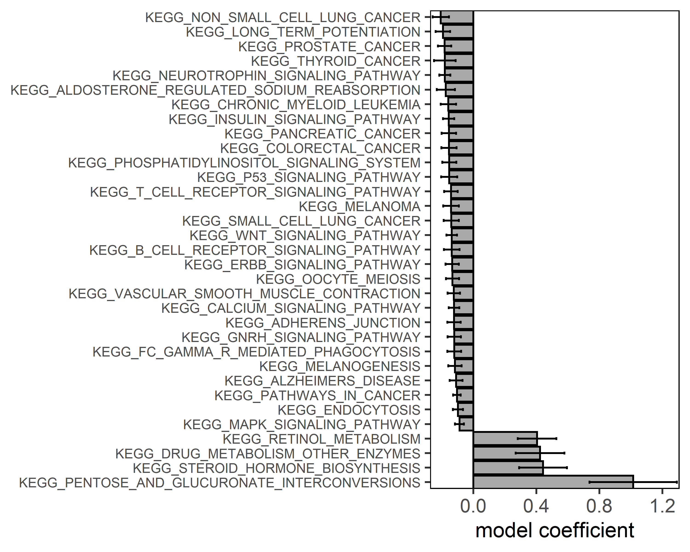
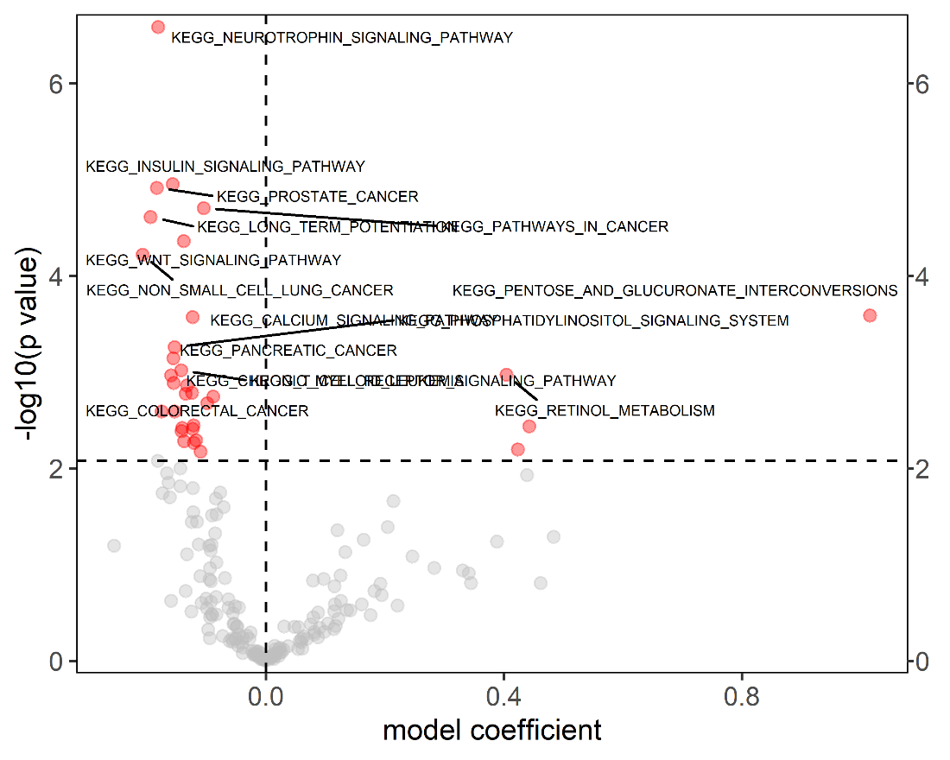
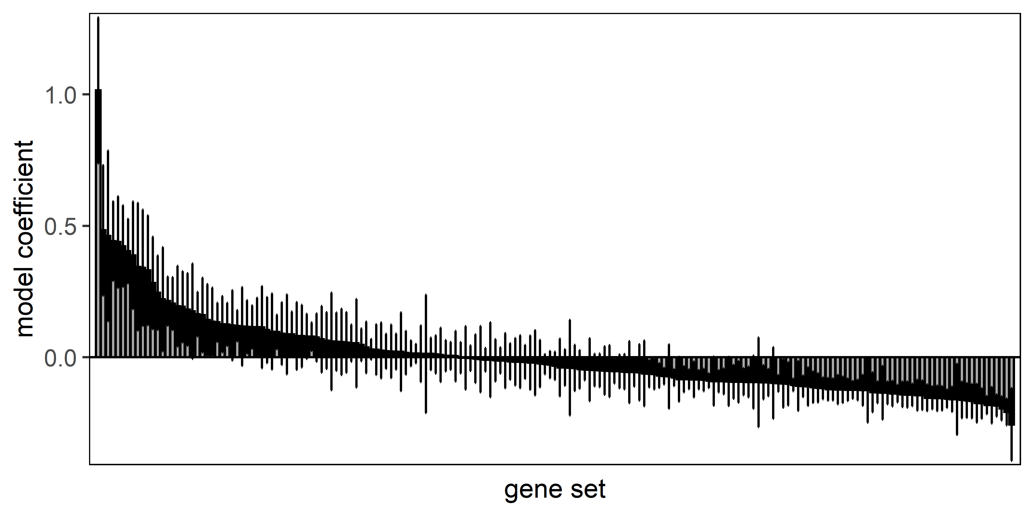
KEGG – cluster 2B (2C)

Slide 15
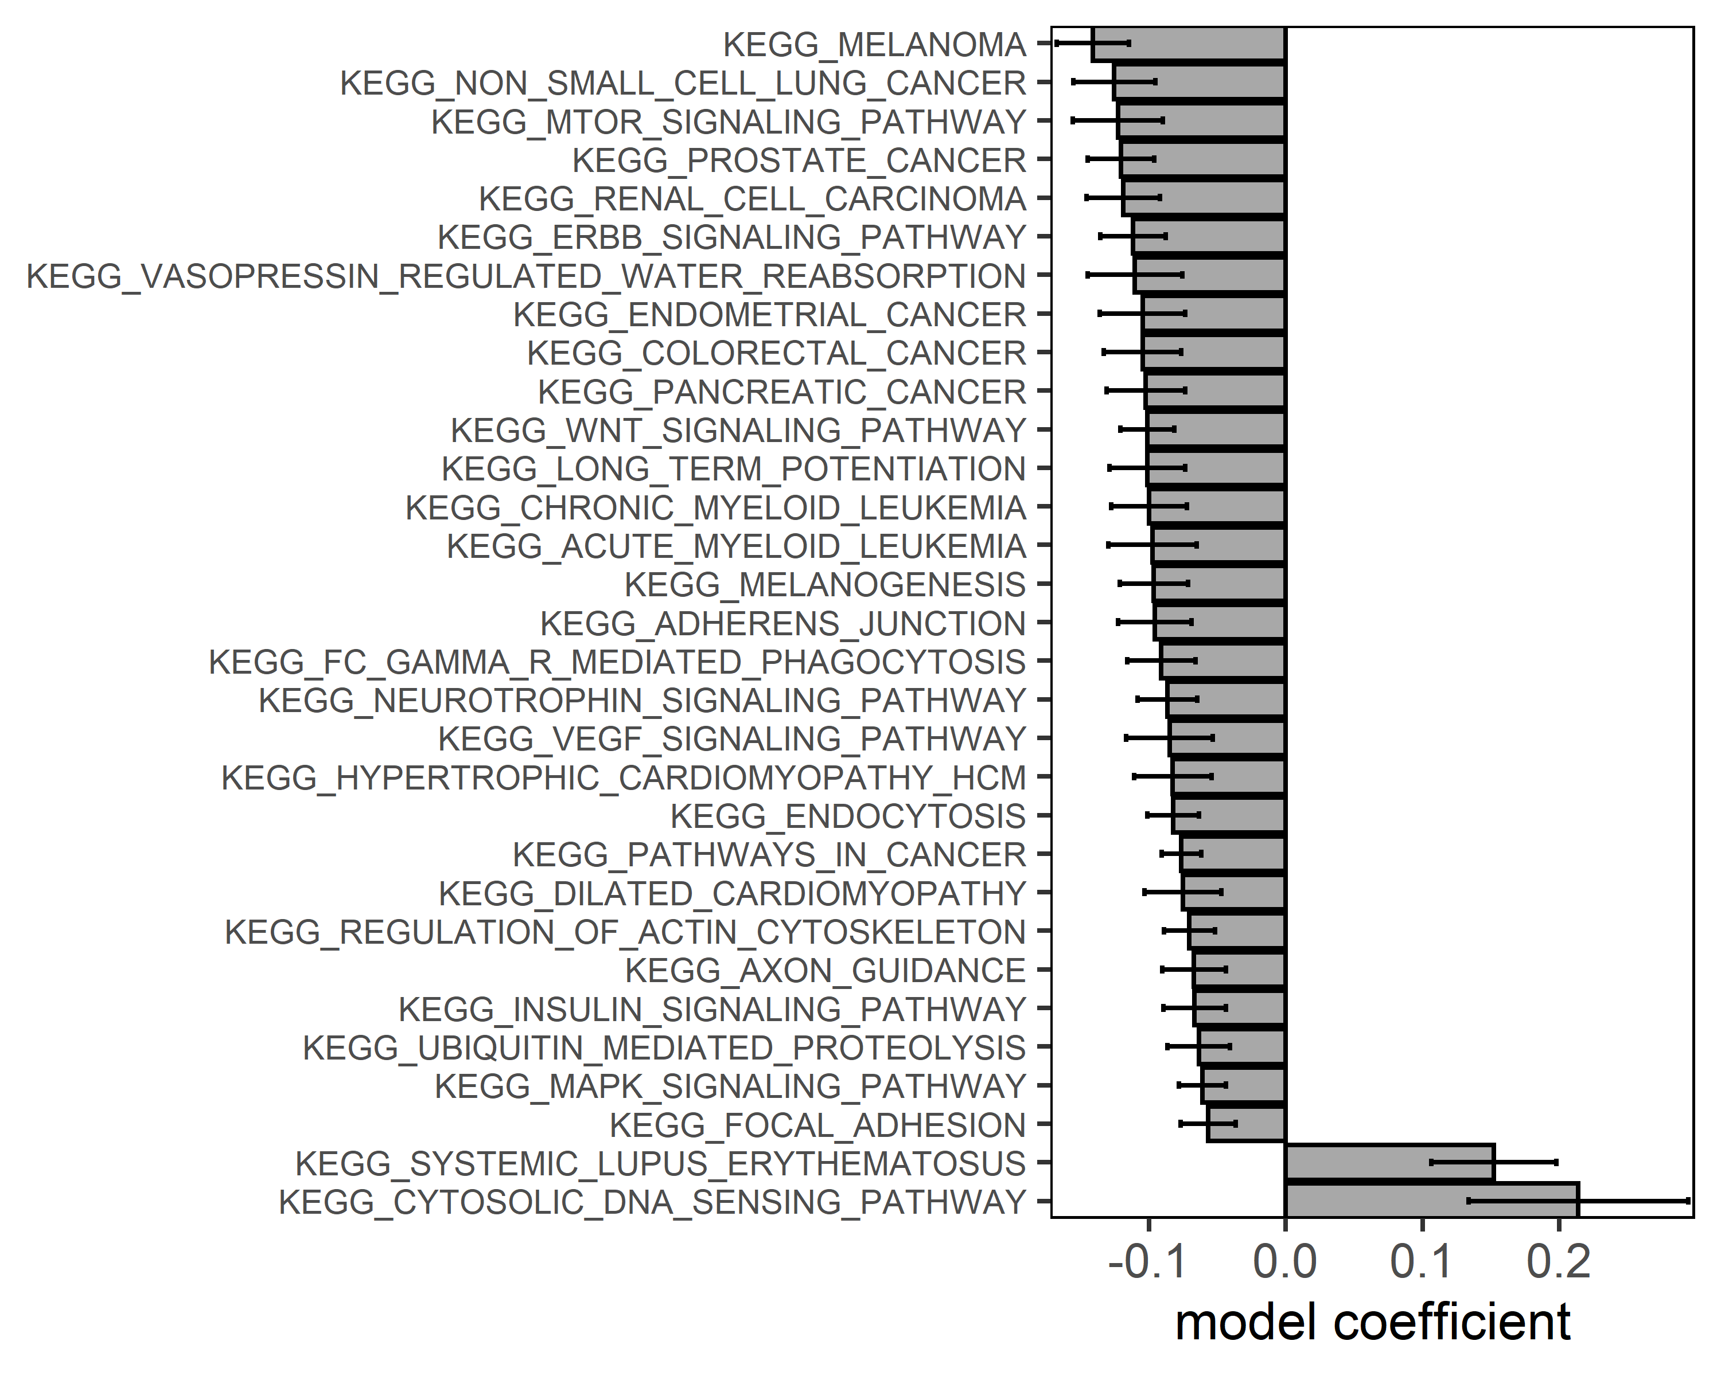
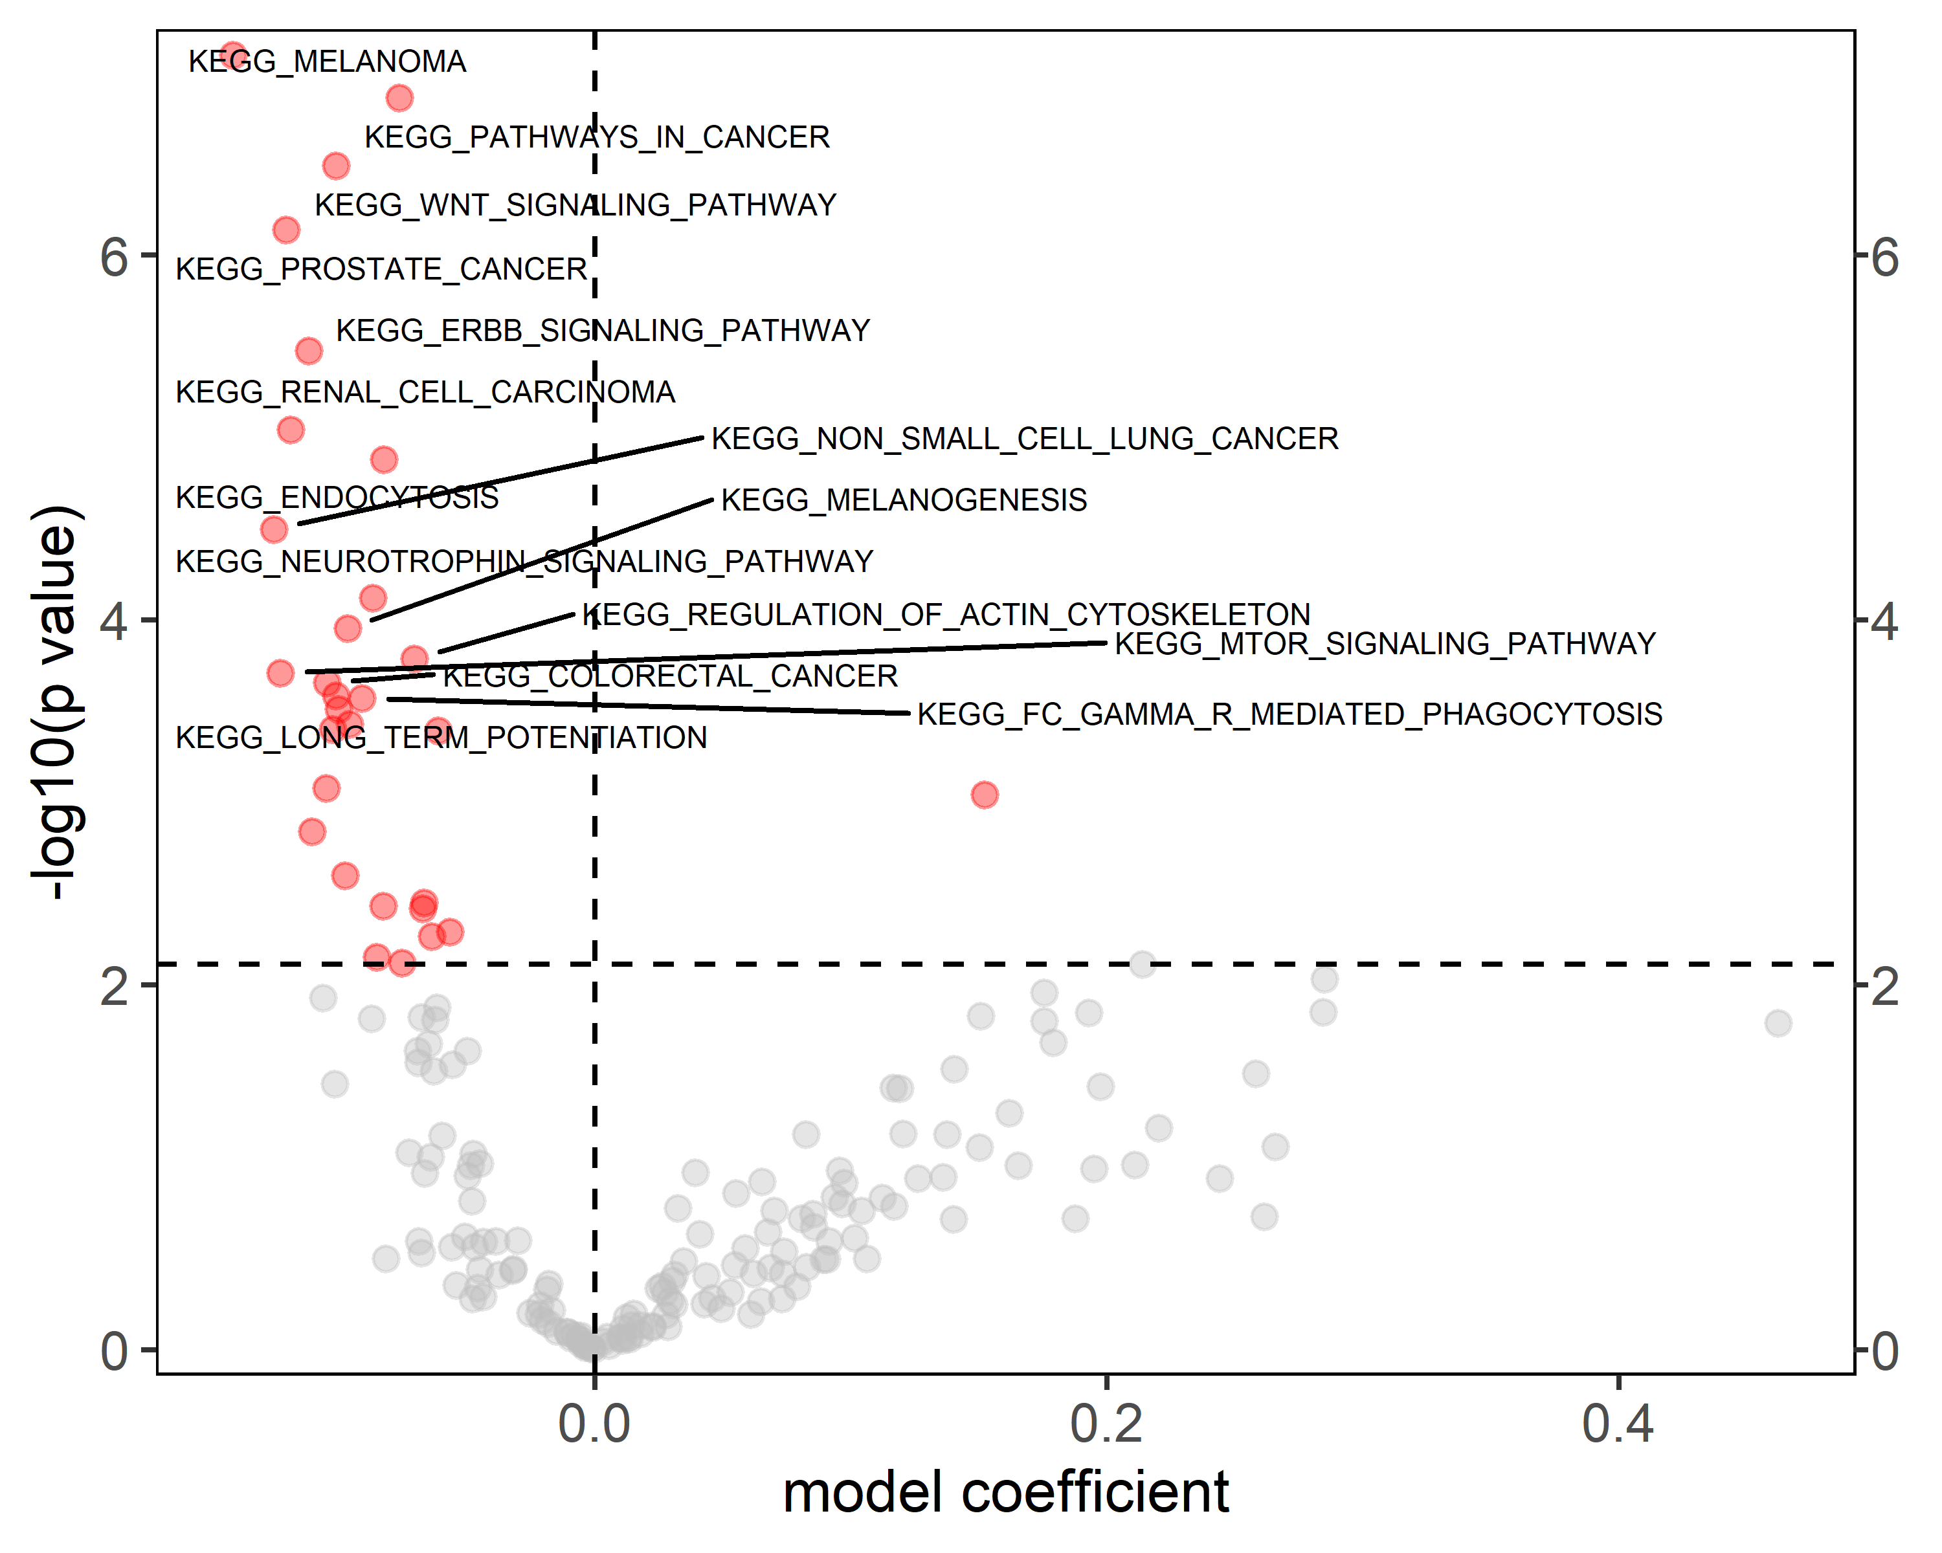
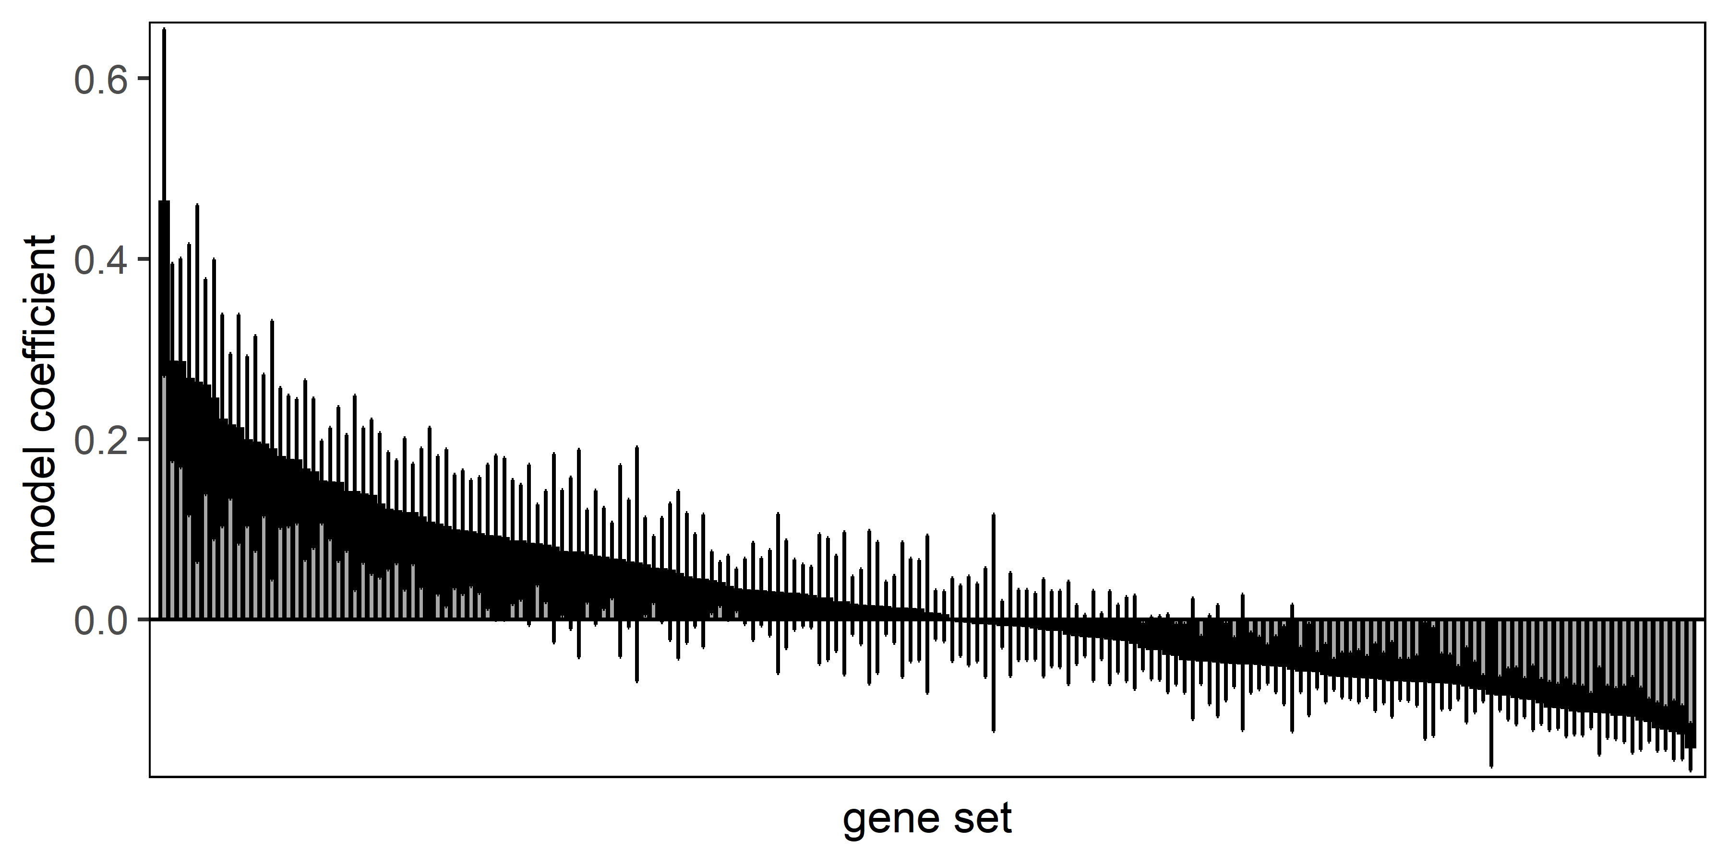
KEGG – cluster 4C (4D+4E)

Slide 16
GO:BP
Controls analogously to KEGG

Slide 17
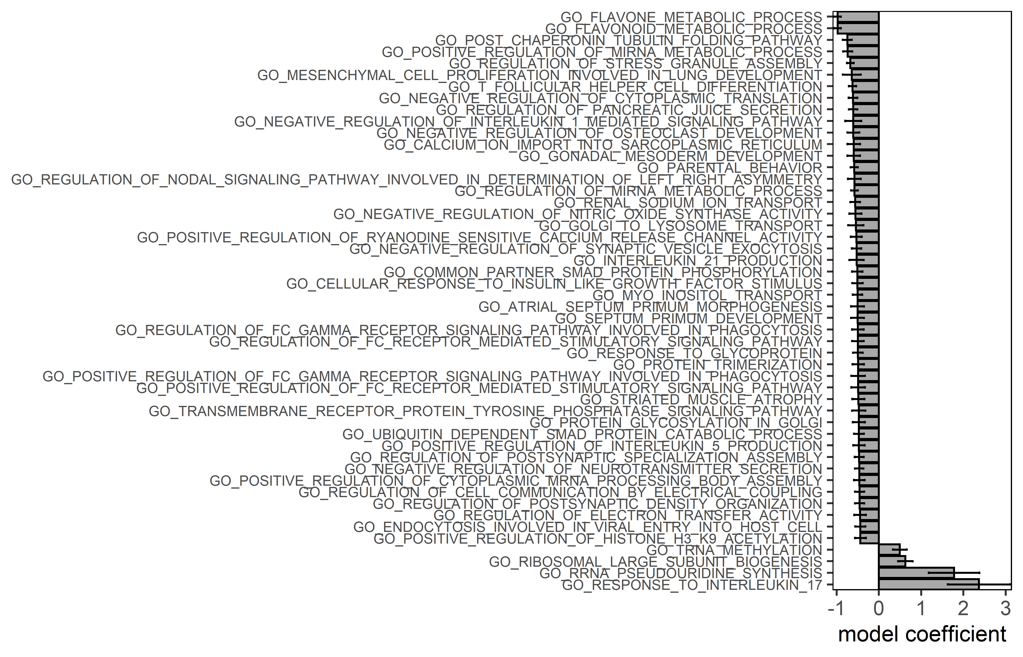
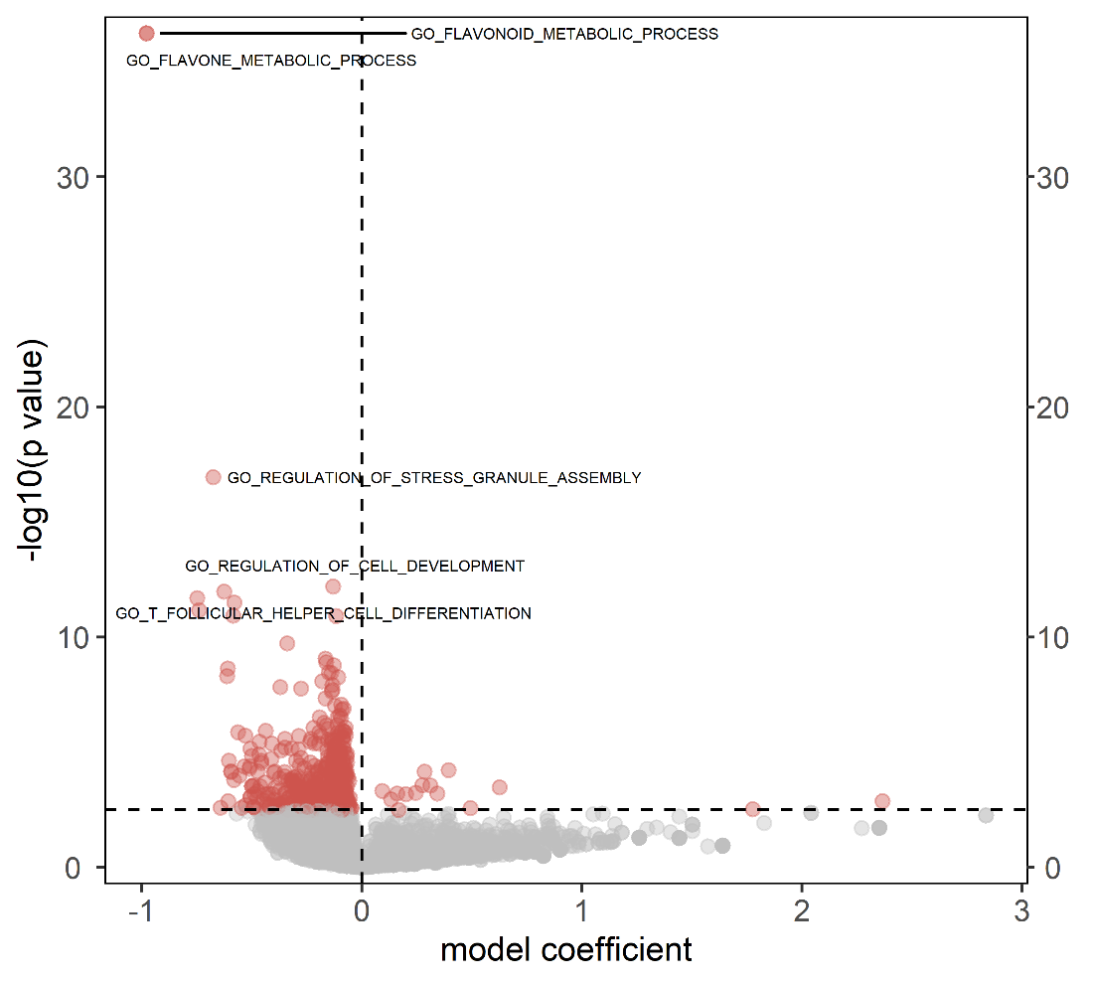
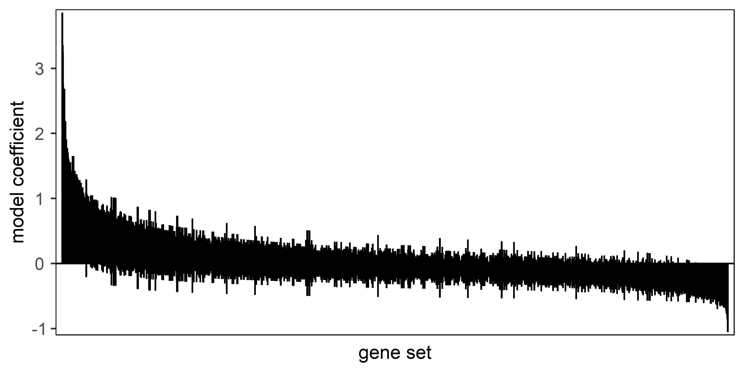
GO:BP – cluster 1A

Slide 18
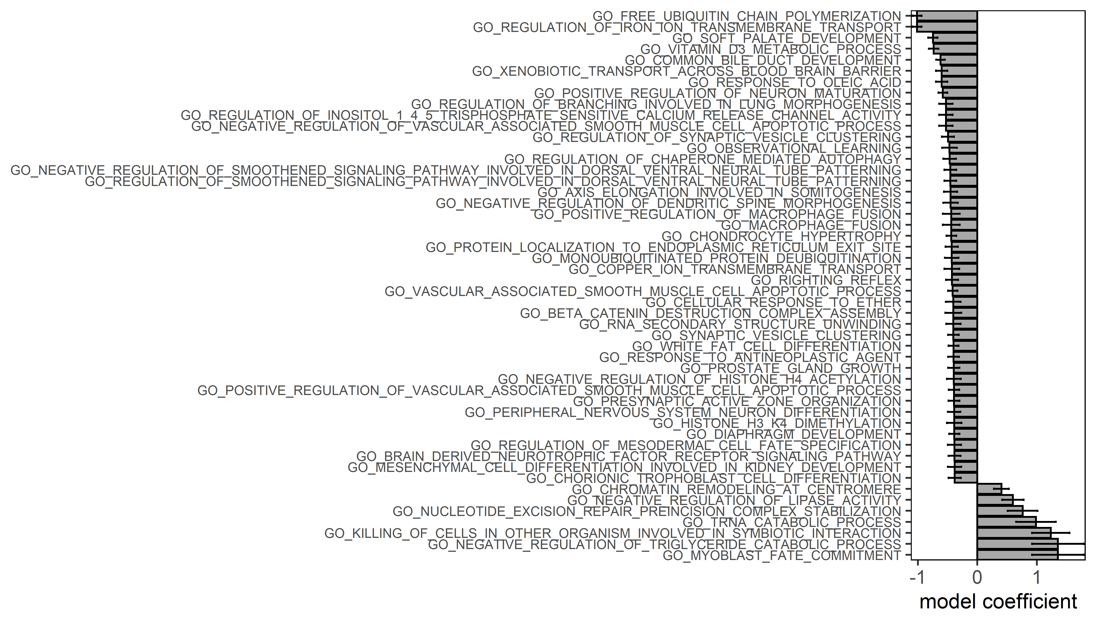
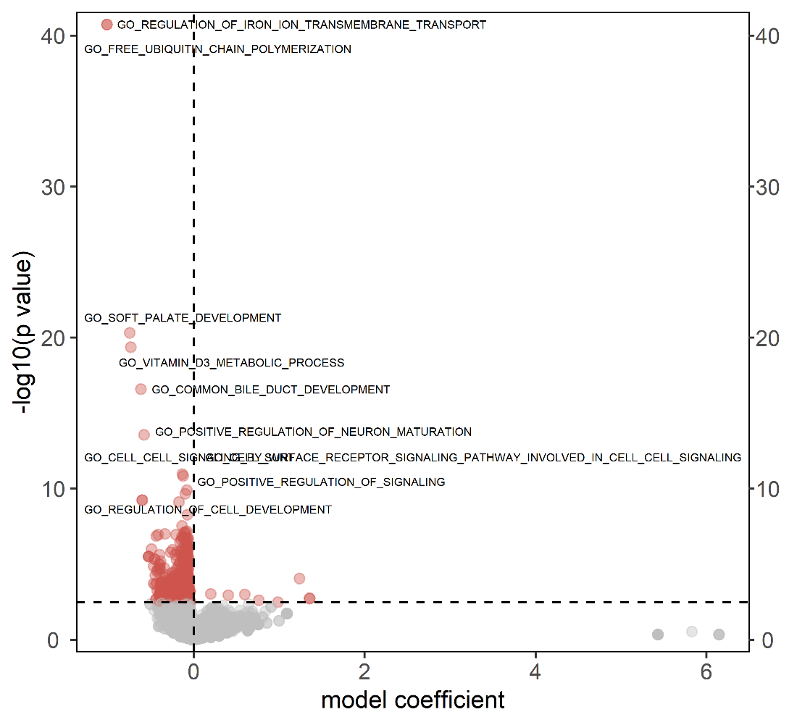
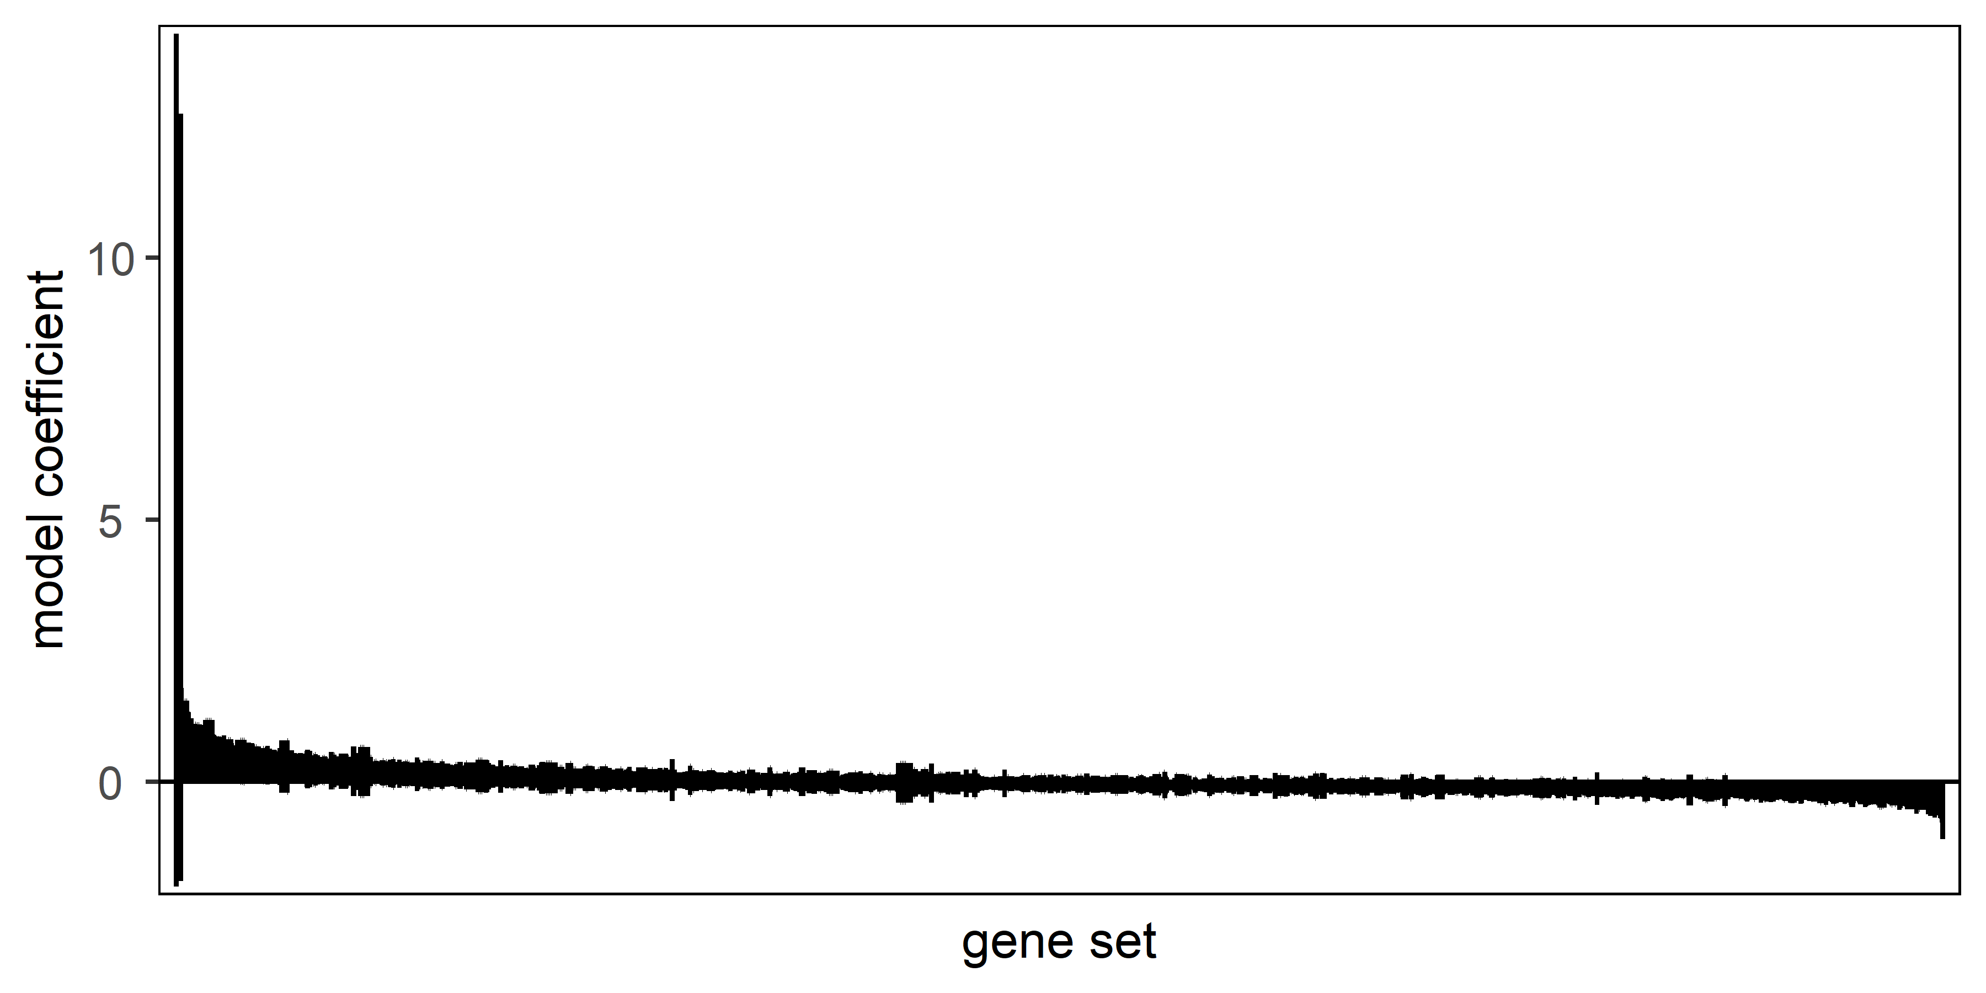
GO:BP – cluster 2B

Slide 19
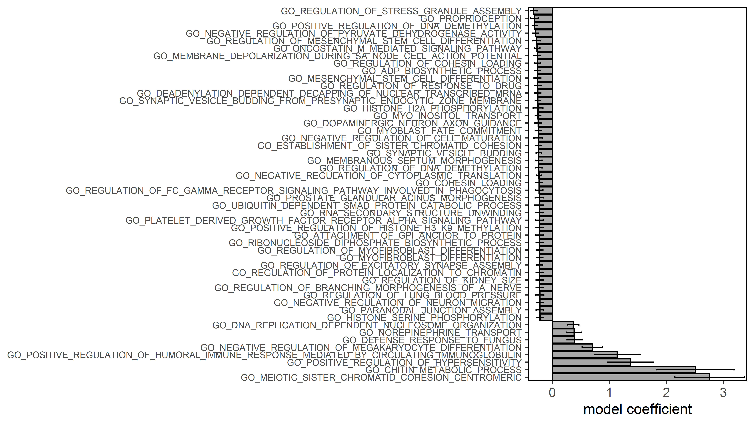
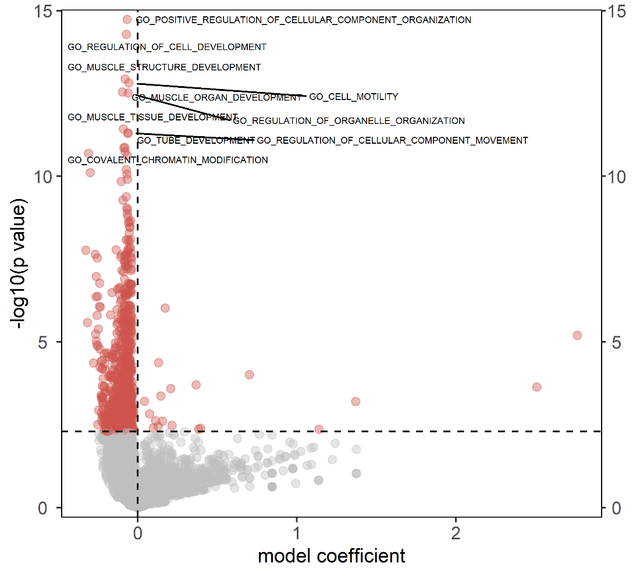
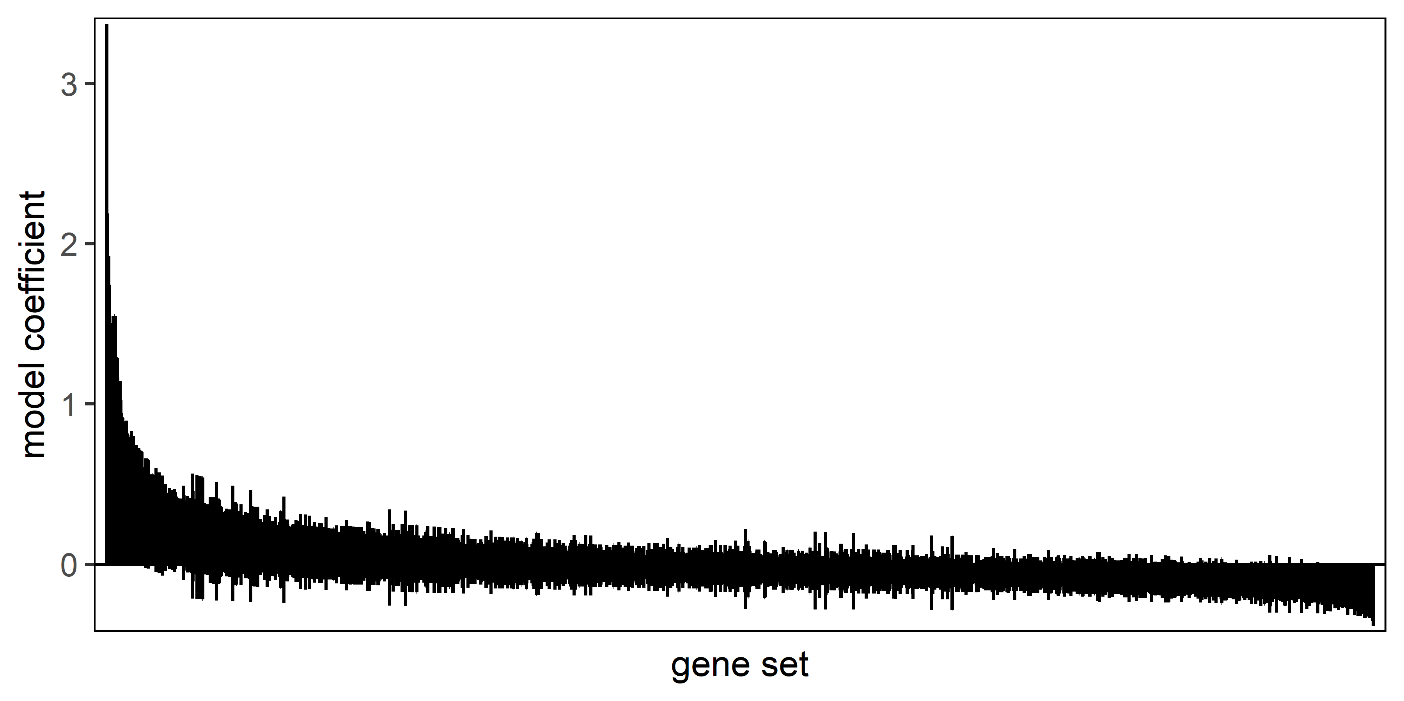
GO:BP – cluster 4C

Slide 20
UV sensititvity

Slide 21
EDA
Verteilung der residuals non-normal
Verteilungen der einzelnen Populationen non-normal, allerdings sind alle Populationen right-skewed und bei 0 limitiert
Shapiro wilk test for normality:
- P = 9.735e-14 → Verteilung nicht normal

Slide 22
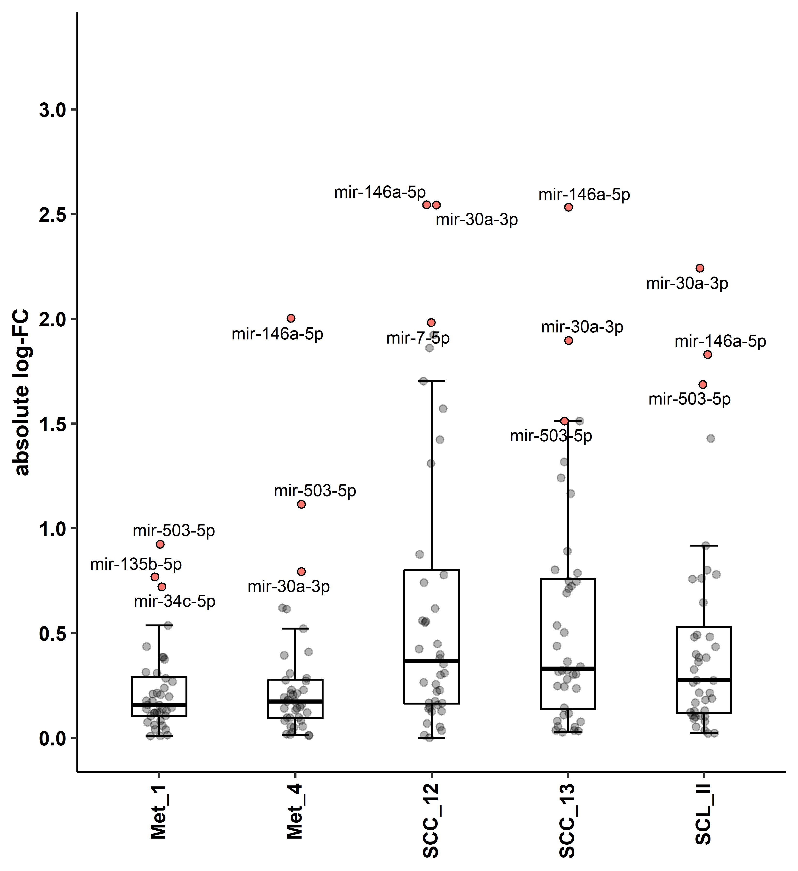
UV sensititvity
# A tibble: 10 x 9
.y. group1 group2 n1 n2 statistic p p.adj p.adj.signif
* <chr> <chr> <chr> <int> <int> <dbl> <dbl> <dbl> <chr>
1 abslog2FC Met_1 Met_4 40 40 0.127 0.899 0.899 ns
2 abslog2FC Met_1 SCC_12 40 40 3.16 0.00157 0.00959 **
3 abslog2FC Met_1 SCC_13 40 40 2.98 0.00288 0.00959 **
4 abslog2FC Met_1 SCL_II 40 40 2.12 0.0338 0.0675 ns
5 abslog2FC Met_4 SCC_12 40 40 3.03 0.00241 0.00959 **
6 abslog2FC Met_4 SCC_13 40 40 2.85 0.00433 0.0108 *
7 abslog2FC Met_4 SCL_II 40 40 2.00 0.0460 0.0767 ns
8 abslog2FC SCC_12 SCC_13 40 40 -0.182 0.856 0.899 ns
9 abslog2FC SCC_12 SCL_II 40 40 -1.04 0.299 0.427 ns
10 abslog2FC SCC_13 SCL_II 40 40 -0.858 0.391 0.489 ns
Kruskal-Wallis, $H_{4}$ = 18.6, p = 0.000927
*: p < 0.05, **: p < 0.01
Dunnett‘s post-hoc test, fdr-adjusted
Shapiro wilk test for normality:
P = 9.735e-14 → Verteilung nicht normal
Levene Test for homogeneity of variance:
P = 0.0000196 → Varianz nicht homogen
Based on CLT: 31 samples enough to use parametric methods
https://www.ncbi.nlm.nih.gov/pmc/articles/PMC5370305/#!po=87.5000 (CLT: cornerstone of modern statistics)
As variances not homogene → Welch ANOVA and Games-Howell Post-Hoc Test
Laut https://stats.stackexchange.com/questions/121852/how-to-choose-between-t-test-or-non-parametric-test-e-g-wilcoxon-in-small-sampl
Trotzdem lieber nonparametrische Methoden verwenden, außer man hat VORHER guten Beweis, dass normalverteilt
(jeweils Mittelwert aus 4 Messungen pro Zelllinie und 5 Zelllinien)
Notes:
MiRNAs mit Median Expression < 2.5 herausgefiltert
31 miRNAs (jeweils Mittelwert aus 4 Messungen pro Zelllinie und 5 Zelllinien)
Unterschiedliche Eigenschaften zeigen sich auch in UV-sensitivity (schwanken stark zelllinienabhängig, p53 Wt niedrigere UV-Sensitivität als p53 defiziente Zelllinien → Korrelation oder Kausal?)
Median kann hier nicht verglichen werden, da mann whitney U Test nur bei gleichen Verteilungsshapes eine Aussage über die Lage des Medians treffen kann, ansonsten
Wird nur die statistische Dominanz zweier Populationen verglichen. Eine gute Alternative ist ein unequal variance T-Test (Ruxton 2006 The unequal variance t-test is an underused alternative to Student's t-test and the Mann–Whitney U test
). Und obwohl samples SCC-12 und SCC-13 nicht normalverteilt sind kann aufgrund der sample größe n=31 und des CLT die T-Verteilung zur Parameterbestimmung genutzt werden
Oder Zimmerman DW, Zumbo BN. 1993
. Rank transformations and the power of the Student t-test and Welch t′-test for non-normal populations.
Denn Median ergibt mehr Sinn hier, aufgrund der Verteilung

Slide 23
Differential expression after irradiation

Slide 24
Gene expression follows a log-normal distribution
https://ieeexplore.ieee.org/stamp/stamp.jsp?arnumber=7991639 (Beal, 2017)
Geometric mean is the same as log-transforming the data, taking the arithmetic mean and then backtransforming using the anti-log of this average
→ calculate statistics in log-transformed values and show geometric mean and sd

Slide 25
Vorgehen
Log transformation (+1)
Werte kleiner 0 wurden 0 gesetzt (negative Expression ist biologisch nicht möglich
Test assumptions:
Outliers checked with boxplot method → no extreme outliers present
Normality: small sample size → shapiro wilk test not very informative, qqplot on residuals showed heavy tails, qqplot on each separate group looked approximately normal
Gene expression follows log-normal distribution → log-transformed values are expected to follow normal distribution
Homogeneity of variance:
When employing the model log_exp~miRNA*cell_line*Irradiation
→ no homogeneity of variances
But within miRNAs there were homogene variances in all miRNAs except 8 (miR-181a, miR-146a-5p, miR-30a, miR-183, miR-205, miR-221, miR-7, miR-15a)
As with a small sample size of 4 per group non-parametric methods lack power, parametric methods were employed to test interactions, main effects and pairwise comparison within each miRNA, moreover gene epxression data is known to be log-normal distributed (therefore unequal variance t-test on logs should yield the best tradeoff between control of alpha and reasonable statistical power)
Because of heterogeneity of variances ANOVA with hccm (heteroscedasticity correction of covariance matrices) and a post-hoc pairwise-t-test with unequal variances was used
White 1980
Long and Ervin (2000) (hc3 correction)

Slide 26
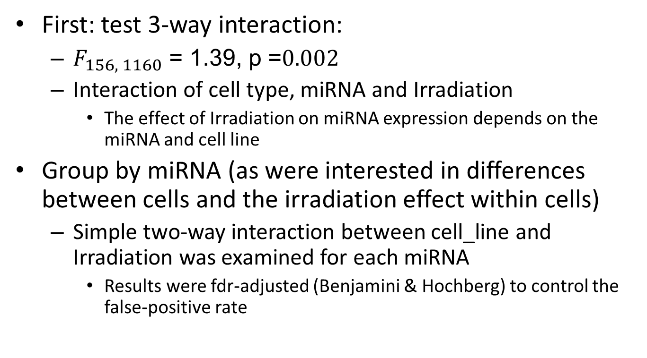
Vorgehen
First: test 3-way interaction:
$F_{156, 1160}$ = 1.39, p =$0.002$
Interaction of cell type, miRNA and Irradiation
The effect of Irradiation on miRNA expression depends on the miRNA and cell line
Group by miRNA (as were interested in differences between cells and the irradiation effect within cells)
Simple two-way interaction between cell_line and Irradiation was examined for each miRNA
Results were fdr-adjusted (Benjamini & Hochberg) to control the false-positive rate

Slide 27
Interaction of cell_line and Irradiation significant in 4 different cell lines
→ in these cell lines the irradiation effect is significantly different across cell lines
Differential expression:
P < 0.05 und FC > 1.5 in at least one cell line (between control and irradiated) grouped by miRNA

Slide 28
To balance Type I and Type II error rate the results were only adjusted for multiple testing at the ANOVA level using fdr-correction to control the false discovery rate→ subsequent t-tests were not adjusted for multiple testing, a confirmation of the results was rather achieved by a follow-up qPCR
Based on Feise 2002 (Rothman 1990 even suggests to not adjust at all)

Slide 29
Interested in the Irradiation effect
To account for an interaction term, two way ANOVA was conducted and adjusted for multiple testing (as 40 miRNAs were tested, so 40 two-way ANOVAs)
Significant interactions are shown below:

Slide 30
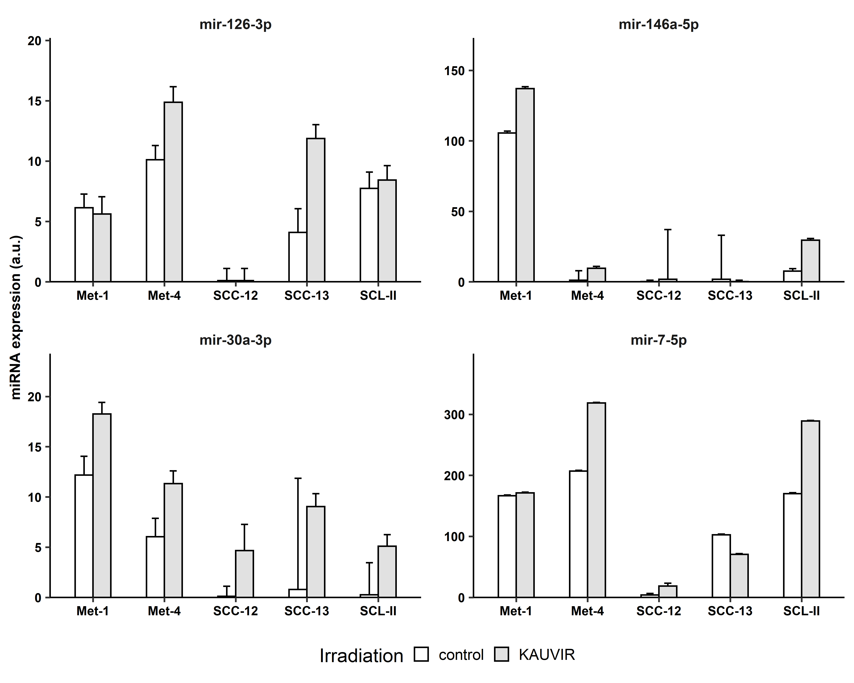
Anova, $F_{4, 29}$ = 3.51, p = 0.019
Anova, $F_{4, 29}$ = 3.37, p = 0.022
*
*
Anova, $F_{4, 29}$ = 3.70, p = 0.015
Anova, $F_{4, 29}$ = 4.56, p = 0.006
*
*
***
In these cell lines there is an Irradiation effect, however it varies between cell lines
Shown are geometric mean and geometric standard deviation
Shown is the ANOVA p value for the interaction term
Notes:
Pairwise T-test with unequal variances (pool.sd = F)
cell_line miRNA .y. group1 group2 n1 n2 statistic df p p.adj p.adj.signif
<chr> <chr> <chr> <chr> <chr> <int> <int> <dbl> <dbl> <dbl> <dbl> <chr>
1 SCC_13 mir-126-3p log_exp control KAUVIR 4 4 -3.44 3.32 0.035 0.035 *
2 SCL_II mir-146a-5p log_exp control KAUVIR 4 3 -5.13 3.45 0.01 0.01 *
3 SCC_12 mir-30a-3p log_exp control KAUVIR 4 4 -4.51 3 0.02 0.02 *
4 SCL_II mir-30a-3p log_exp control KAUVIR 4 3 -9.00 4.10 0.000756 0.000756 ***
5 SCC_12 mir-30b-5p log_exp control KAUVIR 4 4 2.76 4.11 0.049 0.049 *
6 SCC_13 mir-30b-5p log_exp control KAUVIR 4 4 -2.52 5.63 0.048 0.048 *
7 SCC_13 mir-7-5p log_exp control KAUVIR 4 4 2.59 5.50 0.045 0.045 *
8 SCL_II mir-7-5p log_exp control KAUVIR 4 3 -3.45 3.06 0.04 0.04 *
>

Slide 31
Non-significant interaction:
main effect Irradiation was examined and followed by pairwise t-test without pooled sd

Slide 32
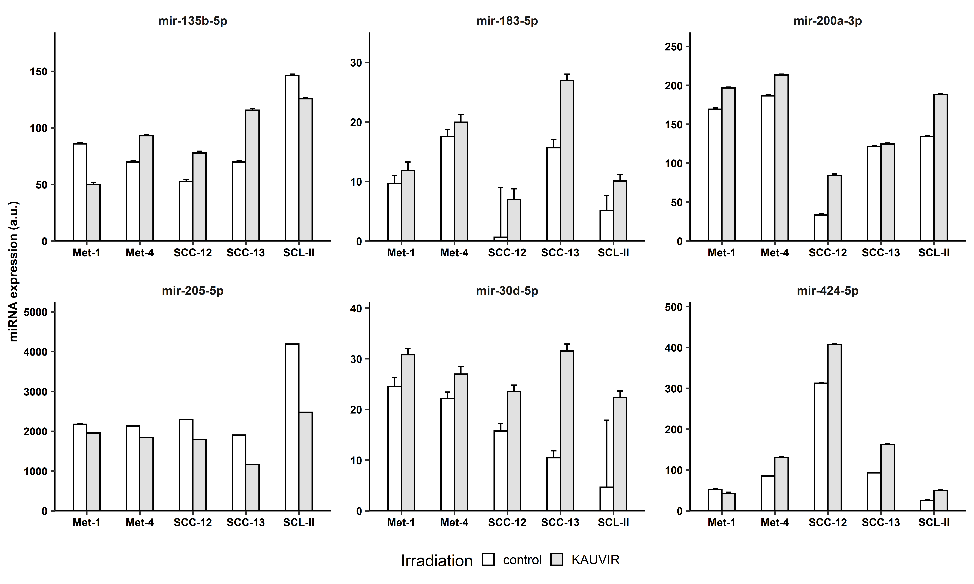
Anova, $F_{1, 29}$ = 5.81, p = 0.0468
Anova, $F_{1, 29}$ = 11.0, p = 0.0054
Anova, $F_{1, 29}$ = 9.88, p = 0.0104
*
*
*
Anova, $F_{1, 29}$ = 21.2, p = 0.000253
Anova, $F_{1, 29}$ = 14.3, p = 0.00212
Anova, $F_{1, 29}$ = 14.3, p = 0.00279
Masterarbeit Marieke: miR-205 stärker methyliert in Met1 und SCC-13 als in HaCaT
**
**
*
In these cell lines, there is a general irradiation effect
Shown are fdr-adjusted p-values for the ANOVA
Comparisons between groups were calculated by post-hoc pairwise t-test without pooled sd
Shown is the ANOVA p-value for the main effect Irradiation
Notes:
Significant results that do not show up in this plot dont have sufficiently large fold changes
cell_line miRNA .y. group1 group2 n1 n2 statistic df p p.adj p.adj.signif
<chr> <chr> <chr> <chr> <chr> <int> <int> <dbl> <dbl> <dbl> <dbl> <chr>
1 Met_4 mir-130a-3p log_exp control KAUVIR 4 4 -3.29 6.00 0.017 0.017 *
2 SCC_13 mir-135b-5p log_exp control KAUVIR 4 4 -3.10 5.50 0.024 0.024 *
3 Met_4 mir-148a-3p log_exp control KAUVIR 4 4 -3.16 5.88 0.02 0.02 *
4 Met_4 mir-15a-5p log_exp control KAUVIR 4 4 3.60 3.95 0.023 0.023 *
5 SCC_13 mir-183-5p log_exp control KAUVIR 4 4 -3.53 3.22 0.035 0.035 *
6 Met_4 mir-200a-3p log_exp control KAUVIR 4 4 -2.51 5.96 0.046 0.046 *
7 SCC_12 mir-200a-3p log_exp control KAUVIR 4 4 -3.01 3.81 0.042 0.042 *
8 SCL_II mir-205-5p log_exp control KAUVIR 4 3 5.51 4.91 0.003 0.003 **
9 Met_4 mir-221-3p log_exp control KAUVIR 4 4 -3.54 5.11 0.016 0.016 *
10 Met_4 mir-23a-3p log_exp control KAUVIR 4 4 3.01 5.79 0.025 0.025 *
11 SCC_13 mir-23a-3p log_exp control KAUVIR 4 4 3.38 3.92 0.028 0.028 *
12 Met_1 mir-29a-3p log_exp control KAUVIR 4 4 -3.13 5.99 0.02 0.02 *
13 SCC_13 mir-30d-5p log_exp control KAUVIR 4 4 -4.79 6.00 0.003 0.003 **
14 SCC_13 mir-424-5p log_exp control KAUVIR 4 4 -3.06 4.12 0.036 0.036 *

Slide 33
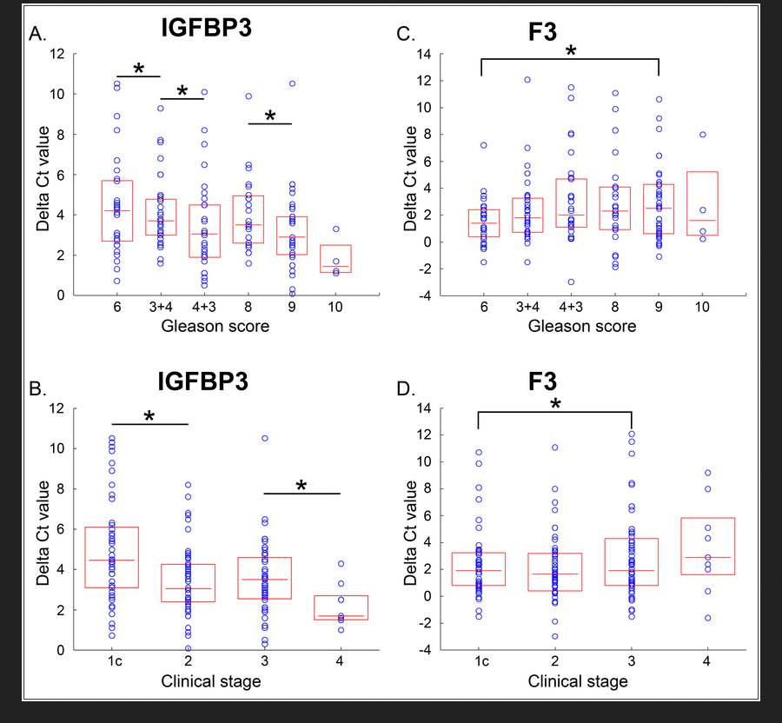
qPCR Validierung
Methode: Vandesompele (ΔΔCt) → Ergebnis sind log-Fold-Changes
One-sample t-test
Und Mittelwert + ci angeben
Notes:
One tailed- one sample t-test, um Ergebnisse zu validieren

Slide 34
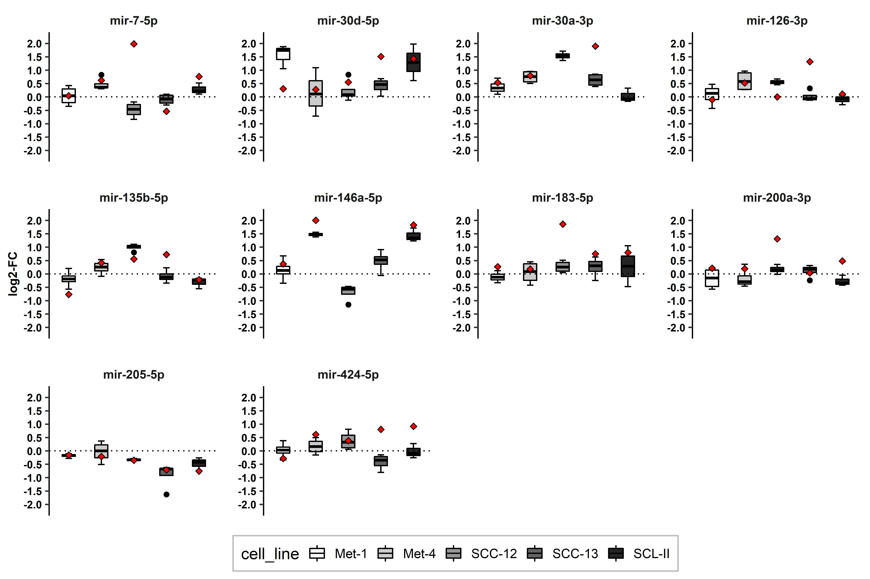
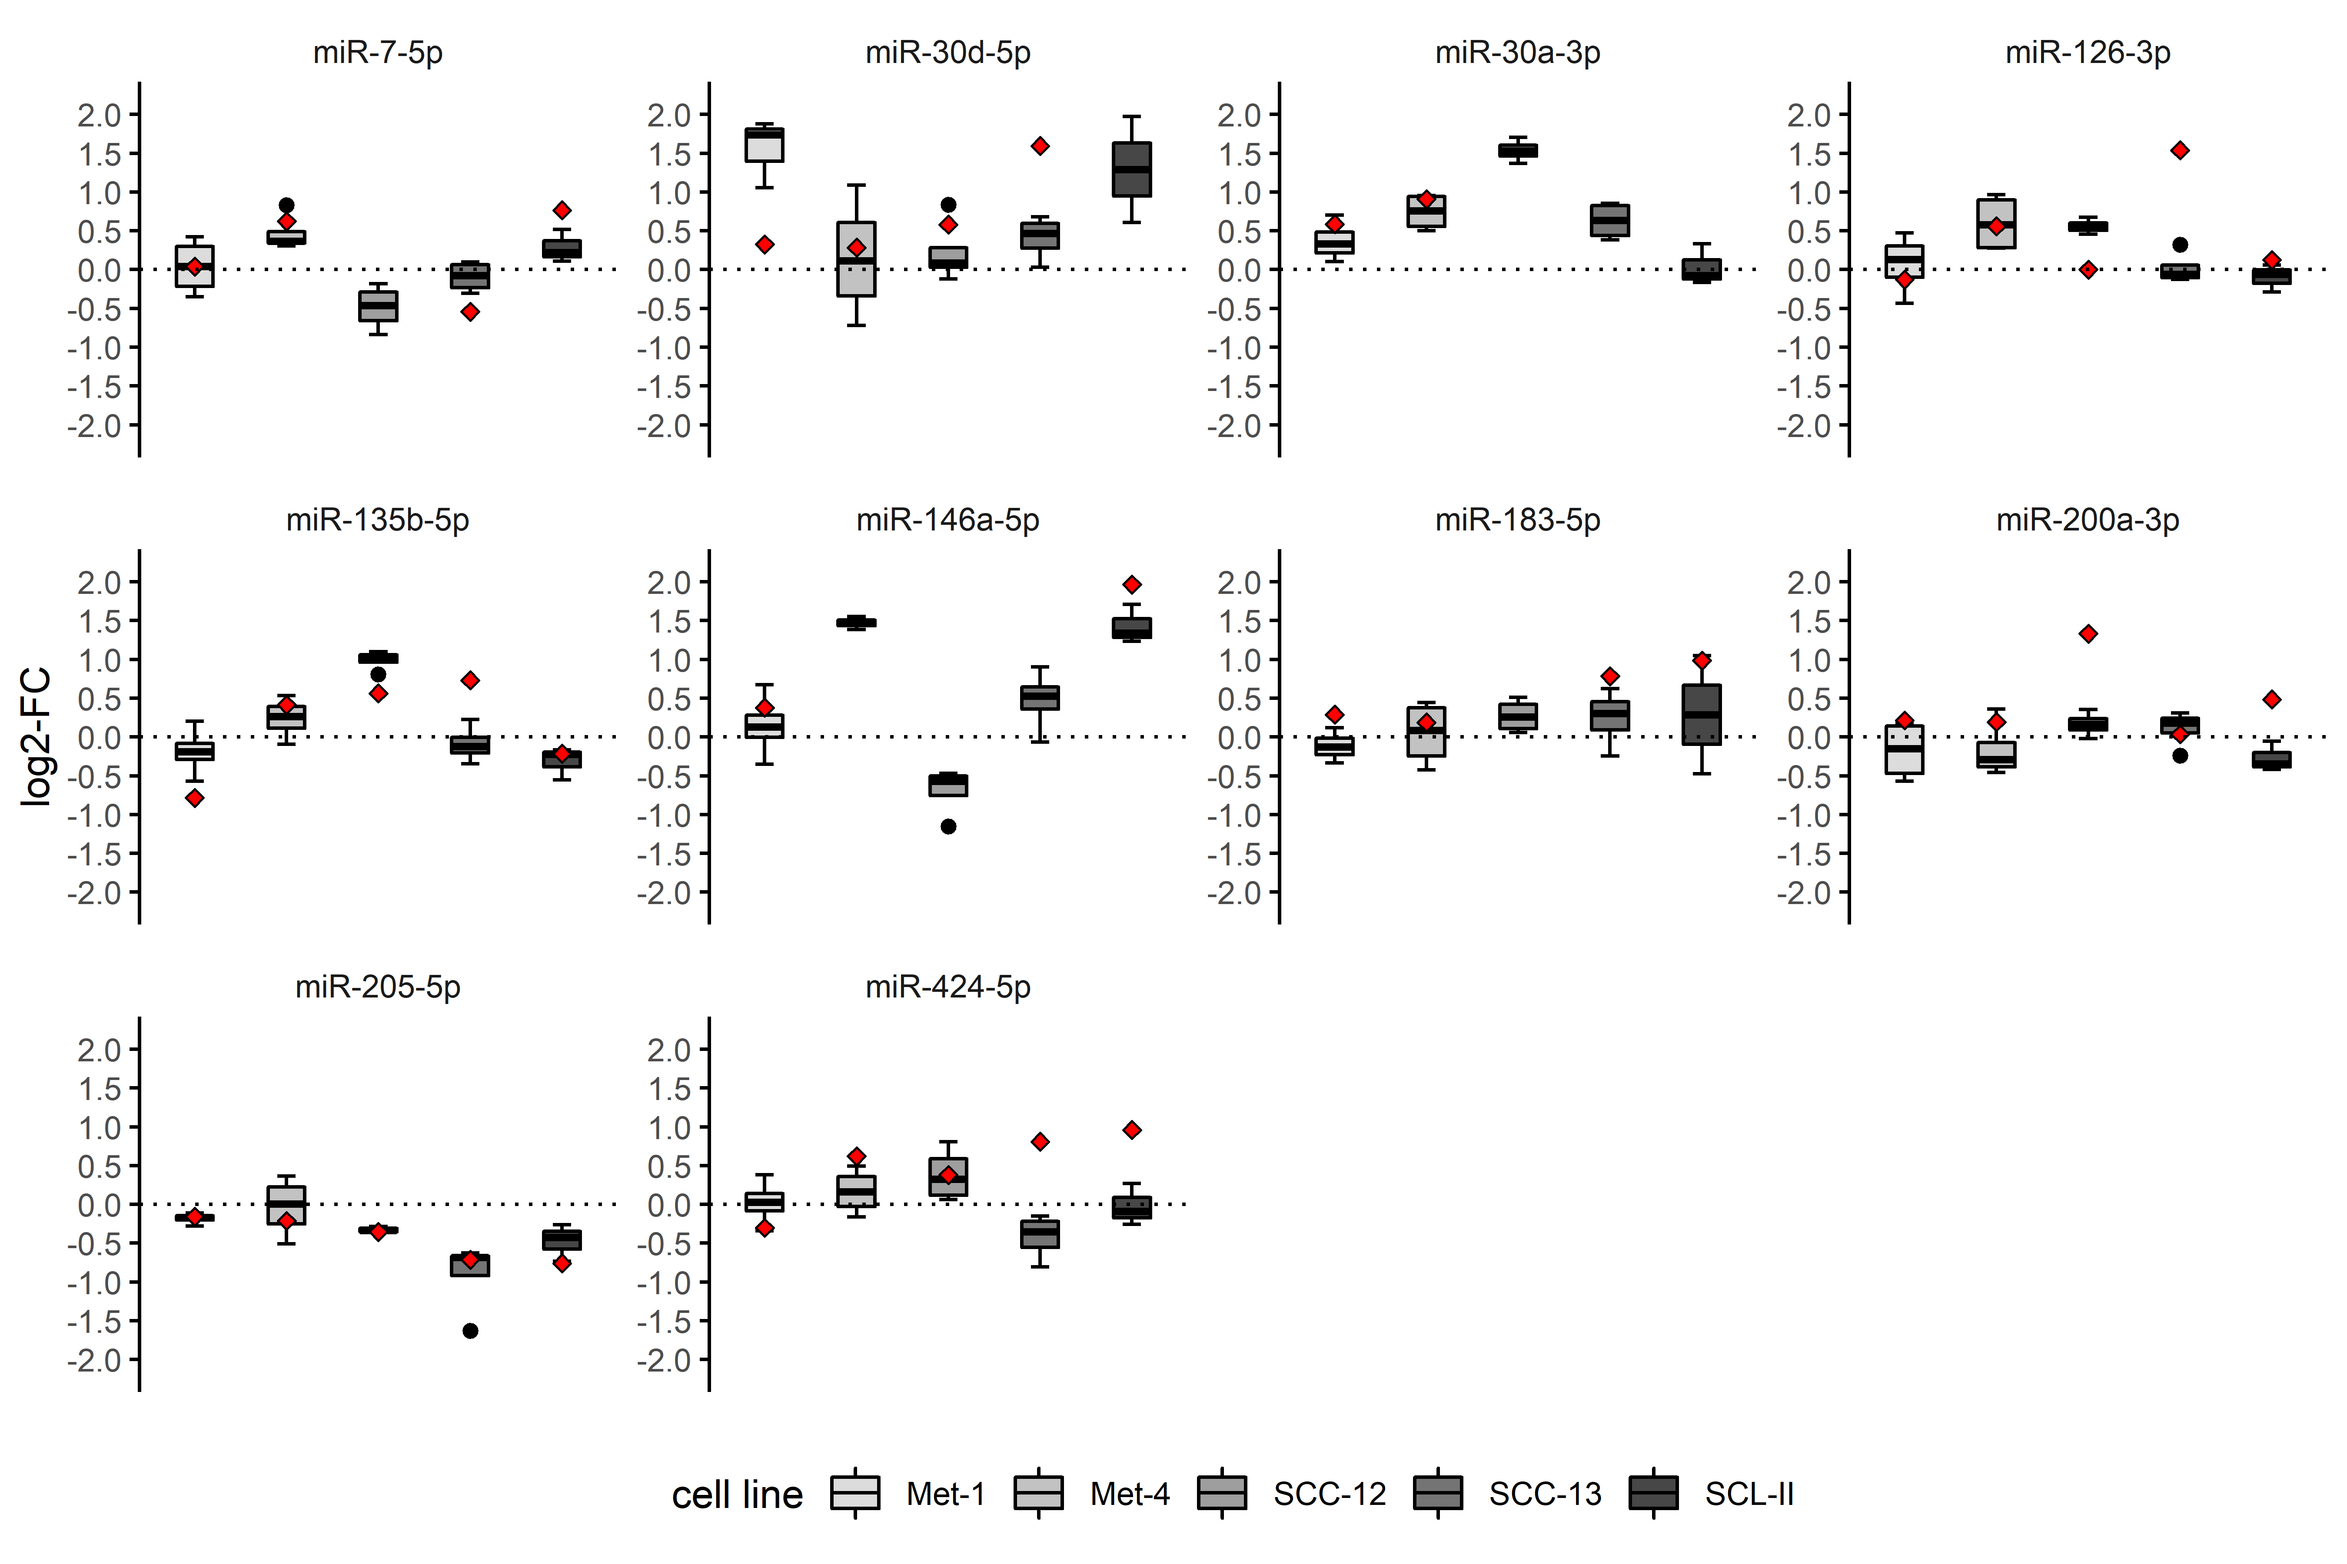
*
***
*
**
*
*
*
*
****
*
***
*
*
***
*
FirePlex:
|log2-FC| ≤ 2
|log2-FC| > 2
Jco palette for different cell lines
Notes:
Pfeile zeigen Fold changes größer > 2 an
Aus übersichtsgründen
One sample t-test vs 0
< 0.05; ** < 0.01; *** < 0.001; **** < 0.0001
n = 4
Nur one sample t-test und dann sagen welche übereinstimmen?
Oder ANOVA mit dCT values? Dann könnte man einfach den interaction oder main effect zeigen ohne anschließende post-hoc Test (oder auch mit)

Slide 35
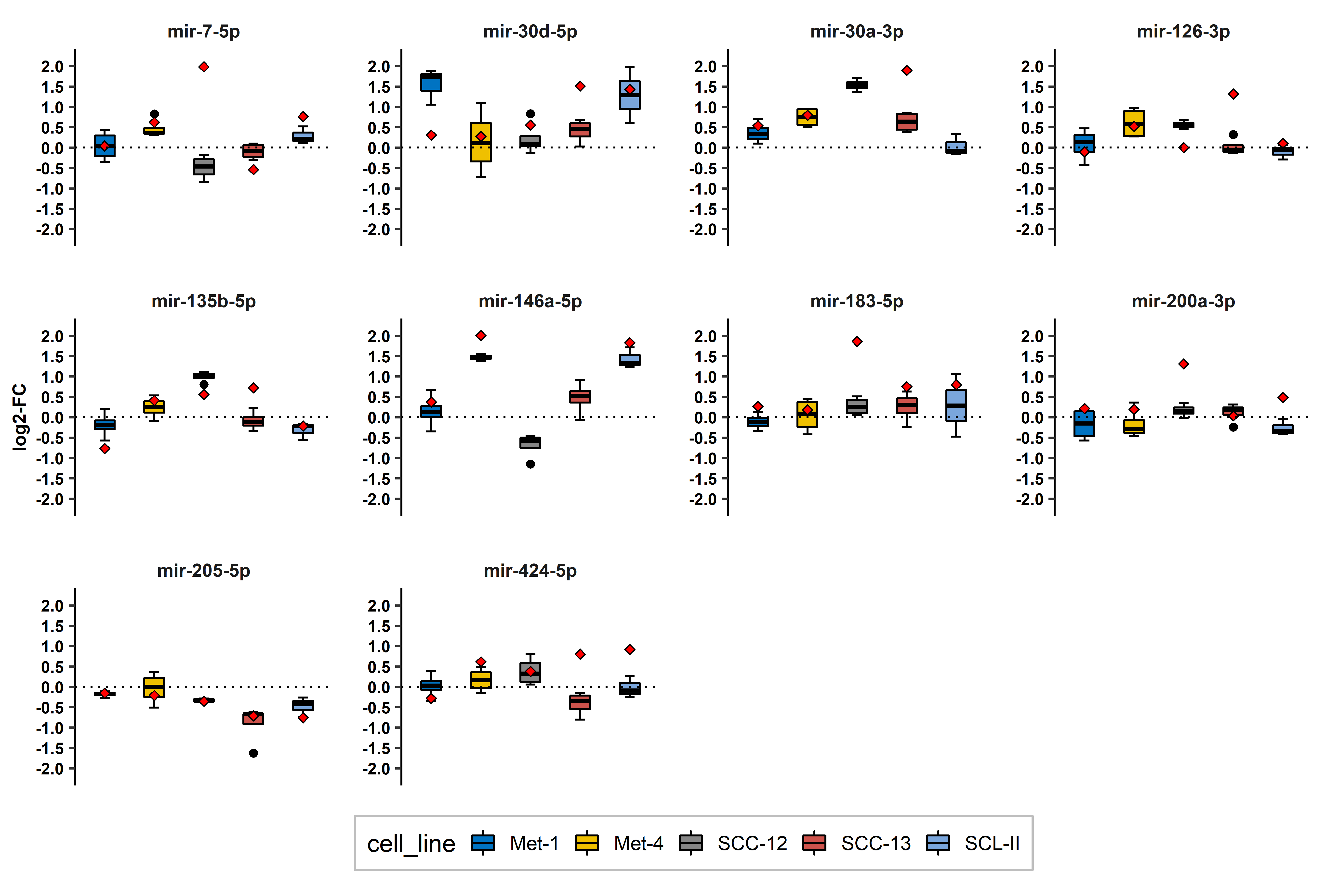
*
***
*
**
*
*
*
*
****
*
***
*
*
***
*
FirePlex:
|log2-FC| ≤ 2
|log2-FC| > 2
Notes:
Pfeile zeigen Fold changes größer > 2 an
Aus übersichtsgründen
One sample t-test vs 0
< 0.05; ** < 0.01; *** < 0.001; **** < 0.0001
n = 4
Nur one sample t-test und dann sagen welche übereinstimmen?
Oder ANOVA mit dCT values? Dann könnte man einfach den interaction oder main effect zeigen ohne anschließende post-hoc Test (oder auch mit)

Slide 36
cSCC tissue

Slide 37
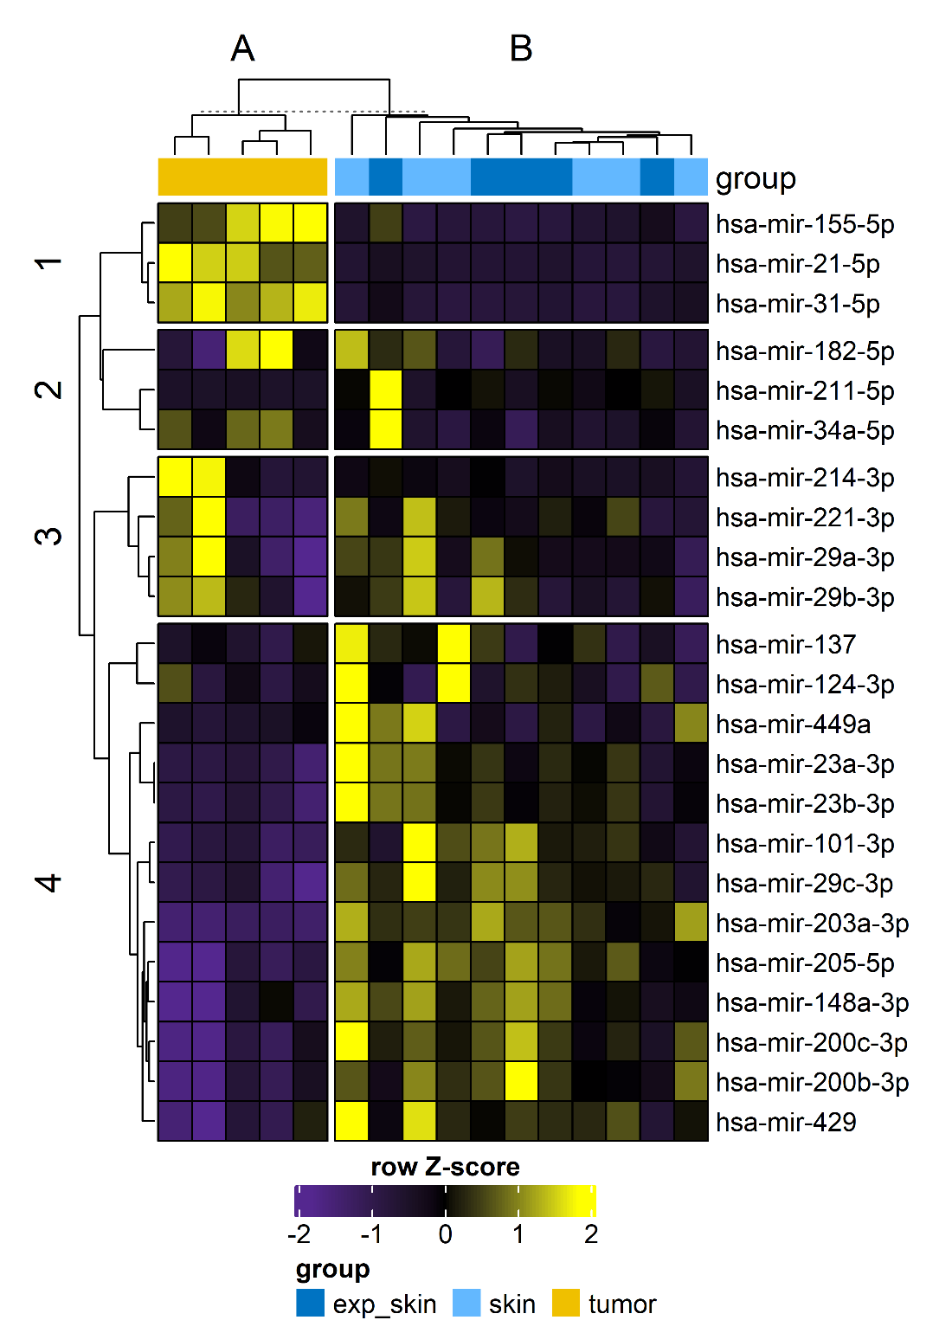
Notes:
hsa-miR-137,hsa-miR-124-3p,hsa-miR-449,hsa-miR-23a-3p,hsa-miR-23b-3p,hsa-miR-101-3p,hsa-miR-29c-3p,hsa-miR-203a-3p,hsa-miR-205-5p,hsa-miR-148a-3p,hsa-miR-200c-3p,hsa-miR-200b-3p,hsa-miR-429

Slide 38
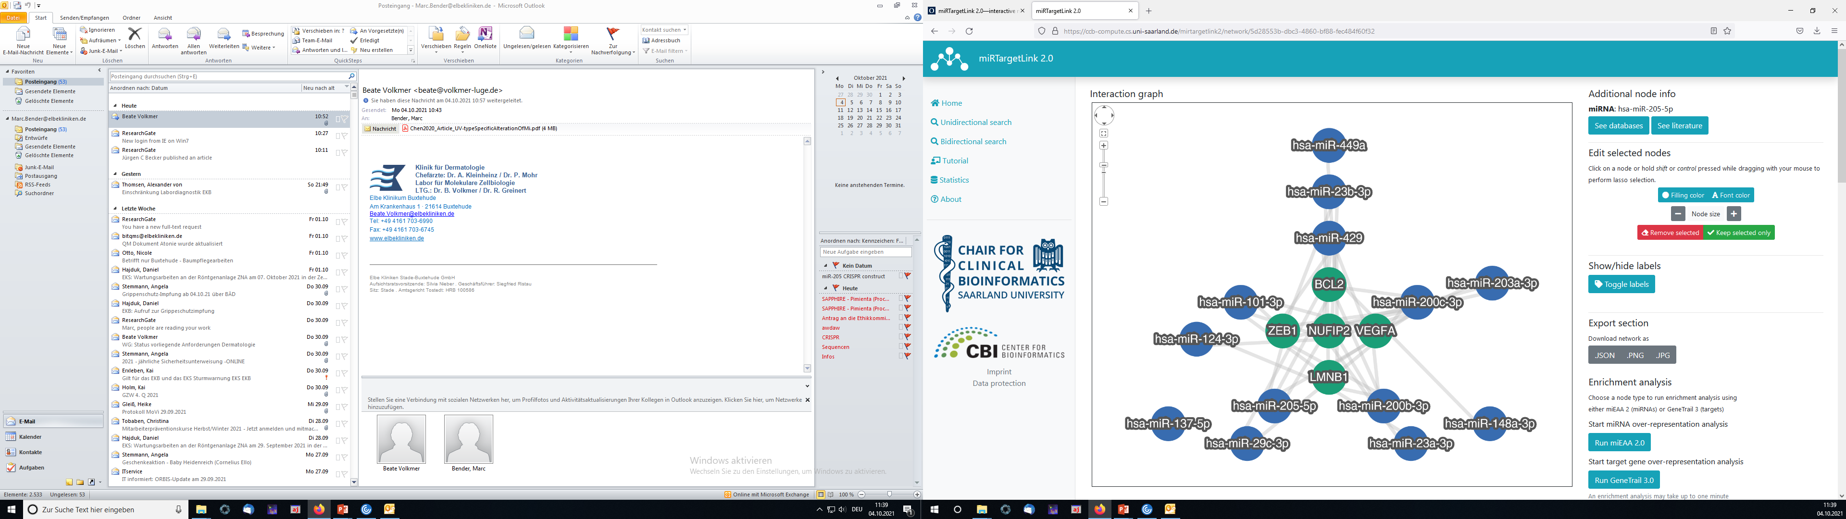
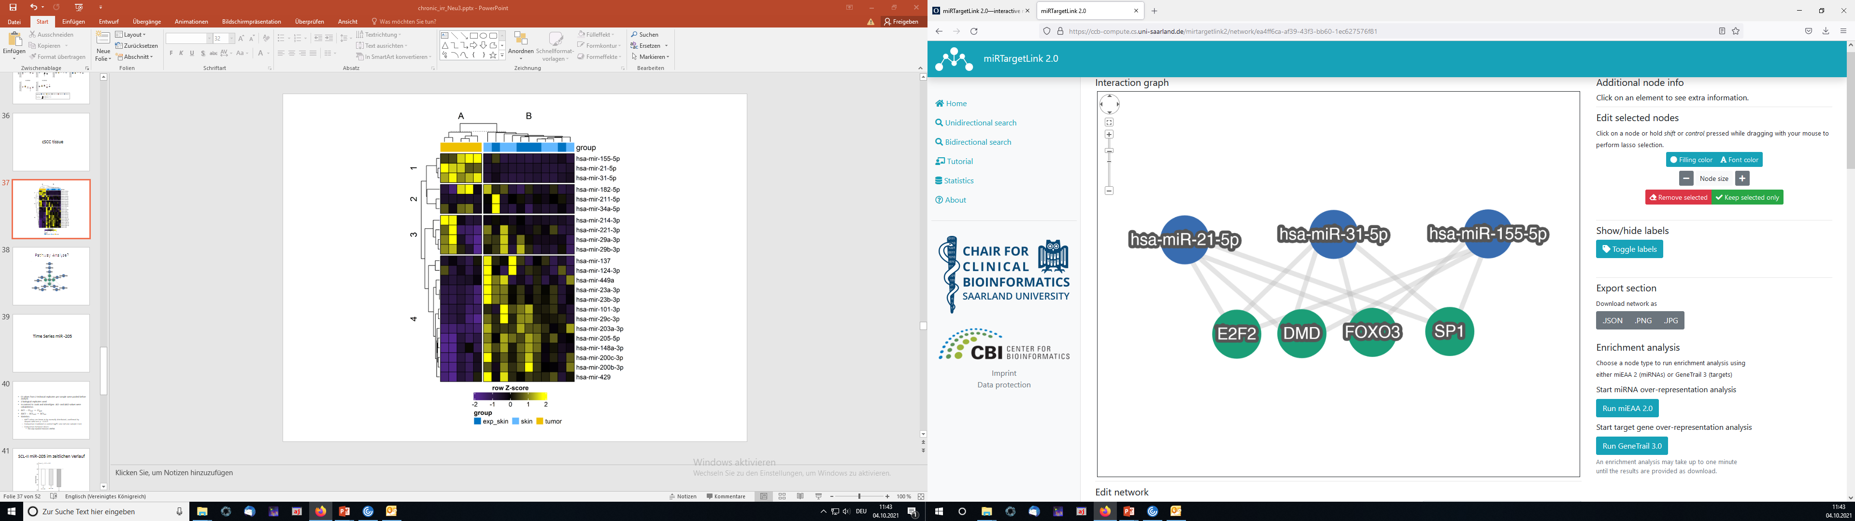
Pathway Analyse?
Notes:
hsa-miR-137,hsa-miR-124-3p,hsa-miR-449,hsa-miR-23a-3p,hsa-miR-23b-3p,hsa-miR-101-3p,hsa-miR-29c-3p,hsa-miR-203a-3p,hsa-miR-205-5p,hsa-miR-148a-3p,hsa-miR-200c-3p,hsa-miR-200b-3p,hsa-miR-429

Slide 39
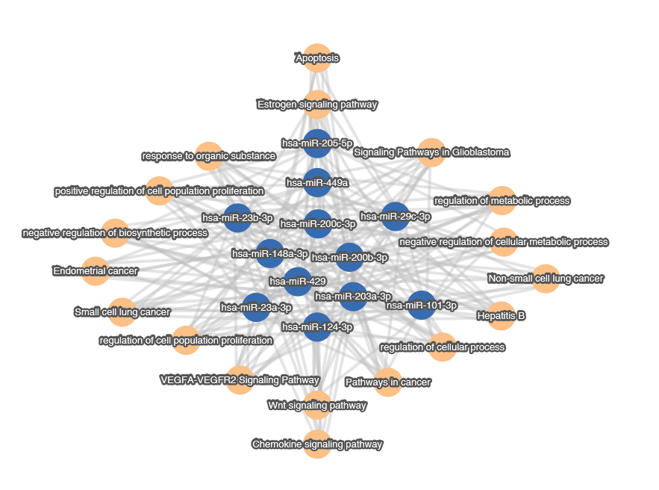

Slide 40
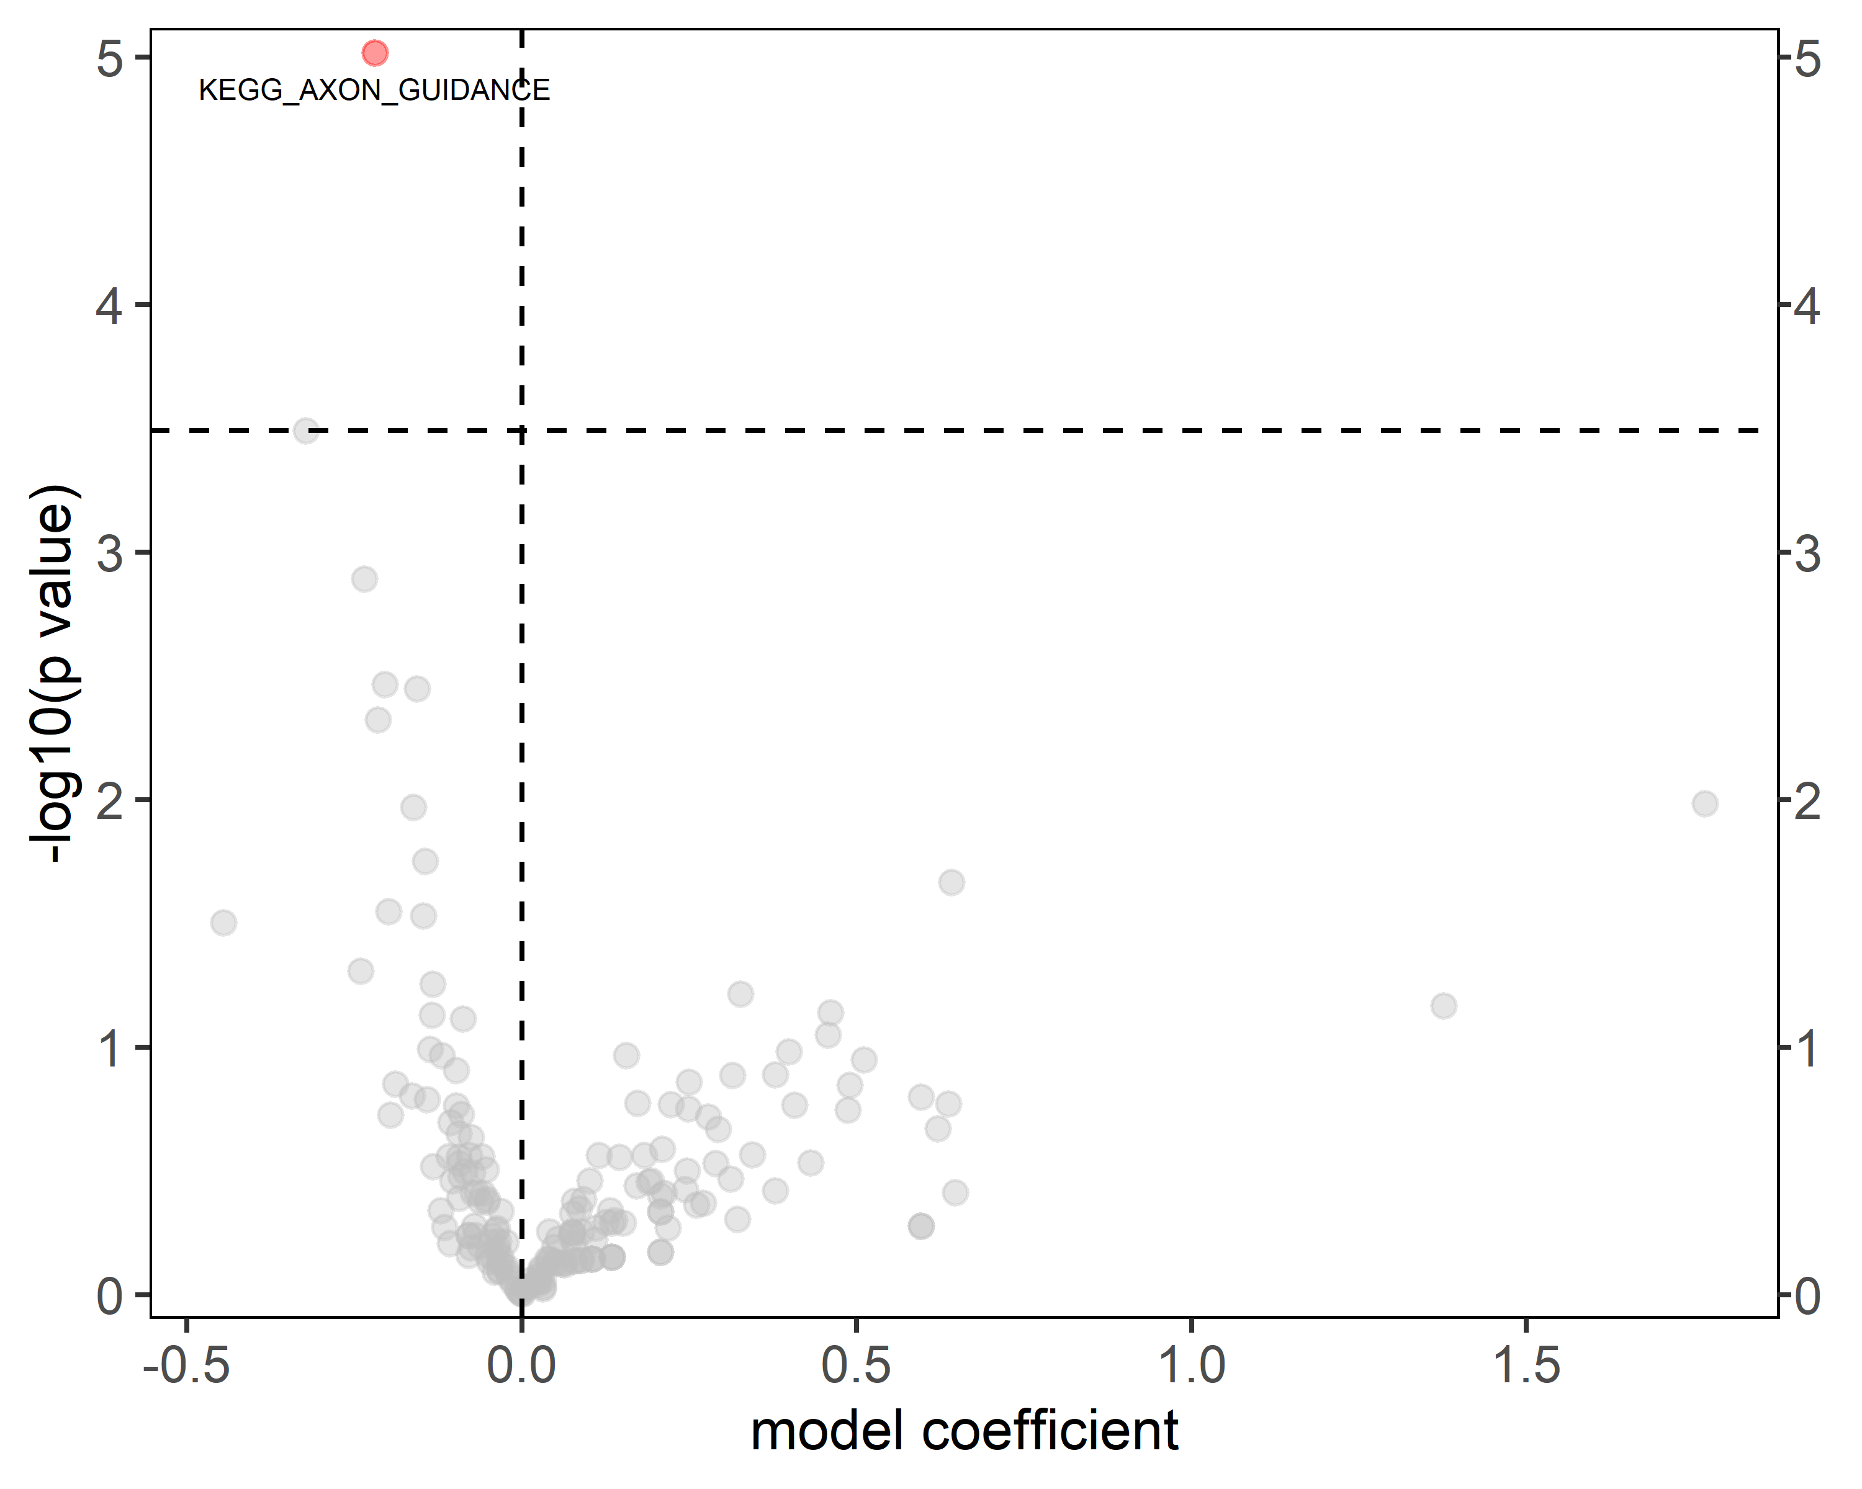
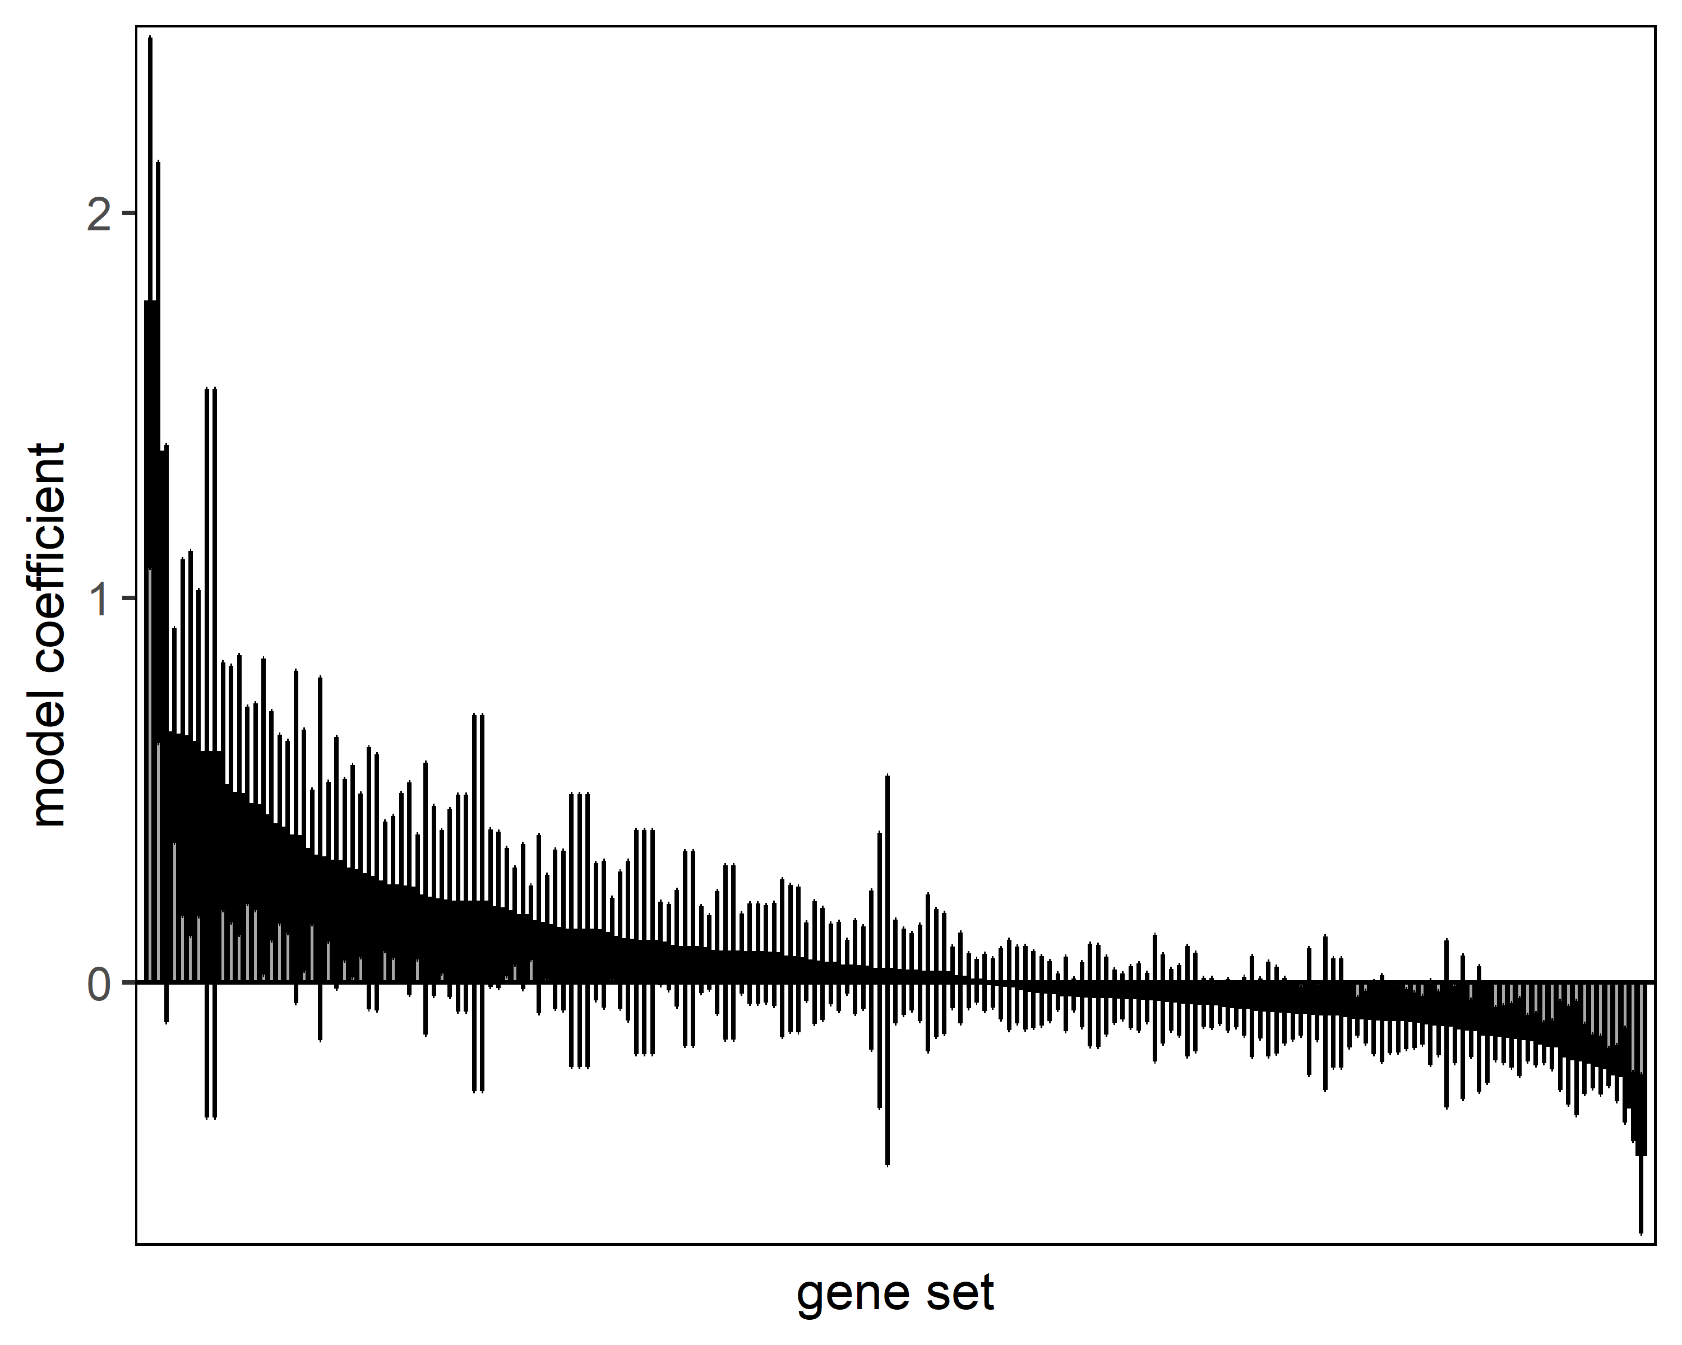
KEGG pathways

Slide 41
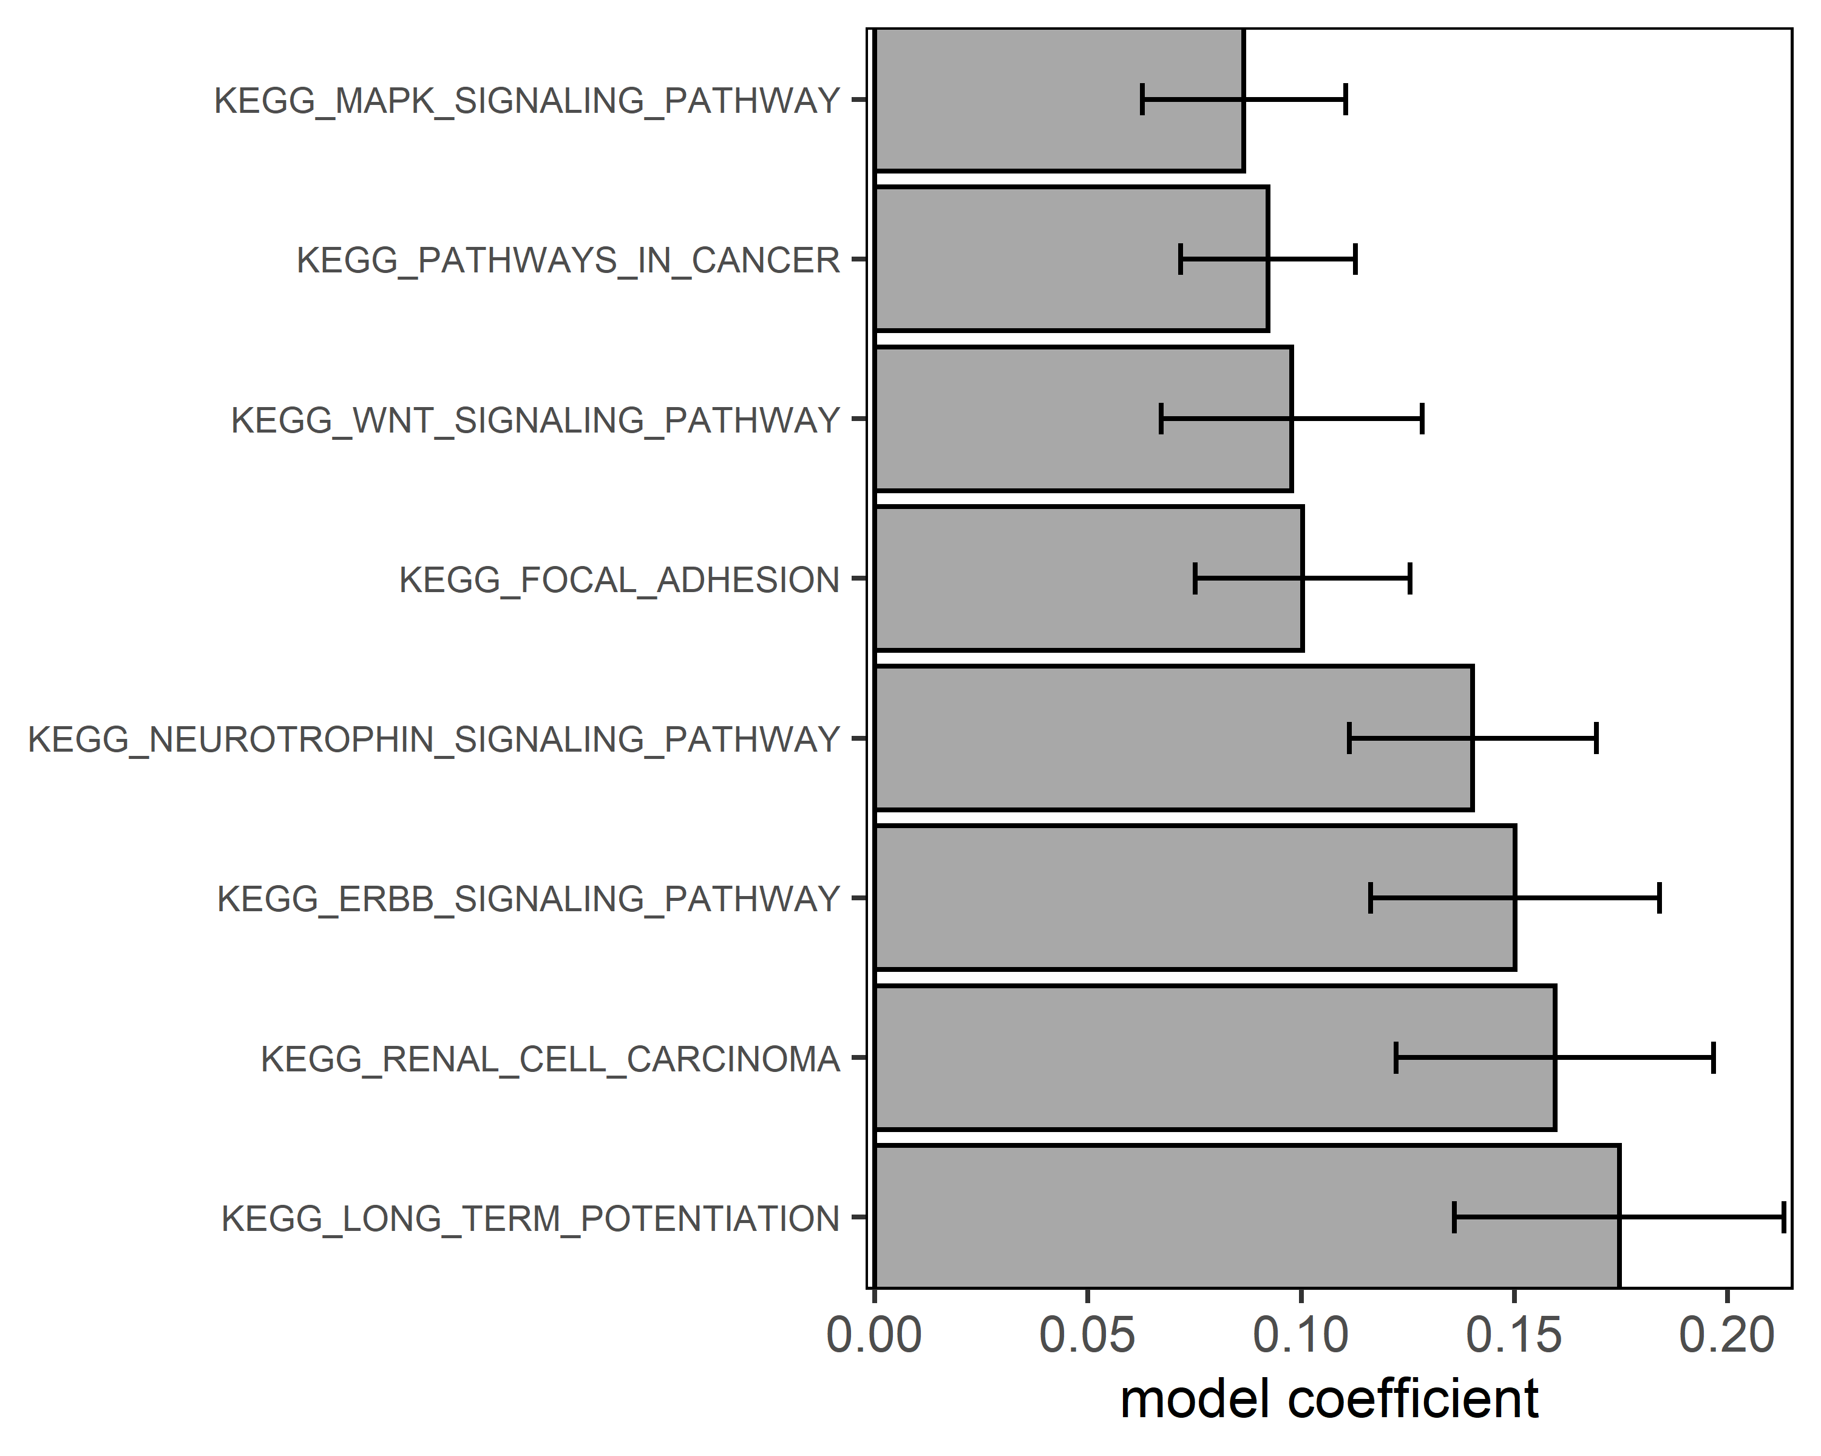
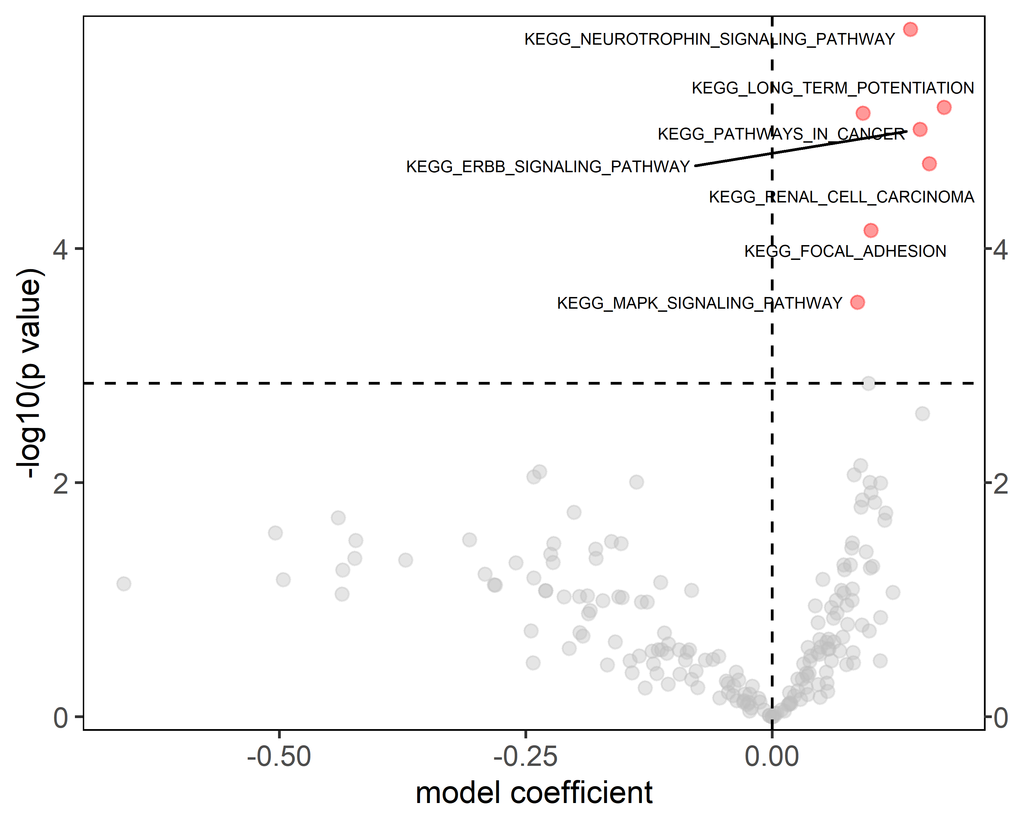
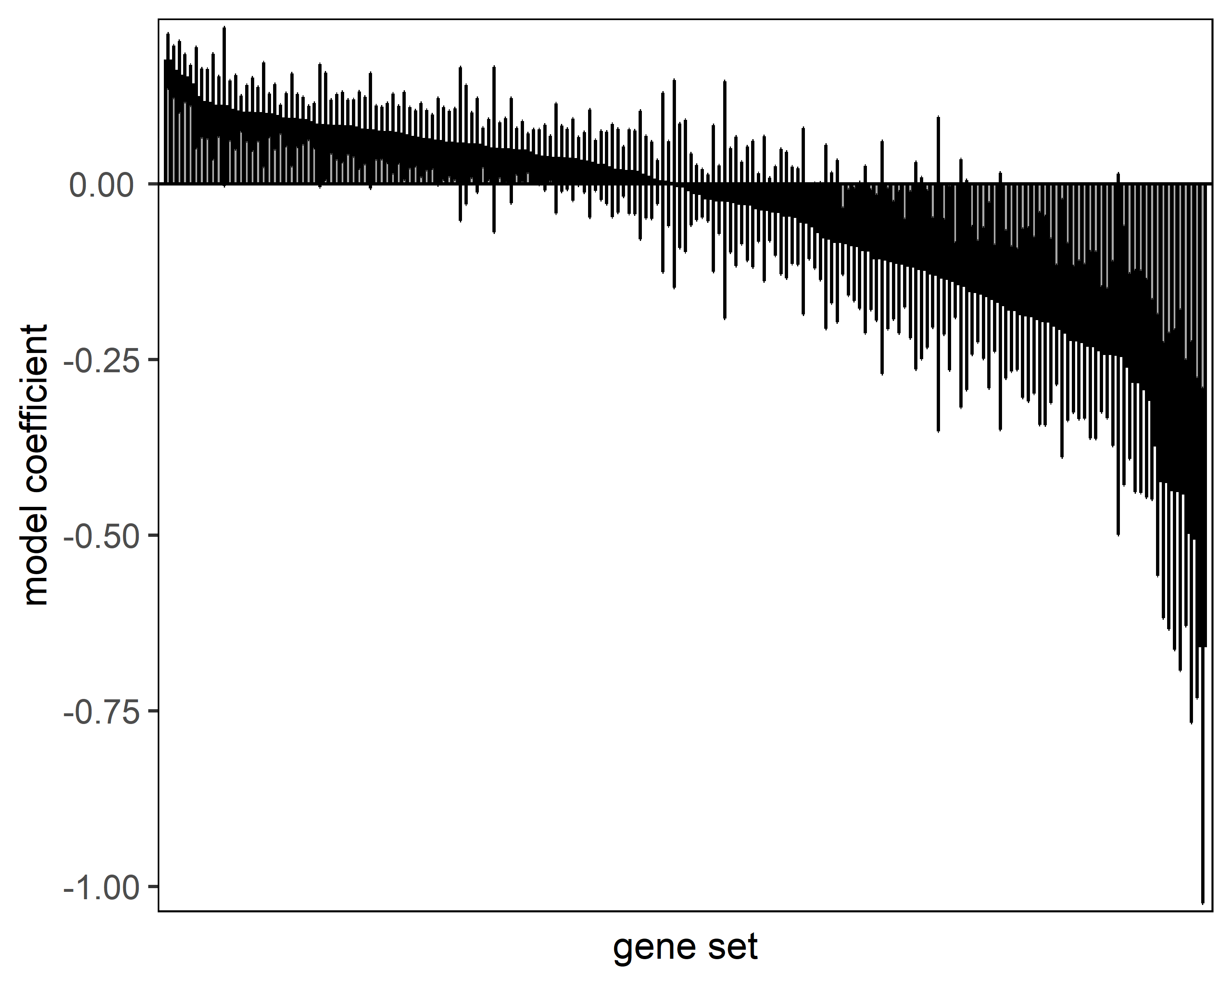
KEGG pathways

Slide 42

A
B
C
D
E
BCL2: anti apoptotic, oncogene
ZEB1: promotes EMT, oncogene
VEGFA: promotes angiogenesis, oncogene
NUFIP2: RNA binding protein, relation to cancer unknown
LMNB1: may exert oncogenic or tumorsuppressor function depending on context
DMD (Dystrophin): Tumor suppressor in myogenic cancers)
E2F2: Oncogene in various cancers
FOXO3: tumor suppressor in various cancer
SP1: may exert oncogenic or tumorsuppressor function depending on context

Slide 43
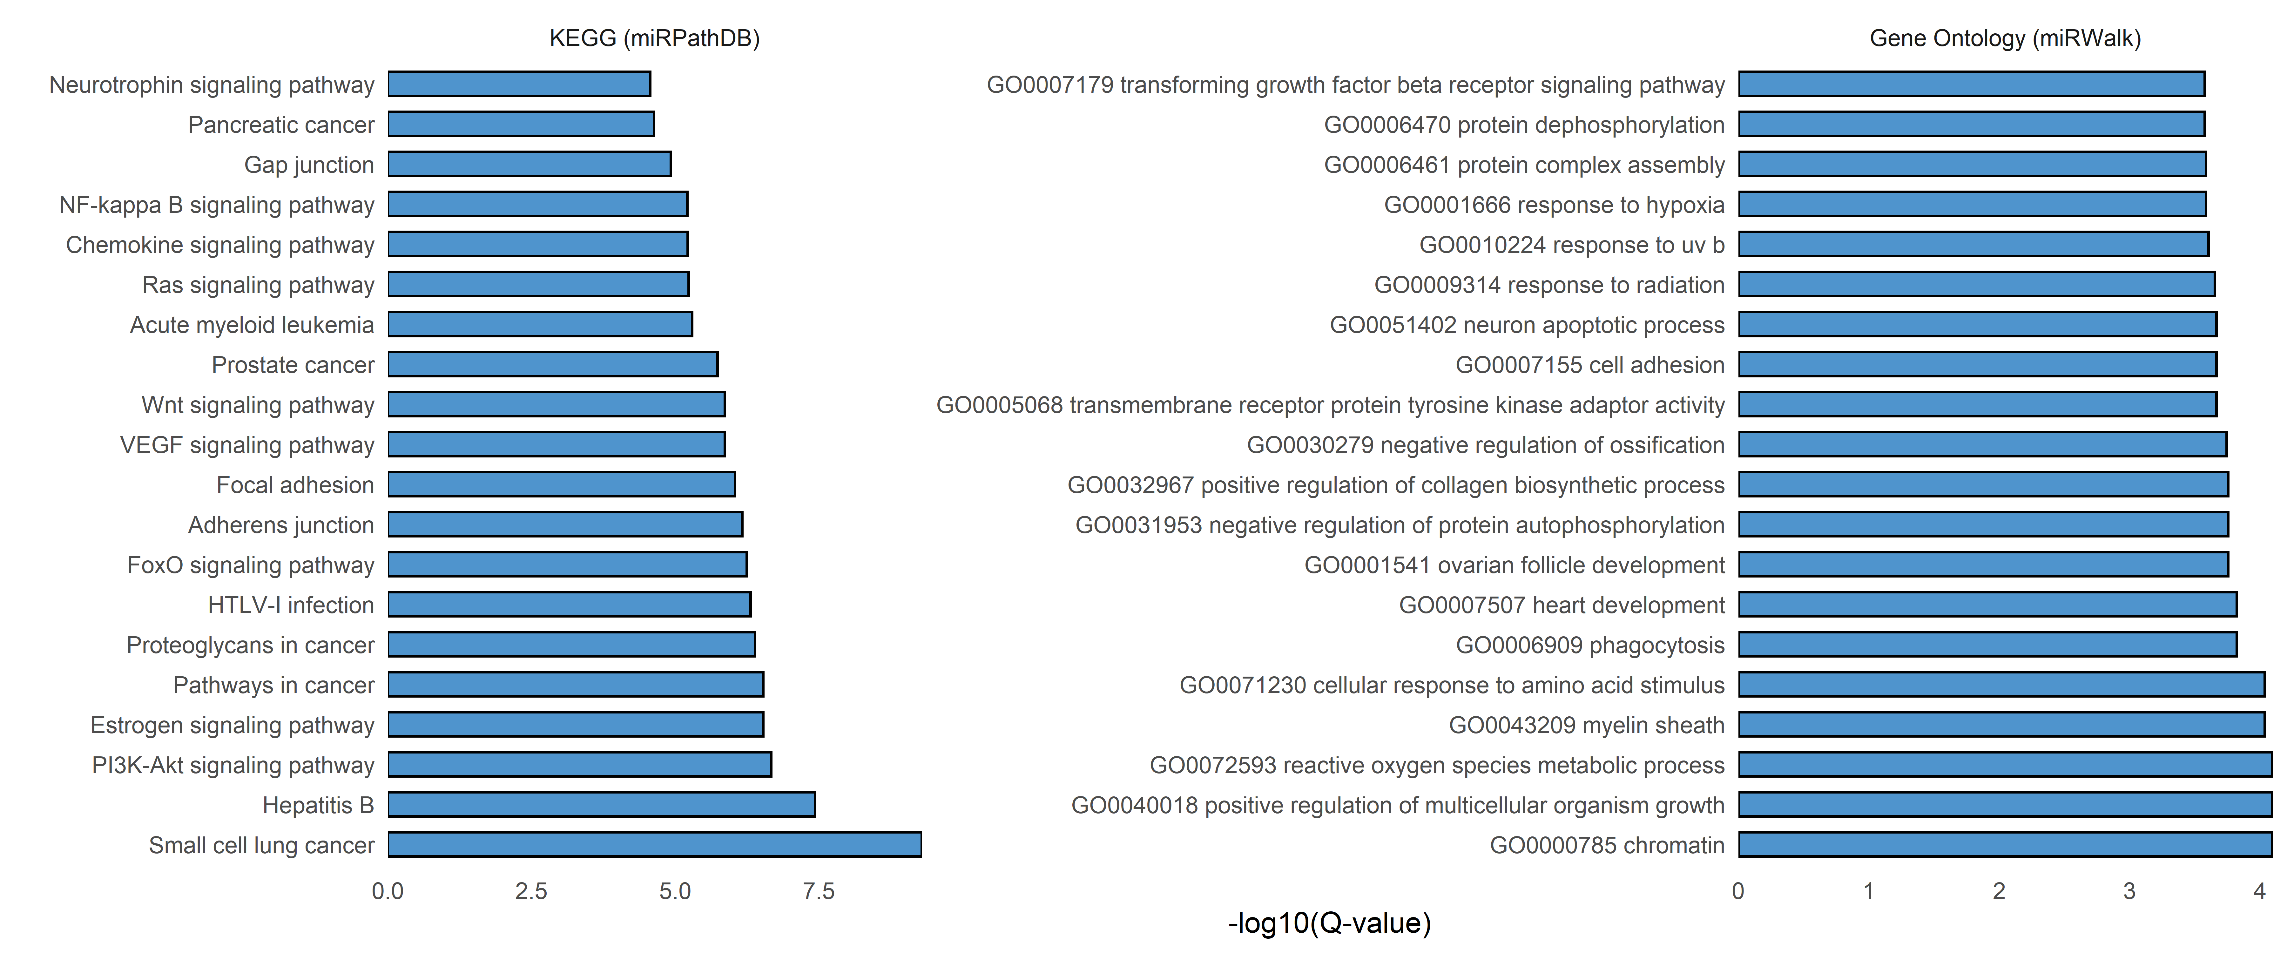

Slide 44
KEGG
Rank | Category | Subcategory | Expected | Observed | Q-value
1 | KEGG (miRPathDB) | Small cell lung cancer | 1.4081 | 12 | 5.14E-10
2 | KEGG (miRPathDB) | Hepatitis B | 2.09346 | 12 | 3.67E-08
3 | KEGG (miRPathDB) | PI3K-Akt signaling pathway | 1.75701 | 11 | 2.12E-07
4 | KEGG (miRPathDB) | Estrogen signaling pathway | 0.909657 | 9 | 2.93E-07
5 | KEGG (miRPathDB) | Pathways in cancer | 2.66667 | 12 | 2.93E-07
6 | KEGG (miRPathDB) | Proteoglycans in cancer | 1.98131 | 11 | 4.09E-07
7 | KEGG (miRPathDB) | HTLV-I infection | 1.45794 | 10 | 4.85E-07
8 | KEGG (miRPathDB) | FoxO signaling pathway | 2.09346 | 11 | 5.67E-07
9 | KEGG (miRPathDB) | Adherens junction | 1.08411 | 9 | 6.80E-07
10 | KEGG (miRPathDB) | Focal adhesion | 1.60748 | 10 | 9.12E-07
11 | KEGG (miRPathDB) | VEGF signaling pathway | 0.523364 | 7 | 1.37E-06
12 | KEGG (miRPathDB) | Wnt signaling pathway | 0.82243 | 8 | 1.37E-06
13 | KEGG (miRPathDB) | Prostate cancer | 2.42991 | 11 | 1.83E-06
14 | KEGG (miRPathDB) | Acute myeloid leukemia | 0.984424 | 8 | 5.08E-06
15 | KEGG (miRPathDB) | Ras signaling pathway | 1.00935 | 8 | 5.80E-06
16 | KEGG (miRPathDB) | Chemokine signaling pathway | 0.672897 | 7 | 6.09E-06
17 | KEGG (miRPathDB) | NF-kappa B signaling pathway | 0.411215 | 6 | 6.15E-06
18 | KEGG (miRPathDB) | Gap junction | 0.461059 | 6 | 1.19E-05
19 | KEGG (miRPathDB) | Pancreatic cancer | 1.74455 | 9 | 2.33E-05
20 | KEGG (miRPathDB) | Neurotrophin signaling pathway | 1.27103 | 8 | 2.73E-05
Cancer and migration/invasion related pathways

Slide 45
GO
Rank | Category | Subcategory | Expected | Observed | Q-value
1 | Gene Ontology (miRWalk) | GO0000785 chromatin | 3.08688 | 12 | 8.08E-05
2 | Gene Ontology (miRWalk) | GO0040018 positive regulation of multicellular organism growth | 1.45145 | 10 | 8.08E-05
3 | Gene Ontology (miRWalk) | GO0072593 reactive oxygen species metabolic process | 1.55366 | 10 | 8.08E-05
4 | Gene Ontology (miRWalk) | GO0043209 myelin sheath | 1.20613 | 9 | 9.26E-05
5 | Gene Ontology (miRWalk) | GO0071230 cellular response to amino acid stimulus | 1.71721 | 10 | 9.26E-05
6 | Gene Ontology (miRWalk) | GO0006909 phagocytosis | 0.919932 | 8 | 1.51E-04
7 | Gene Ontology (miRWalk) | GO0007507 heart development | 3.4753 | 12 | 1.51E-04
8 | Gene Ontology (miRWalk) | GO0001541 ovarian follicle development | 2.63714 | 11 | 1.76E-04
9 | Gene Ontology (miRWalk) | GO0031953 negative regulation of protein autophosphorylation | 0.388416 | 6 | 1.76E-04
10 | Gene Ontology (miRWalk) | GO0032967 positive regulation of collagen biosynthetic process | 0.981261 | 8 | 1.76E-04
11 | Gene Ontology (miRWalk) | GO0030279 negative regulation of ossification | 1.43101 | 9 | 1.81E-04
12 | Gene Ontology (miRWalk) | GO0005068 transmembrane receptor protein tyrosine kinase adaptor activity | 0.69506 | 7 | 2.17E-04
13 | Gene Ontology (miRWalk) | GO0007155 cell adhesion | 3.78194 | 12 | 2.17E-04
14 | Gene Ontology (miRWalk) | GO0051402 neuron apoptotic process | 2.7598 | 11 | 2.17E-04
15 | Gene Ontology (miRWalk) | GO0009314 response to radiation | 2.08518 | 10 | 2.23E-04
16 | Gene Ontology (miRWalk) | GO0010224 response to uv b | 1.08348 | 8 | 2.49E-04
17 | Gene Ontology (miRWalk) | GO0001666 response to hypoxia | 3.9046 | 12 | 2.61E-04
18 | Gene Ontology (miRWalk) | GO0006461 protein complex assembly | 2.9029 | 11 | 2.61E-04
19 | Gene Ontology (miRWalk) | GO0006470 protein dephosphorylation | 2.94378 | 11 | 2.67E-04
20 | Gene Ontology (miRWalk) | GO0007179 transforming growth factor beta receptor signaling pathway | 3.98637 | 12 | 2.67E-04
Cancer and response to (UV) radiation/DNA damage response

Slide 46
Localization
Rank | Category | Subcategory | Expected | Observed | Q-value
1 | Localization (RNALocate) | exosome | 2.43464 | 11 | 1.98E-06
2 | Localization (RNALocate) | Cytoplasm | 2.0016 | 10 | 3.34E-06
3 | Localization (RNALocate) | Microvesicle | 3.33921 | 10 | 2.43E-04
4 | Localization (RNALocate) | Nucleus | 3.34884 | 10 | 2.43E-04
5 | Localization (RNALocate) | Nucleolus | 0.65437 | 5 | 4.90E-04
6 | Localization (RNALocate) | Circulating | 4.88853 | 11 | 6.07E-04
7 | Localization (RNALocate) | Mitochondrion | 3.20449 | 8 | 5.98E-03
8 | Localization (RNALocate) | Exosome | 8.28549 | 12 | 1.43E-02
9 | Localization (RNALocate) | microvesicle | 8.40096 | 12 | 1.51E-02
10 | Localization (RNALocate) | Extracellular vesicle | 0.80834 | 3 | 4.17E-02
Enriched in exosomes/microvesicles

Slide 47
Targets
Rank | Category | Subcategory | Expected | Observed | Q-value
1 | Target genes (miRTarBase) | ZEB1 | 0.201405 | 7 | 5.00E-07
2 | Target genes (miRTarBase) | DNMT3B | 0.0655738 | 5 | 1.68E-06
3 | Target genes (miRTarBase) | ZEB2 | 0.140515 | 6 | 1.68E-06
4 | Target genes (miRTarBase) | BCL2 | 0.313817 | 7 | 3.07E-06
5 | Target genes (miRTarBase) | JUN | 0.173302 | 6 | 3.07E-06
6 | Target genes (miRTarBase) | LMNB1 | 0.360656 | 7 | 5.86E-06
7 | Target genes (miRTarBase) | SHC1 | 0.0468384 | 4 | 2.43E-05
8 | Target genes (miRTarBase) | SIRT1 | 0.163934 | 5 | 8.06E-05
9 | Target genes (miRTarBase) | TPD52L1 | 0.0655738 | 4 | 8.06E-05
10 | Target genes (miRTarBase) | VEGFA | 0.562061 | 7 | 8.06E-05
- Targets like ZEB1/ZEB2, BCL2 and VEGFA are enriched → with the miRNAs being downregulated these targets are most likely upregulated
- The only miRNA that is consistently regulated after Irradiation is miR-205

Slide 48
Time Series miR-205

Slide 49

Ct values from 2 technical replicates per sample were pooled before analysis
2 biological replicates used
In contrast to Livak and Schmittgen ΔCt- and ΔΔCt-values were calculated as:
$ΔCt={Ct}_{ref} − {Ct}_{goi}$
$ΔΔCt={ΔCt}_{ctrl} − {ΔCt}_{trt}$
Statistics:
ddCT values are know to be normally distributed, confirmed by shapiro-wilk test: p = 0.417
Comparison irradiated vs control logFC: one-tail one-sample t-test
Comparison between doses:
One-way repeated measures ANOVA

Slide 50

SCL-II miR-205 im zeitlichen Verlauf
Anova, $F_{2, 2}$ = 0.217, p = 0.822
p = 0.0748
p = 0.0548
p = 0.101
Dose 1x 250 J/m² 5x 250 J/m² 8x 250 J/m²
Lysis 24 h 24 h 72 h

Slide 51





 | SCC-13 | SCC-12 | Met-1 | Met-4 | SCL-II
Ploidie | Hyperdiploid | Hypotetraploid | Diploid | Hypotetraploid | Hypodiploid
Art des Tumors | Primärtumor | Primärtumor | Primärtumor | Lymphknoten-metastase | Primärtumor
p53-Mutation | + | + | - | - | +
H-ras Mutation (Codon 12) | + | + | - | - | -
Tumorigenität in Nacktmäusen | 100% | 100% | 50% | 50% | 64%
Morphologie
Differenzierungsgrad
Notes:
In OTKs gucken und schneiden
Anschließend single cell rna seq

Slide 52
Weiteres Vorgehen
miR-205 Knockouts und overexpression
Upstream Prozesse

Slide 53
miR-205 Knockdown

Slide 54

24 h
72 h
144 h
Transfection reagent
1.5 µL + - - - + - - - -
3 µL - + + + - + + + +
Antago-miR concentration
5 nM + + - - + + - - -
10 nM - - + - - - + - -
50 nM - - - + - - - + +
n = 2-4

Slide 55
miR-205 Target gene expression

Slide 56
Growth curve
Template

Slide 57












Cell cycle
A
24 h
48 h
72 h
96 h
168 h
B
Cell number
24 h
48 h
72 h
96 h
168 h
C
DNA content
A: Control
B: Antagomir-205
n = 2 (nochmal wiederholen)
Transfektion 24h nach Einsaat (abgelöste Zellen nach t24 noch nicht transfiziert)

Slide 58

Scratch Assay (48h post transfection)

Slide 59
Apoptose

Slide 60
Transwell migration Assay

Slide 61
TGF beta
Paradoxical roles of TGF-β signaling in suppressing and promoting squamous cell carcinoma (Wu 2018)
Important for paradox role of miR-205?
Early stages: tumor suppressor by inhibiting proliferation
Later stages: oncogene by promoting EMT

Slide 62

TGFβ1
Keratinocytes/cSCC cells
TGFβ1
Fibroblasts
II
II
I
I
I
II
II
I
P
P
miR-205
P
AKT
Smad2/3
Zeng 2016 (NSCLC)
TGFβ1
Smad4
SHIP2
PIP3
mTOR complex 1
Brenner 2005 (Fibros)
Ciazynska 2017 (Fibros)
Yu 2010
Smad4
P
Smad2/3
miR-205
Gregory 2008
ORF
ZEB1/2
UV(B)
ATM
Zhang 2014
EMT-like procedure
Cancer stem-like
properties
N-cadherin
Vimentin
Snail
Slug
MMP-9/13
Bmi1
Sox2
Musashi1
Tumor sphere ability
Song 2018
Metastasis
Notes:
Was davon ist wirklich in Hautzellen und was in anderen Zelltypen?
Metformin inhibits TGF-β1-induced epithelial-to-mesenchymal transition-like process and stem-like properties in GBM via AKT/mTOR/ZEB1 pathway (Song 2018)

Slide 63

A
B
TGFβ1
TGFβ1
Fibroblasten
cSCC-Zellen
I
II
II
I
P
PI3K
P
miR-205
P
TGFβ1
AKT
Smad2/3
Smad4
SHIP2
PIP3
Brenner 2005 (Fibros)
Ciazynska 2017 (Fibros)
mTOR complex 1
Smad4
P
Smad2/3
Zeng 2016 (NSCLC)
ORF
miR-205
ROS
ZEB1/2
miR-200
UV
cSS?
C
ATM
Yu 2010
Zhang 2014
TGFβ1
Song 2018
cSCC-Zellen
Stammzell-
eigenschaften
I
II
II
I
EMT
P
N-Cadherin
Vimentin
Snail
Slug
MMP-9/13
BMI1
SOX2
Musashi1
Sphärenbildung
P
TGFβ1
ROS
UV
cSS?
Metastasierung
Notes:
Was davon ist wirklich in Hautzellen und was in anderen Zelltypen?
ROS: 10.1016/j.redox.2015.09.009, 10.1155/2015/654594
ROS induce TGF beta expression or lead to activation of TGF beta in its active form
TGF beta on the other hand regulates ROS levels (up or downregulation possible)
https://doi.org/10.1111/jcmm.14822 ROS inhibieren miR-205

Slide 64
How are the miRNAs regulated?
DNA damage? Apoptosis? Cell Cycle? Proteine (p53, others?)
Methylation? Histone modification
Chronic irradiation:
Cell cycle analysis with CPD induction/Kinetics
Apoptosis
FACS of upstream regulators
Epigenetic regulation: methylation and histone modification

Slide 65
R packages
Circlize
Gu, Z. circlize implements and enhances circular visualization in R. Bioinformatics 2014.
ComplexHeatmap
Gu, Z. (2016) Complex heatmaps reveal patterns and correlations in multidimensional genomic data. Bioinformatics.
Ggpubr
Alboukadel Kassambara (2020). ggpubr: 'ggplot2' Based Publication Ready Plots. R package version 0.3.0. https://CRAN.R-project.org/package=ggpubr
Rstatix
Alboukadel Kassambara (2020). rstatix: Pipe-Friendly Framework for Basic Statistical Tests. R package version 0.5.0. https://CRAN.R-project.org/package=rstatix
Factoextra

